Slide 1
School Modernization
VML Human Development & Education Policy Committee
July 30, 2021

Slide 2
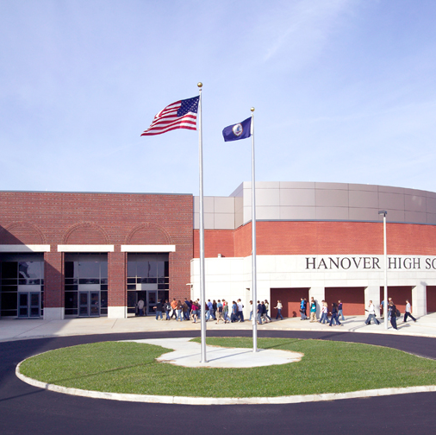
What Is School Modernization?
Necessary construction and renovations of schools
Allocation of funds for improvement of physical structure
Critical for success of students
This Photo by Unknown Author is licensed under CC BY-SA

Slide 3
2021 Findings for Virginia Schools
June 2021 presentation by DOE to Commission on School Construction and Modernization
First review of statewide inventory since 2013
Previous reviews: 2002, 1996

Slide 4
Enrollment versus Inventory
Statewide enrollment: 3.6 percent increase, 2010-2019
Anticipated 4.7 percent increase by 2026
Northern Virginia: 7.9 percent increase
Southwest Virginia: 2.2 percent decrease
Majority of schools already at or near capacity
Schools at/above capacity: 41 percent
School approaching capacity: 29 percent

Slide 5
State of Existing Schools
Half of all Virginia school inventory >50 years old (1,046 schools)
Major structural issues not limited to oldest buildings
Statewide capital improvement plans total $9.8 billion

Slide 6
COVID and School Modernization
Sixty-two percent of school divisions completed at least some HVAC renovations
Only 30 percent of planned projects have been completed
More than 7x HVAC projects undertaken during COVID than included in standard capital improvement plans (3,444 total)

Slide 7
How Have We Reached This Point?
Funding sources dried up in 2009
Virginia Public School Authority (VPSA)
NO local tax authority

Slide 8
Where Are We Now?
ARPA
Local Tax Authority

