Slide 1
Transit Update
Virginia Municipal League - July 28, 2021
Jennifer Mitchell, Director
Department of Rail and Public Transportation

Slide 2
State of Transit in the Commonwealth
2020 Omnibus Bill increased funding and created a new, streamlined funding allocation model
Dedicated Funding provided to larger systems
WMATA Capital Fund
Commuter Rail Operating and Capital Fund
Central Virginia Transportation Authority
Hampton Roads Regional Transit Fund
Transit Ridership Incentive Program dedicated funding to zero fare programs and regional routes
2018 MERIT reforms brought greater accountability and transparency to DRPT funding programs
New innovations and technology pilots enhanced the transit industry
Toll revenues (I-66, I-395/95) and interstate funding (I-81) set aside for transit projects

Slide 3
State of Transit in the Commonwealth
Pre-pandemic, transit services and ridership were growing throughout the Commonwealth
26 transit agencies reported ridership increases through February 2020
Mode | FY19 (July ’18 – Feb ‘19) | FY20 (July ’19 – Feb ‘20) | % Change
Heavy Rail | 58,778,997 | 61,469,907 | +4.6%
Bus | 49,033,235 | 49,060,605 | +0.1%
Paratransit | 1,013,218 | 1,005,736 | -0.7%
Commuter Rail | 2,811,187 | 2,994,111 | +6.5%
Light Rail | 958,534 | 867,388 | -9.5%
Ferryboat | 181,939 | 173,685 | -8.0%
TOTAL | 112,777,110 | 115,571,432 | +2.5%

Slide 4
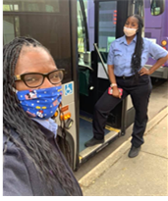
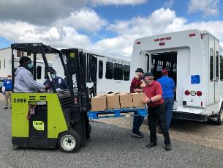
COVID-19 Impact on Transit
CTB provided $11M in March 2020 in emergency statewide transit operating assistance
Transit declared an essential service
Guidance to agencies included best practices for transit systems like face coverings, rear boarding, and fare-free collections
Federal Funding* provided:
CARES Act: $207.5M
CRRSAA: $14.7M
ARPA: $114.4M
Executive Order 63 required face coverings on all transit and rail stations and vehicles in Virginia
DRPT & VDOT distributed cloth face coverings provided by USDOT to transit agencies statewide with fewer than 40 employees
*Excludes funding provided to DC Metro Area

Slide 5
COVID-19 Impact on Transit

Slide 6
COVID-19 Research Demonstration Grant
DRPT received FTA funding to support the creation of a comprehensive COVID relief toolkit
$2M for transit recovery marketing
DRPT will receive proposals for mid-cycle applications
Statewide marketing campaign to be released in Summer 2021
Provides a unified message to most appropriately attract riders back
Reiterates the presence of new safety measures
Provides explanation on why public transportation is a safe and viable option
Strategies Handbook to be released in September 2021
Will provide necessary information for transit agencies on tactics to mitigate risk
Tailoring options
Limiting vehicle capacities
Heightening sanitation efforts

Slide 7
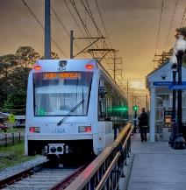
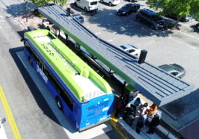
FY22 SYIP Transit Highlights
Statewide Operating Assistance
Offset a portion (20-30%) of agency’s operating expenses in a typical year
Transit performance metrics utilized to allocate operating assistance have varied greatly across the state (ridership, service levels)
Carryforward performance data utilized to calculate operating assistance for FY21 (pre-pandemic) for FY22
Provide 2% increase in state transit operating assistance program
Statewide Capital Assistance
Focus on state of good repair/minor enhancement needs and vehicle purchases delayed due to pandemic
Purchase of 394 transit vehicles
152 diesel buses
21 electric buses

Slide 8
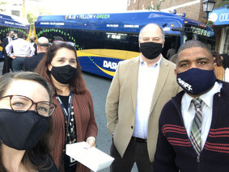
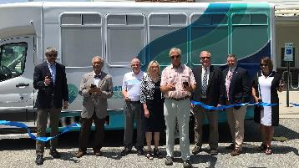
Technology in Transit
VW Mitigation Trust Funds
FY22: $7.8M allocation leveraged with transit capital
Final year of three year $16.7M partnership with DRPT & DEQ
Replacement vehicles prioritized through MERIT Process
Greater Roanoke Transit Company
Blacksburg Transit
Fairfax County
Microtransit Deployment Initiative
Funded in part through FTA Integrated Mobility Innovation Grant and VA’s Innovation Technology Transportation Fund
Will handle dispatch, assign pickup location, and route vehicles allowing multiple riders to share a single vehicle
Pilots- Bay Transit (Bay Express) & Mountain Empire Older Citizens (METGo)

Slide 9
Transit Ridership Incentive Program
FY22:
$10M in 2021 Transportation Initiative Funding dedicated for Zero-Fare Pilots
$3.6M of regular TRIP funding must be used for congestion mitigation projects
Beyond FY22:
Up to 25% annually can be utilized for Zero-Fare/Low Income projects

Slide 10
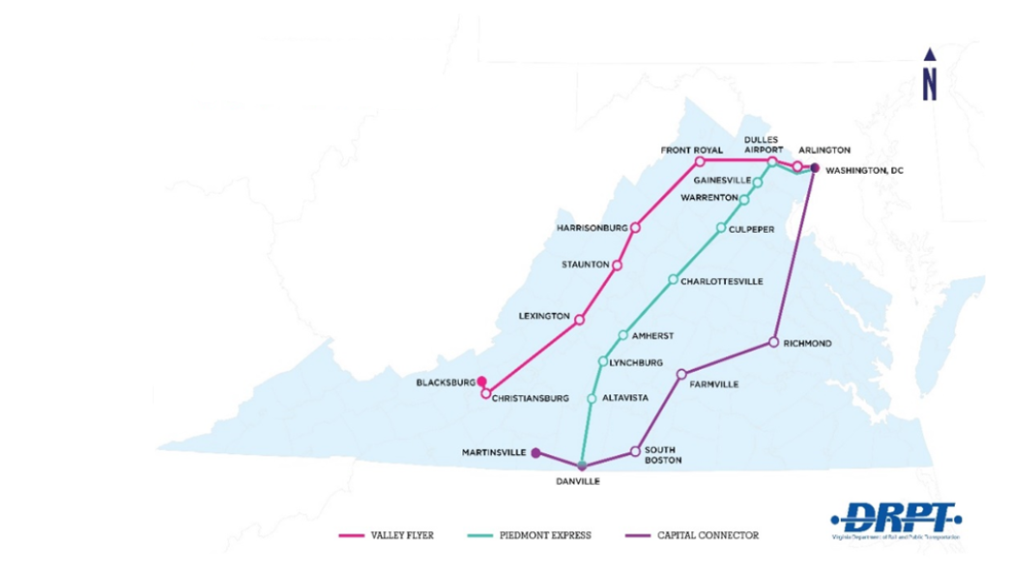
Virginia Breeze
Intercity Bus Service:
Provides limited service between two or more urban areas on fixed-route schedules
Connects underserved communities with limited travel options
Virginia Breeze:
Valley Flyer: Blacksburg-DC
Piedmont Express: Danville-DC
Capital Connector: Martinsville-RVA-DC
Highlands Rhythm: Bristol-DC (COMING SOON!)
Monthly Ridership Grew by 53% in second half of FY21

Slide 11
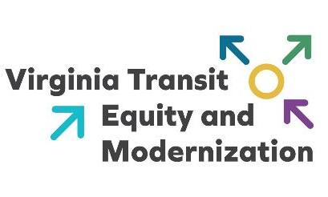
Transit Equity & Modernization Study
Study Areas:
Transit Accessibility
Adequacy of Transit Infrastructure
Transit Electrification
Implementation of Emerging Technology
Safety
System Engagement
Focus on transit services and engagement opportunities for underserved and underrepresented communities
Timeline:
Interim Report - December 1, 2021
Final Report - August 1, 2022

Slide 12
Springfield-Quantico Public Transportation Study
2020 General Assembly approved a budget amendment directing DRPT to conduct a feasibility study:
"F. The Department of Rail and Public Transportation, in cooperation with Fairfax and Prince William counties, shall evaluate enhanced public transportation services from the Franconia-Springfield Metro Station to Fort Belvoir, Lorton, Potomac Mills, and Marine Corps Base Quantico in Prince William County, including the cost and feasibility of extending the Blue Line and other multimodal options such as bus rapid transit along Interstate 95 and U.S. Route 1. The Director of the Department of Rail and Public Transportation shall submit a report of its findings to the Chairs of the House Appropriations Committee and the Senate Finance and Appropriations Committee by December 1, 2021.“
Study must be completed by December 1, 2021
A range of multimodal transit investments will be evaluated

Slide 13
Springfield-Quantico Public Transportation Study

Slide 14
Transit Update
Virginia Municipal League - July 28, 2021
Jennifer Mitchell, Director
Department of Rail and Public Transportation

