Slide 1
Overview and Context for Governor Northam’s Proposed Amendments to the 2020-22 Biennial Budget
Presentation to the Virginia Municipal League
January 11, 2021
Joe Flores
Deputy Secretary of Finance
Commonwealth of Virginia
www.finance.virginia.gov

Slide 2
Outline
A review from the Roller Coaster ride that was 2020
A High Level Overview of the Governor’s Proposed Amendments to the 2020-22 Budget
Observations and Concluding Thoughts

Slide 3
At the start of the year…
We began 2020 in a good position
General fund revenue growth was strong
Employment was at historic levels
Salaries were on the rise
Concerns about the durability of this historic expansion were minor
Traditional budget drivers – K-12 and Medicaid – were up but manageable. The Governor’s proposed budget:
Added $2.0 billion for K-12 Education and Health and Human Resources.
Expanded funding for:
Housing, broadband, and economic development;
Access to health care and social services; and
Behavioral health and developmental disability services.
Set aside additional GF revenue in reserve.
News reports about a mysterious virus in China were starting to get people’s attention

Slide 4
Then in early March…
The General Assembly finished its work
But the adage “the Governor proposes and the Legislature disposes” was certainly applicable during the 2020 Session.
The General Assembly enacted $4.6 billion in new general fund spending offset by nearly $2.0 billion in savings. Additional resources went to:
Education (i.e., early childhood, K-12, and higher education);
Medicaid (i.e., forecasted growth, provider rates), behavioral health, developmental disability, and social services;
Salary increases for teachers and support staff as well as state- and state-supported local employees; and
Additional revenues were still set aside.
A week later the World Health Organization declared a global pandemic

Slide 5
In April, Everything Came to a Halt
One month later, the budget that the General Assembly had just passed had to be reconsidered.
The impact of the virus on general fund revenues was unclear.
What is COVID, how does it spread, how do we test for it?
How will it affect general fund revenues?
What is the impact of the pandemic on schools, businesses, local governments, and health care?
Are all these new investments sustainable?
How can the federal government help?
At the Reconvened Session in April, the Governor recommended that most new discretionary spending – roughly $2.2 billion GF -- be unallotted or frozen.
The revenue picture would need to be reassessed before we could proceed responsibly.

Slide 6
The feds stepped up…sort of
In the spring, Congress enacted four federal stimulus bills in quick succession
The largest bill, the Coronavirus Aid, Relief, and Economic Security or CARES act, infused more than $7 billion in direct aid to Virginia.
The Coronavirus Relief Fund (CRF) within the CARES Act, provided $3.3 billion in funding to state and local governments in Virginia.
Statutory limitations and evolving guidance stalled the roll-out of these desperately needed federal funds in late spring and summer.
The federal government provided funding to states, but…
Leadership to combat the virus was lacking;
Federal guidance sometimes lagged funding announcements;
The window to spend CRF dollars was very narrow – expenses incurred from March 1, 2020 – December 30, 2020; and
Funds could only be used on expenditures related to the pandemic – replacing lost revenues was not an option.

Slide 7
August to November - Special Session I
When the General Assembly convened in August, it became clear that general fund revenues would need to be adjusted downward…by $2.7 billion for the biennium.
$1.7 billion in new general fund spending that had been unallotted (i.e., frozen) was subsequently removed from the current budget.
$2.2 billion had been unallotted in April.
Enhanced federal Medicaid funding, additional general fund reductions, and use of the unappropriated balance, allowed the General Assembly to restore budget items that had been frozen.
The “unallottments” above were not cuts to existing programs but increases that did not take effect, including:
Proposed investments in K-12 and higher education;
Increases for HHR programs;
Salary increases for state employees and state-supported locals; and
Planned deposits to the revenue reserve fund.

Slide 8
What survived the budget up and downs?
In Health and Human Resources, budget priorities that were funded revolved around:
Investments in Behavioral Health Services
Restored funds for STEP-Virginia;
Increased funding for discharge assistance planning;
Added resources for permanent supportive housing; and
Included funds to address census pressures at state hospitals.
Community capacity for developmental disability services
Provider rate increase for personal care attendants;
Added overtime pay for consumer-directed personal care attendants;
Updated Medicaid DD waiver rates (i.e. rate refresh); and
Increased reimbursement rates for skilled and private duty nursing.
Access to Health Care and Social Services
Added dental benefits for adult Medicaid recipients
Restored funds for local DSS prevention services

Slide 9
A Quick Shift to the 2021 Budget
After the General Assembly passed its budget in mid-November, we began to make decisions on the next budget.
The protracted 2020 Special Session gave us one month to put together a budget.
Budget development typically begins in August/September.
But we couldn’t start until the special session ended.
What is our starting point?
What did the General Assembly’s budget include/exclude?
How did the General Assembly modify the use of Coronavirus Relief Funds within the CARES Act that needed to be spent by December 30, 2020?
In fairness, Governor’s “off-year” budgets generally tweak the current budget.
Mid-biennial budgets often address emerging concerns or crises.
How much has really changed in just a few weeks?

Slide 10
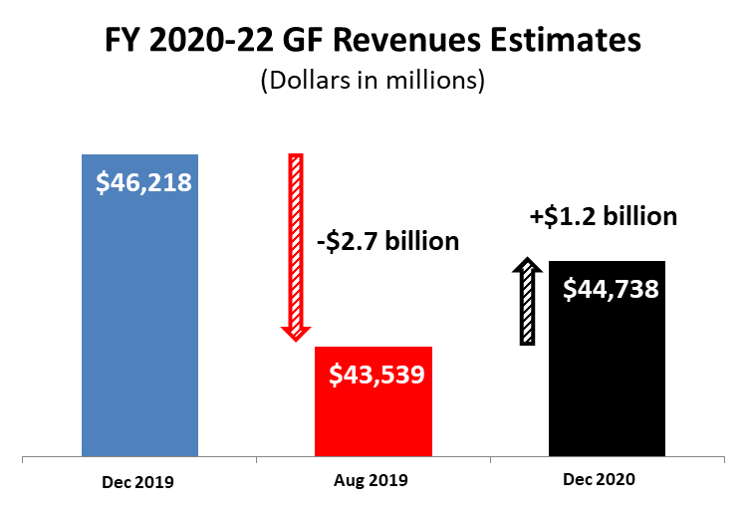
A Review of the 2020 Revenue Ride
Biennial general fund revenue projections have gyrated this year.
But revenues have not fully recovered from December 2019 projections.

Slide 11
Revenue Outlook and Budget Goals
Based on guidance from the Joint Advisory Board of Economists (JABE) and the Governor’s Advisory Counsel on Revenue Estimates (GACRE), general fund revenues were revised upward by $1.2 billion.
Negative impact in the current fiscal year (FY 2021) is less than previously expected.
But growth in FY 2022 is projected to be slower than anticipated back in August.
Less money in the second year for ongoing needs.
Significant general fund resources are already in the bank.
The Governor’s proposed amendments:
Respond to the direct and indirect impact of COVID-19
Set aside additional general fund revenues due to uncertainty
Restore funding for priority programs

Slide 12
Response to COVID-19
Beyond mandates, the first priority was to address the impact of COVID-19 on the Commonwealth.
Some of the direct responses to the pandemic include:
$89.3 million for a mass vaccination effort and develop systems to efficiently store and distribute COVID-19 vaccines;
$78.9 million to increase funding for COVID-19 disaster response through VDEM from January 2021 through December 2021; and
$19.0 million to enhance communication efforts in response to the pandemic through the Virginia's Health is in Our Hands campaign.
Proposals that address the indirect impact of the virus include:
$513.5 million to ensure local school divisions don’t lose funding due to COVID-19.
This additional funding is offset by $400.6 million in reductions based on actual Average Daily Membership from the fall of 2020;
$10.0 million to increase customer support staff for unemployment insurance; and
$6.4 million to conduct comprehensive surveillance at state hospitals.

Slide 13
Response to Uncertainty
Due to continuing economic uncertainty, the Governor proposes to:
Set aside $650 million in the revenue reserve; and
Make a one-time deposit of $100 million to the Virginia Retirement System to reduce unfunded liabilities for teacher’s retirement plan and state employee health insurance.
The Governor also proposes one-time spending initiatives to limit ongoing commitments.
$97.8 million for a one-time bonus for state- and state-supported local employees;
$80.0 million for a one-time bonus for teachers, instructional and support positions; and
These one-time bonuses were consistent with the Appropriations Act.
$50.0 million to extend intercity passenger rail service from Roanoke to Blacksburg-Christiansburg and along the I-81/Route 29 Corridor from Washington, DC.

Slide 14
Additional Budget Priorities of the Governor
The proposed budget restores some of the Governor’s key priorities including:
$40.7 million to increase funding for the housing trust fund;
$39.4 million to the Water Quality Improvement Fund;
$36.0 million to restore funding to implement the Get Skilled, Get a Job, Give Back Program or G3 Program;
$30.3 million to restore funding for undergraduate financial assistance;
$26.6 million to add more school counselors;
$15.3 million for broadband activities;
$12.0 million for water, land, and air quality improvements;
$11.1 million to maximize access to K-12 education;
$10.8 million to plan for the future of Monument Avenue; and
$10.2 million to update the formula used to provide funding to local health districts.
REMEMBER -- this budget makes minor changes to a budget that was just enacted.

Slide 15
Additional Resources on the Budget
Additional detail on the Governor’s proposed amendments to the 2020-22 budget can be found at the following link. https://dpb.virginia.gov/index.cfm
Governor Northam’s Speech to the Money Committees
Governor Northam’s 2021 Budget Document (details)
Secretary of Finance Aubrey Layne’s Presentation to the Money Committees
Budget Director Dan Timberlake’s Presentation to the Money Committees
The Senate Finance and Appropriations (SF&AC) and House Appropriations Committees (HAC) will also prepare summaries of the Governor’s proposed budget.
Money committee staff will jointly prepare a narrative document.
Separately, the staff will put together PowerPoint presentations.

Slide 16
Observations Going into the 2021 Session
We continue to monitor general fund revenue collections.
Growth has remained strong.
There is an “upward bias” to the current general fund forecast.
Congress enacted a fifth stimulus bill.
Additional federal funding is earmarked for vaccines, testing, education, child care, and stimulus payments.
Tax relief is also included in the budget.
The deadline for expenses for Coronavirus Relief Fund (CRF) within the CARES Act was extended from December 30, 2020 to December 31, 2021.
No additional CRF dollars were appropriated and all CRF dollars have been obligated, and we still cannot use funds to replace lost revenues.
From federal guidance issued by the US Department of Treasury in September 2020: “Funds may not be used to fill shortfalls in government revenue to cover expenditures that would not otherwise qualify under the statute. Although a broad range of uses is allowed, revenue replacement is not a permissible use of Fund payments.”

Slide 17
Concluding Thoughts
Everyone seems to be exhausted…and the fun is just beginning!
How everyone advocates for “their initiatives” is going to be extremely challenging.
At the same the Northam Administration is winding down, the Biden Administration is getting ready to roll.
And it’s an election year…again!

Slide 18
Contact information:
K. Joseph Flores
Deputy Secretary of Finance
804.692.2575
joe.flores@governor.virginia.gov

