Slide 1
Promoting Civility in Local Government
Presented by:
Thomas Bullock
Director of Education and Training

Slide 2
I never considered a difference of opinion in politics, in religion, in philosophy, as cause for withdrawing from a friend”
— Thomas Jefferson

Slide 3
Somebody Needs a Timeout!!

Slide 4
Today’s Local Governance Environment
Erosion of trust in government;
Cynicism toward government;
Diversity of citizens’ views;
Complex issues;
Polarization;
A breakdown in basic civility;

Slide 5
Challenges for Local Government
Wicked problems;
Disengagement between citizens and local government;
Getting sufficient perspective;
Limitations of discussion and debate;
A crisis of confidence in government;
Increasing incivility in public life.

Slide 6
Wicked Problems
Complex, interdependent issues
Lack a clear problem definition
Conflicting values and perspectives
Multiple stakeholders
No right or wrong, only better or worse
Key to success is collaboration & engagement

Slide 7
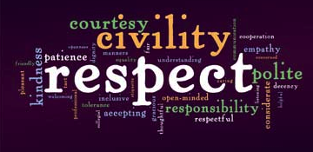
Civility in Public Discourse

Slide 8
Civility isn’t a New Idea
“Every action done in company, ought to be with some sign of respect, to those that are present,”
George Washington (at age 16)
Rule #1, 110 Rules of Civility and Decent Behavior

Slide 9
It’s Easy for Incivility to Develop!
Lots of pressures…from everywhere;
Issues are complex, difficult…wicked;
A lot at stake for citizens, for communities, for local officials personally;
Frustration develops and tempers can flare.

Slide 10
Top 10 Consequences of Incivility
Civility in America2019: Solutions for Tomorrow

Slide 11
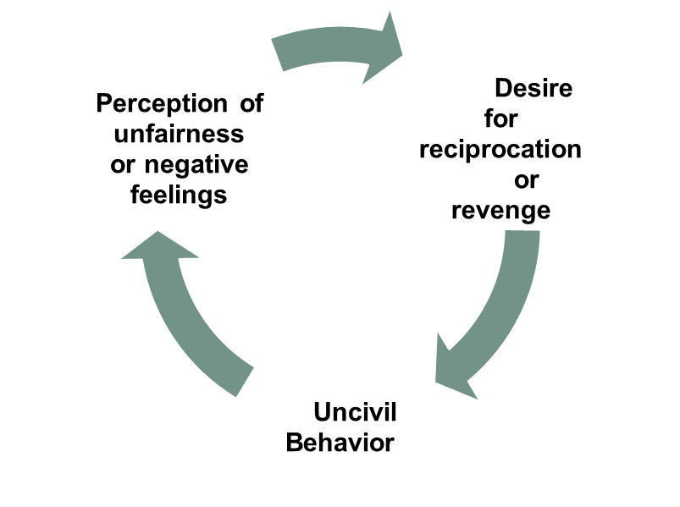
The Incivility Spiral

Slide 12
What is the Civility Payoff?
A civil atmosphere makes it possible to thoughtfully and effectively talk about, learn about, consider, and leverage a wide range of ideas and perspectives;
When leaders talk about issues effectively it becomes possible to find solutions which might not have otherwise surfaced.

Slide 13
A Synopsis of Civility Principles
Tolerance
Respect and acknowledge the legitimacy of opposing views
Respectful Interaction
No personal attacks, belittling, name calling, profanity, insults, or disparaging remarks.
No jumping to conclusions without knowing what is being said or suggested.
No interrupting someone when they have the floor.
Does permit offering constructive criticism or politely challenging one’s assumptions, both of which may serve to enhance the policy dialogue.

Slide 14
A Synopsis of Civility Principles
Listening
To understand what someone else is saying
To understand their views and interests
To consider new information and become better informed
Does not include gathering information to repudiate or attack someone
Compromise
Recognizing and accepting that the best decisions are often necessarily a product of compromise where good-faith attempts are made to integrate opposing interests
Focus is on the greatest public good

Slide 15
A Synopsis of Civility Principles
Dialogue
Examine assumptions and interests behind positions.
Dialogue is deeper and more purposeful than discussion.
The intended outcome is to ‘discover’ synergistic solutions.
Analysis and Deliberation
The intent is to carefully examine as many facets of an issue or problem as possible.
The purpose is to craft a solution that serves the greatest good.

Slide 16
The Ladder of Inference

Slide 17
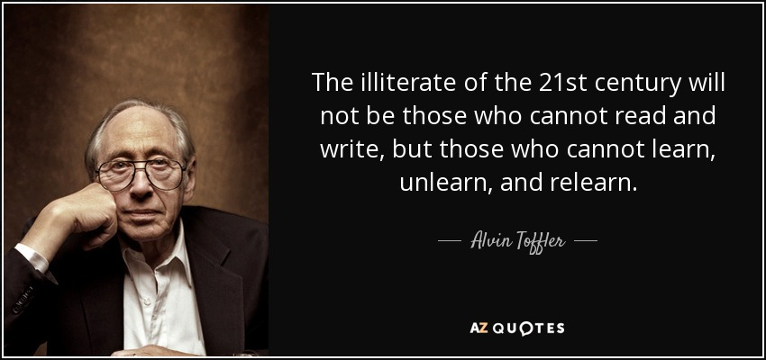

Slide 18
Civil Discourse
Civil
Discourse
“Polite but not friendly, only as polite as a person needs to be in order to not be rude; of, relating to, or involving the general public, their activities, needs, or ways, or civic affairs as distinguished from special (as military or religious) affairs.” (Merriam-Webster Dictionary)
” The use of words to exchange thoughts and ideas.”
(Merriam-Webster Dictionary

Slide 19
Civil Discourse
The polite exchange of thoughts and ideas relating to affairs of the public.

Slide 20
5 G’s for Having Difficult Conversations
Get your motives right-Do No Harm
Go in with good intentions
Get your emotions in check
Get curious (Be prepared to listen)
Get ready to hear hard truths

Slide 21
Social and Emotional Intelligence

Slide 22
Ways to Deal with Incivility
Keep control of yourself
Adjust your expectations
Maintain a professional demeanor
Choose your battles wisely
Listen
Respectful, forthright

Slide 23
Ways to Deal with Incivility
Use empathy
Switch extremes into facts
Move to problem solving
Pause before responding
Model the way in your actions and words
Promote civility on your council and in your community

Slide 24
Why Should we Care About Civility?
Incivility contributes to voter alienation
Leads to antipathy towards government
Core value of a well functioning community
Civility strategic plan

Slide 25
Final Thoughts
You may not be able to control your first thought, but you can control your second thought and your first action.
Never be ashamed of your emotions, but never let your emotions shame you.

Slide 26
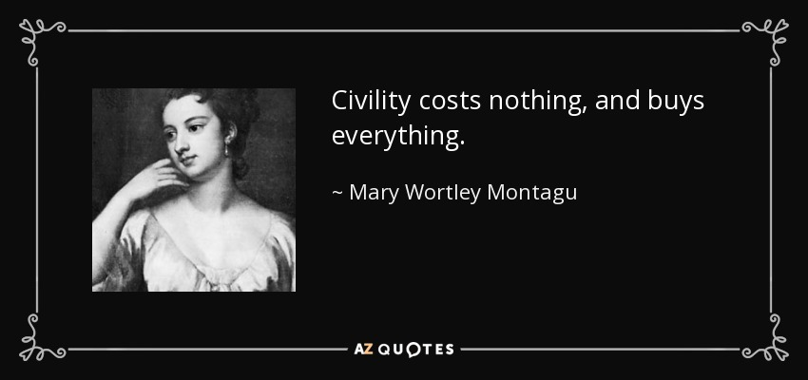

Slide 27
Email: tbullock@vrsa.us

