Slide 1
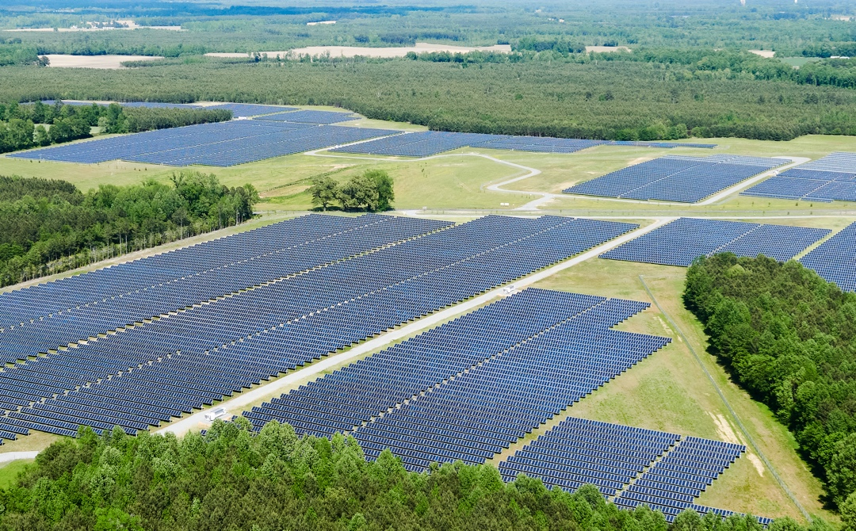
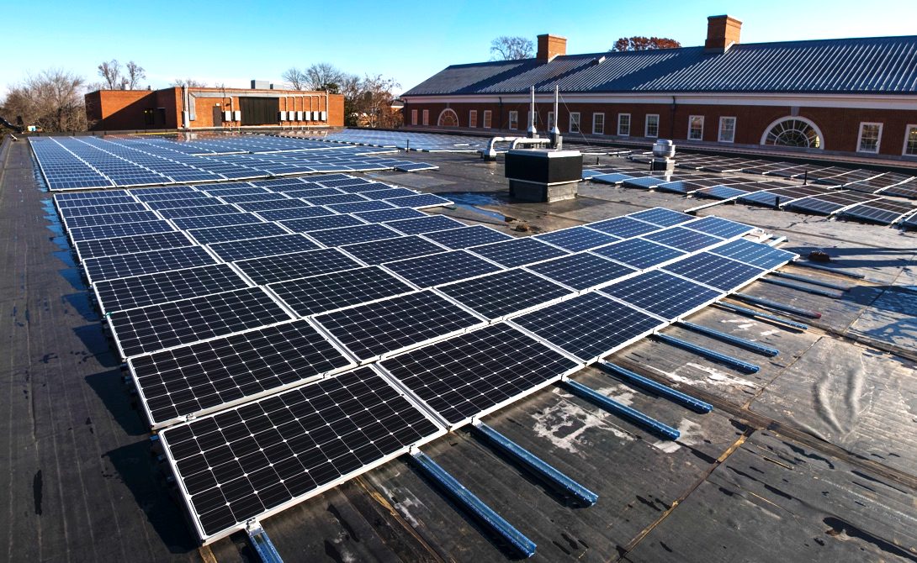
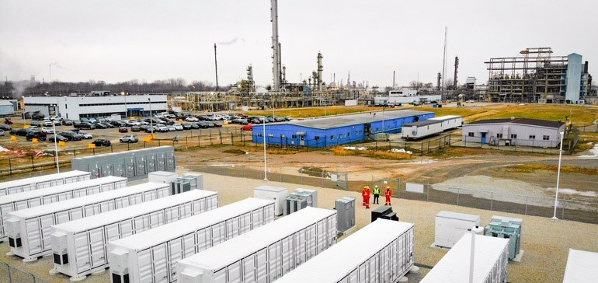
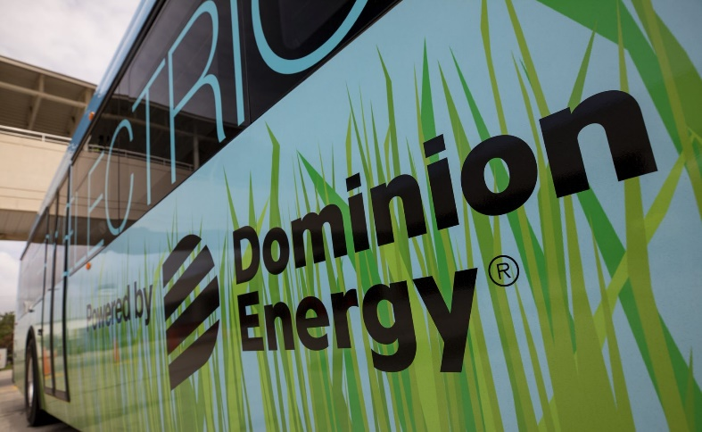
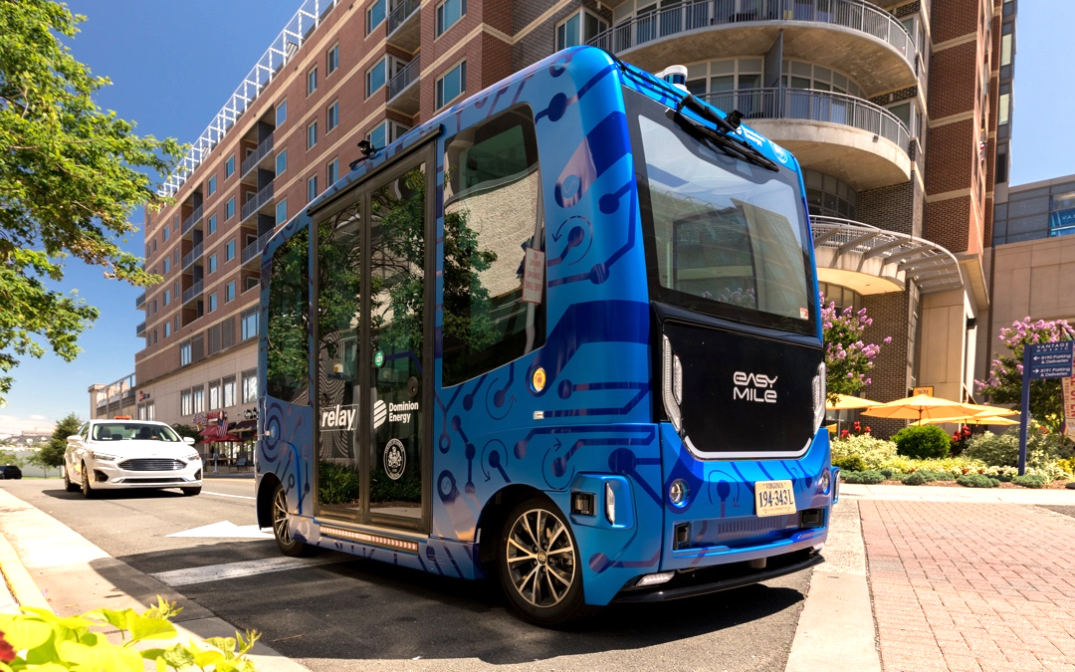
Virginia Municipal League
2020 Annual Conference

Slide 2
Virginia Clean Economy Act
Virginia Clean Economy Act (VCEA)
Senate Bill 851 & House Bill 1526
Most consequential energy policy reform since 2007 Reregulation Act.
Energy Storage
2.7 GW by 2035
One project up to 800MW
At least 35% from third parties (via Power-Purchase Agreements)
Major Provisions
Mandatory renewable portfolio standard
Retirement of carbon-emitting electric generating units
Virginia’s participation in a regional carbon trading program (RGGI)
Solar or Onshore Wind
16.1 GW by 2035, including:
1,100 MW small-scale (<3 MW)
200 MW on brownfield sites
At least 35% from third parties (via Power-Purchase Agreements)
Offshore Wind
5.2 GW by 2034
2,700 MW project in public interest
Costs must be reasonable/prudent
Priority hiring for veterans, workers from local/disadvantaged communities
Energy Efficiency Standard
Targeted reductions in energy sales, using 2019 as a baseline:
1.25% in 2022 → 5% by 2025
SCC to determine future targets

Slide 3
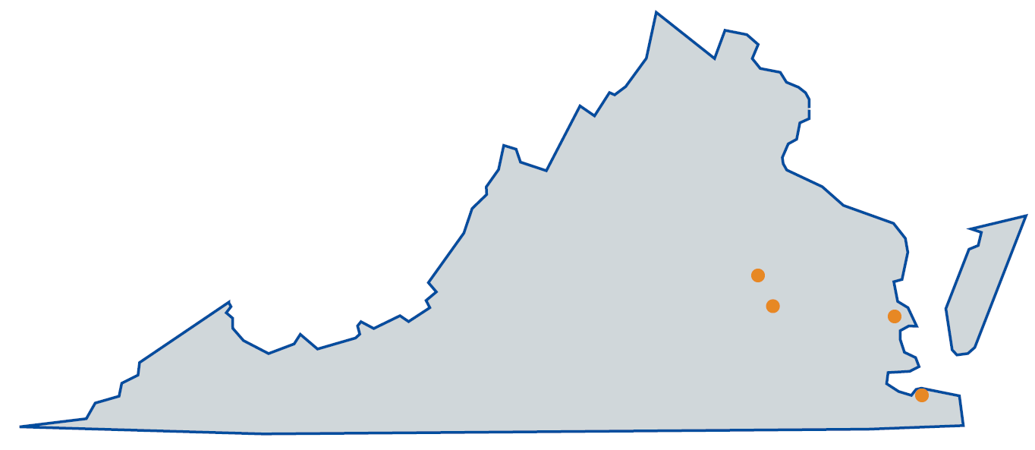
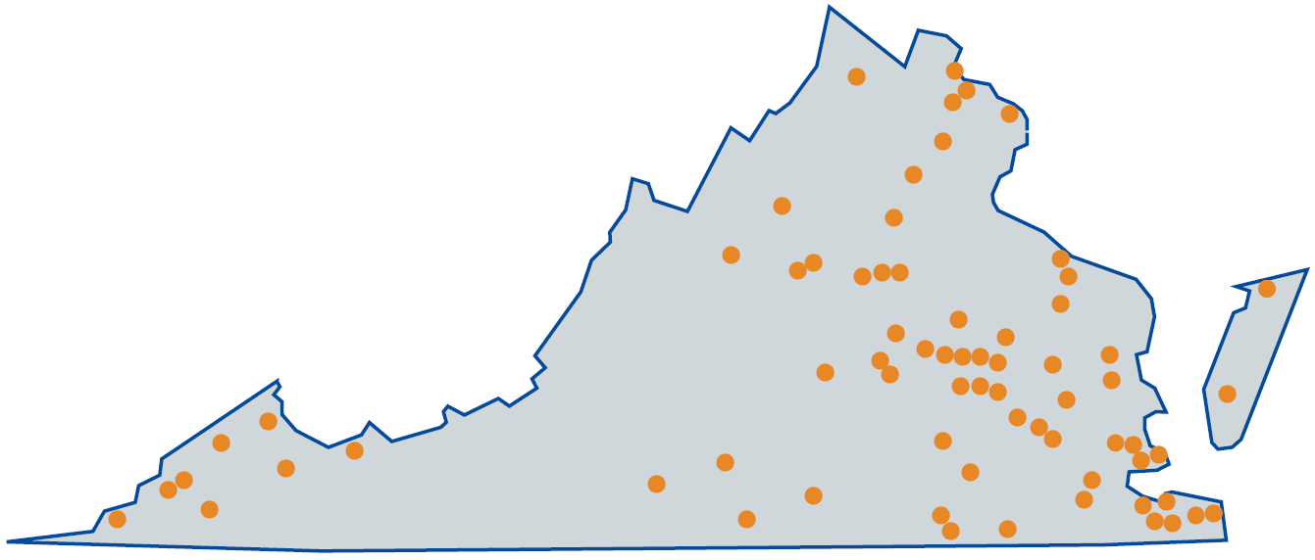
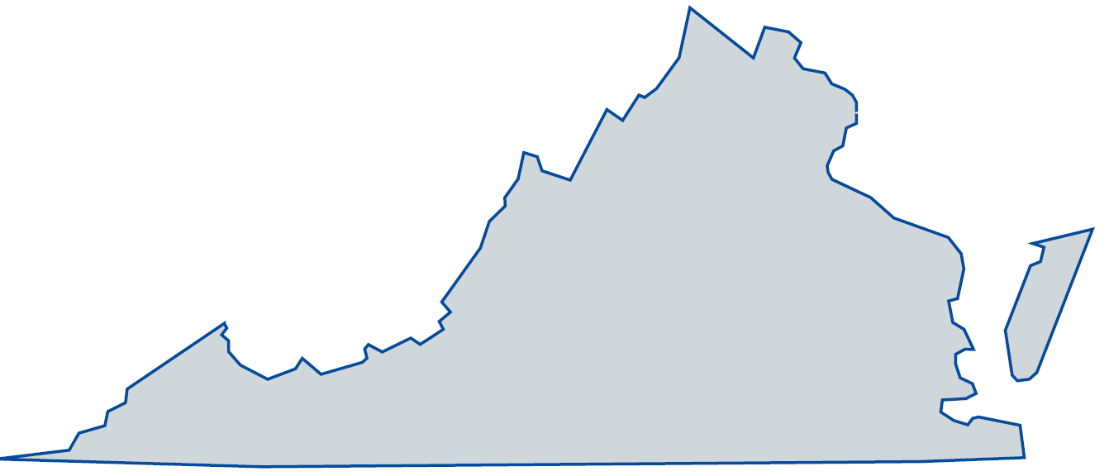
Solar Progress
2015
Today
Total solar capacity in Virginia = 1 MW
Solar in operation, under development,
or under construction = 3,803 MW
Quick Facts
Surpassed our target to have 3,000 MW of solar/wind generation online or under development in Virginia two years ahead of schedule.
As a result of legislation, forecasts show more than 300% increase in projected solar and wind generation development compared to this time last year.
3,803 MWs is the carbon equivalent of taking over 1,240,000 passenger vehicles off the road annually.
2035
?
Projected total solar capacity in Virginia
= 16,100 MW

Slide 4
Solar Opportunities
Small-Scale Renewables RFP
Announcing soon.
DG projects under 3 MW, total goal of 80 MW.
Ideal projects 30 acres or less.
Ground-mounted, brownfield, rooftop, and canopy.
DominionEnergy.com/2020DistributedSolarRFP
Land RFI
Announced August 11.
Identify areas of land greater than 500 acres for future solar development.
Must be relatively flat, free of wetlands and cultural resources, and within service area.
DominionEnergy.com/SolarLandRFI
Large-Scale Renewables RFP
Announced May 1.
1,000 MW of solar and onshore wind.
250 MW of battery storage.
Resources can be paired or standalone.
Largest solicitation in the Company’s history.
DominionEnergy.com/2020SolarWindRFP
Key Highlights
Annual request for projects.
Favorable consideration for use of labor, materials and other resources within Virginia and from Virginia businesses.
Potential opportunities for local governments and schools?

Slide 5
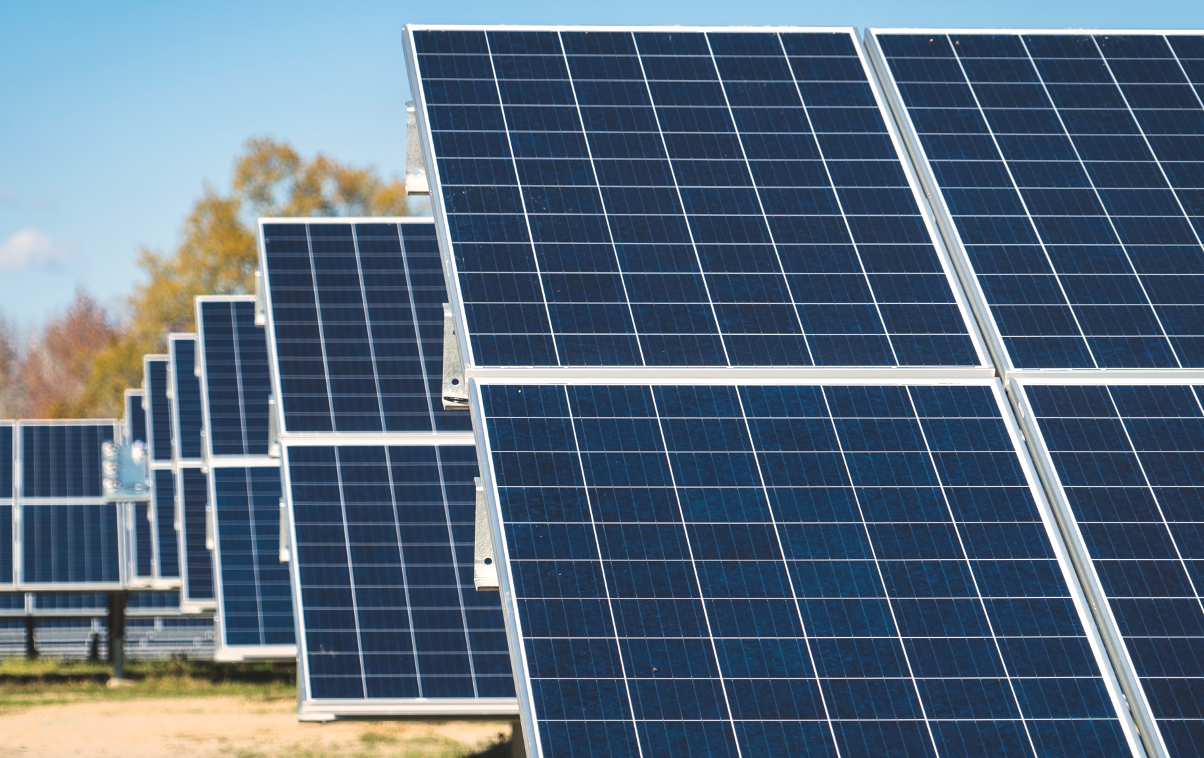
Solar Policy Changes
Taxing Solar Projects
Virginia lawmakers approved changes to how solar is taxed.
For existing projects, nothing has changed.
For new solar projects, localities have the option to apply property taxes with new step-down exemption schedule OR a revenue share assessment.
Special Conditions for Solar Projects
Recent legislation permits local governments to impose an obligation that a project provides financial or other benefits to the locality.
Must be reasonably related to the project.
Property Tax | Energy Tax
First five years: 80% exempt Second five years: 70% exempt Remainder: 60% exempt | Up to $1,400 per MW of capacity installed per project.
Facility impacts composite index formula. | 100% exempt from property tax; does not impact composite index.
Depreciation of asset will impact tax revenue. | More predictability of expected tax revenue over the life of the asset.

Slide 6
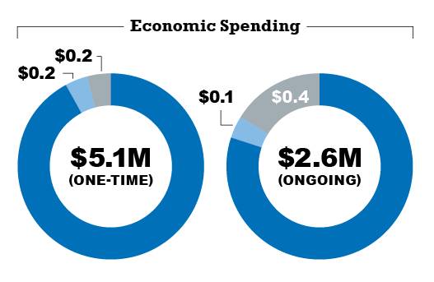
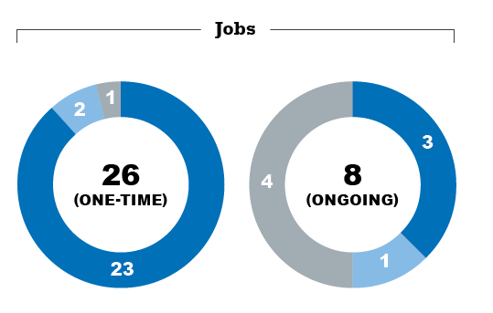
Solar Economic Development
Impacts from a 100 MW Solar Project
Investments in solar bring broader community benefits such as increased local tax revenues and the creation of new clean energy jobs.
Benefits for Localities
Projects often use
Virginia and locally-based
suppliers and labor.
Support a clean and
sustainable energy
future in Virginia.
Increase local tax
revenues.
Partner with a financially
secure, Fortune 250
Company headquartered
and invested in Virginia.
Help create clean
energy jobs.
What might a locality expect for a typical 100 MW solar project?
Direct
Indirect
Induced

Slide 7
Broadband
Broadband access is more important now than ever. By closing this digital divide, reliable high-speed internet service will help fill critical economic, education, and employment infrastructure needs.
Middle Mile Infrastructure
Enabling Policy
2018: Virginia Grid Transformation and Security Act required each utility to evaluate broadband expansion.
2019: HB 2691 established rural broadband pilot program.
7
Substation
“Middle Mile”
Substation
“Middle Mile”
“Last Mile”
Key Elements of Pilot
Expand access in unserved areas
25 Mbps Download / 3 Mbps Upload
Pilot period of 3 years
Projects subject to SCC Approval
“Last Mile”
Local Internet Service Provider

Slide 8
Battery Storage Pilot
Safety Features
Meets industry standards and certified by independent third-party.
Battery Management System, smoke detection, gas detection, temperature controlled, and emergency generator in case of outage.
Fire Department Connection installed to flood each enclosure eliminating the need for any personnel to enter.
Emergency response plans and training provided to first responders.
Powhatan County: Solar Plus Storage
Adjacent to large solar project.
10MWac/40MWh and 2MWdc/8MWh
New Kent County: Solar Plus Storage
Adjacent to large solar project.
2 MW/4 MWh
Ashland, Hanover County
Adjacent to electric transmission substation.
2MW/4MWh

Slide 9
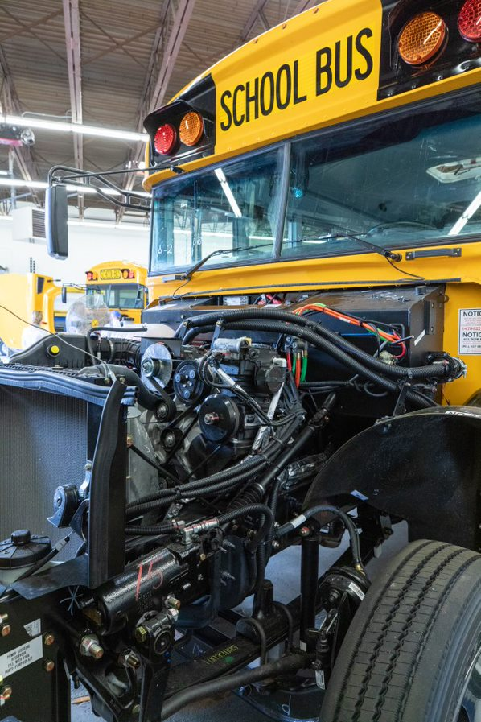
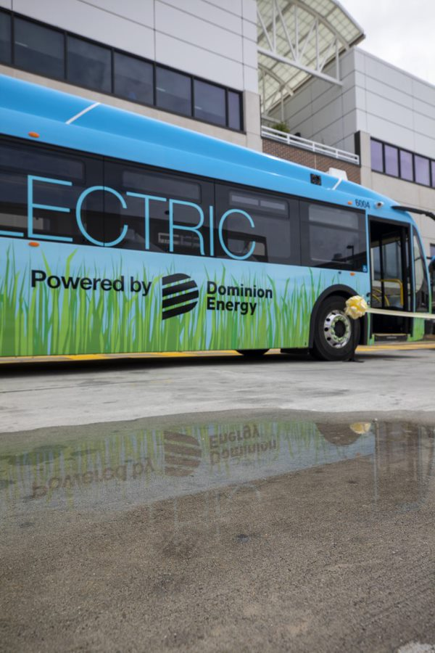
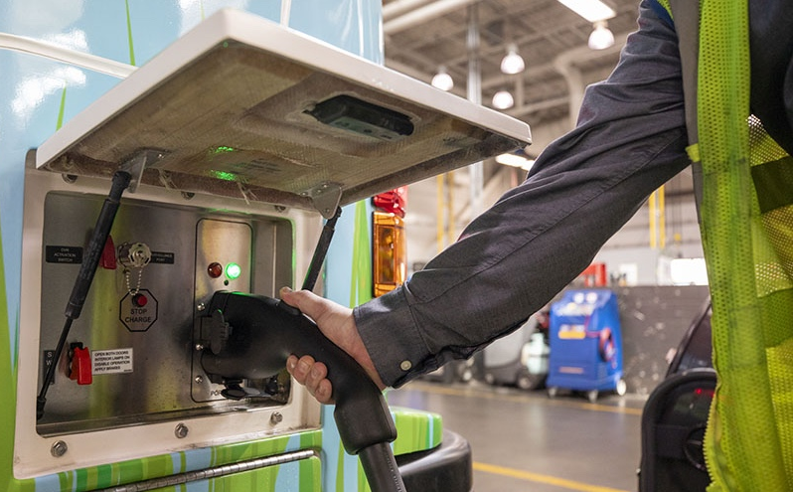
Transportation Electrification
Electric Autonomous Shuttle “Relay”
Electric School Buses
Electric Mass Transit Buses

Slide 10
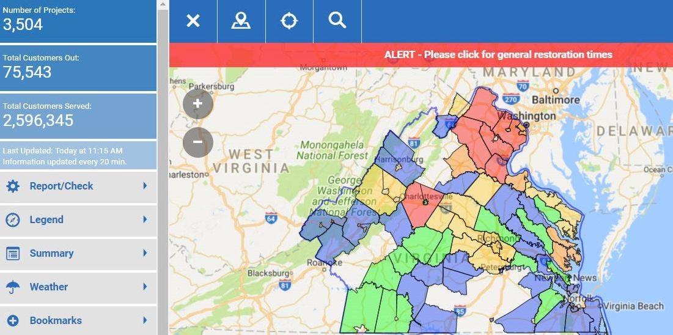
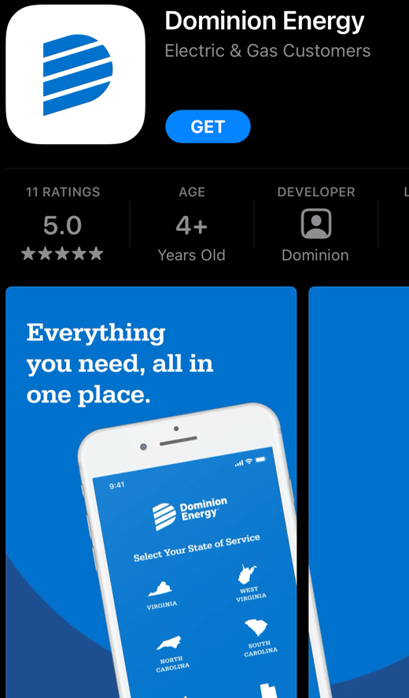
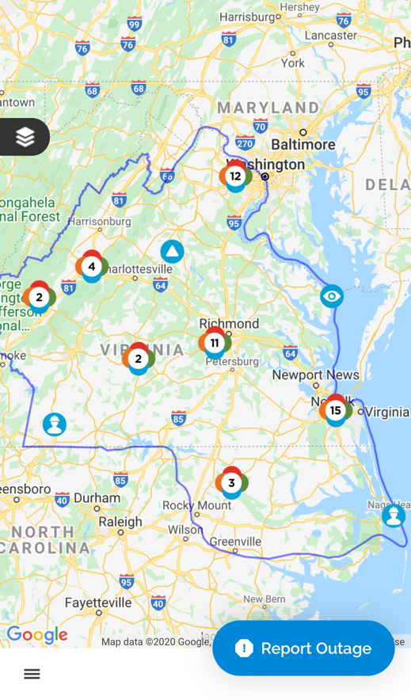
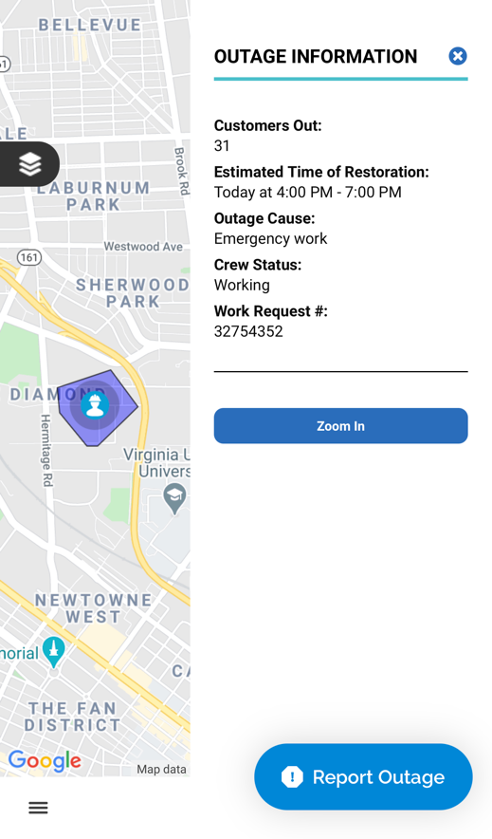
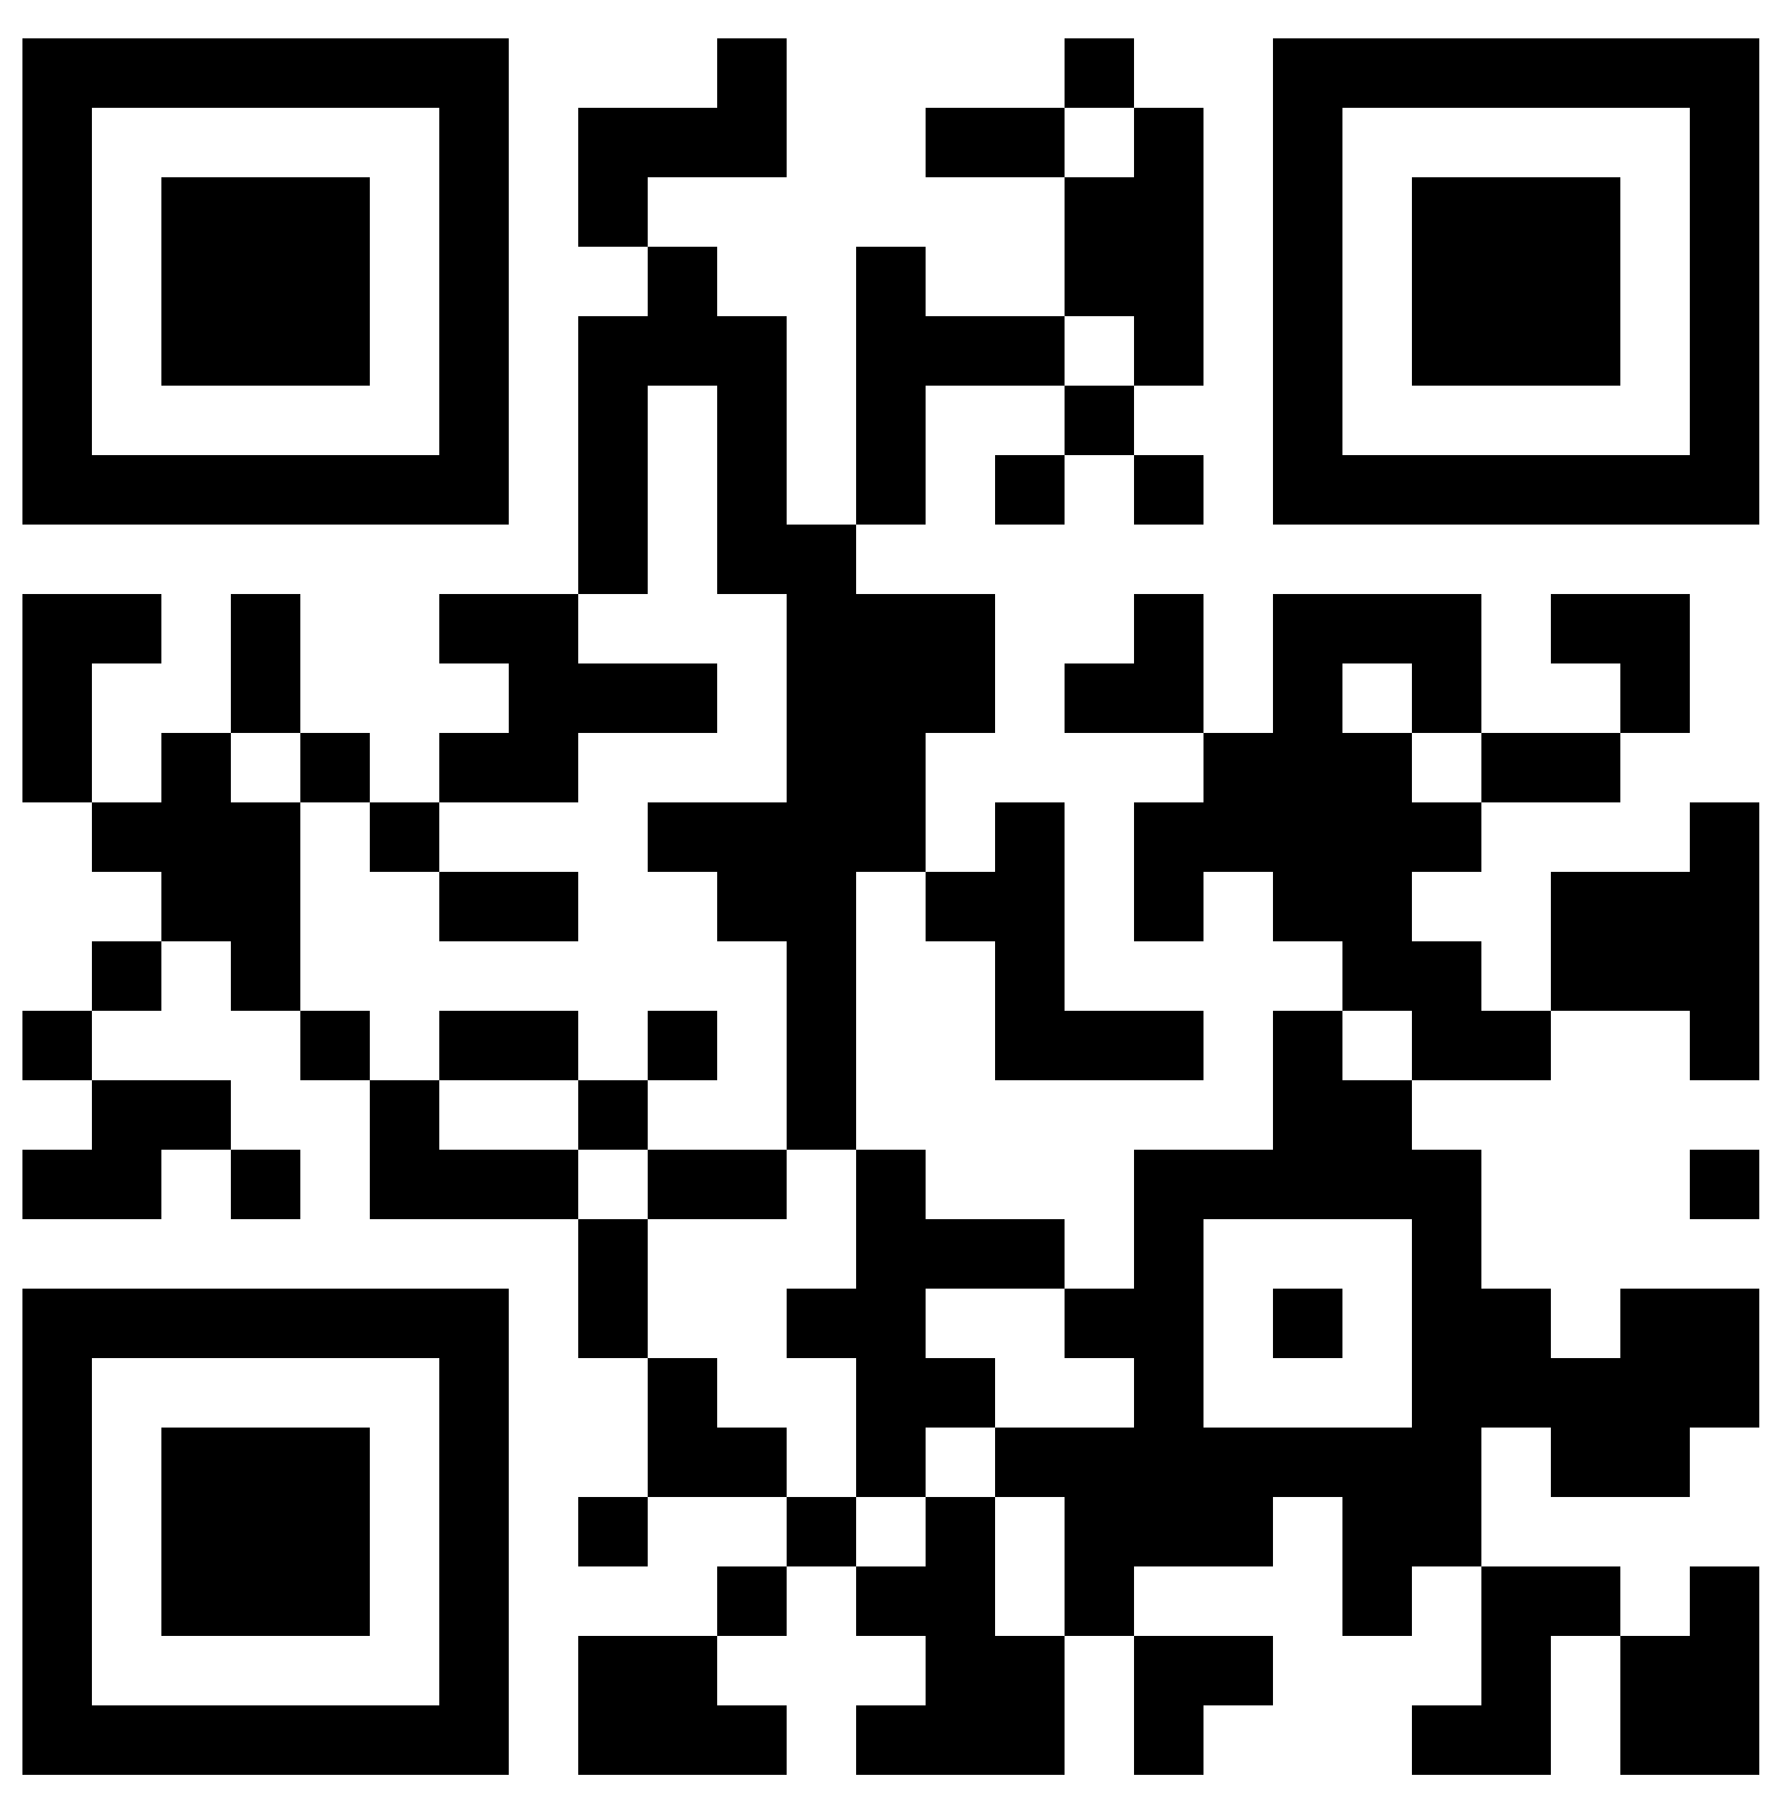
Reporting Outages
Working from Home
Power flickers and power outages, either large or small, can be especially disruptive when working and learning virtually from home.
While we are quickly working to make the grid smarter and more resilient, outages do occur, and we don’t know your power is out unless you tell us!
DOWNLOAD
the mobile app.
Scan the appropriate
QR code to download the app on your mobile phone.
REPORT
your outage.
Using the mobile app, report your outage. You will need your account number, or the phone associated with the account.
TRACK
your outage.
You can also track your report, the current status, and estimated time of restoration.

