Slide 1
Hurricane Season Webinar
Date: August 7, 2020

Slide 2
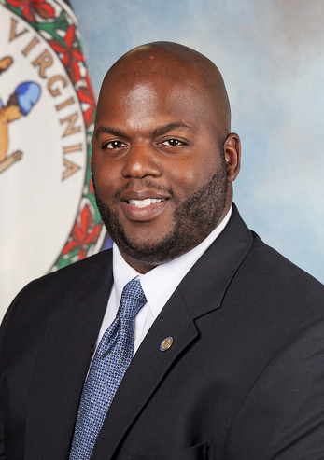
State Coordinator of Emergency Management Curtis Brown
Gov. Ralph Northam appointed Curtis Brown as State Coordinator of Emergency Management at VDEM on June 9, 2020
Curtis previously served as Chief Deputy State Coordinator and Deputy Secretary of Public Safety & Homeland Security

Slide 3
2020 Atlantic Hurricane Season Outlook
Named Storms
13-19
----------------
Hurricanes
6-10
----------------
Major Hurricanes
3-6
Information provided by the National Weather Service

Slide 4
VDEM Structure & Updates
Absorbed ISP Division from VITA (now called 9-1-1 and Geospatial Services NGS)
Reorganization created four new bureaus as of July 1 – NGS, Financial Management, Chief of VEST, Chief of Staff (see next slide for org chart)
Currently operating virtually due to COVID-19
Currently activated for several concurrent emergency declarations
COVID-19, First Amendment Events, now in recovery phase for TS Isaias

Slide 5
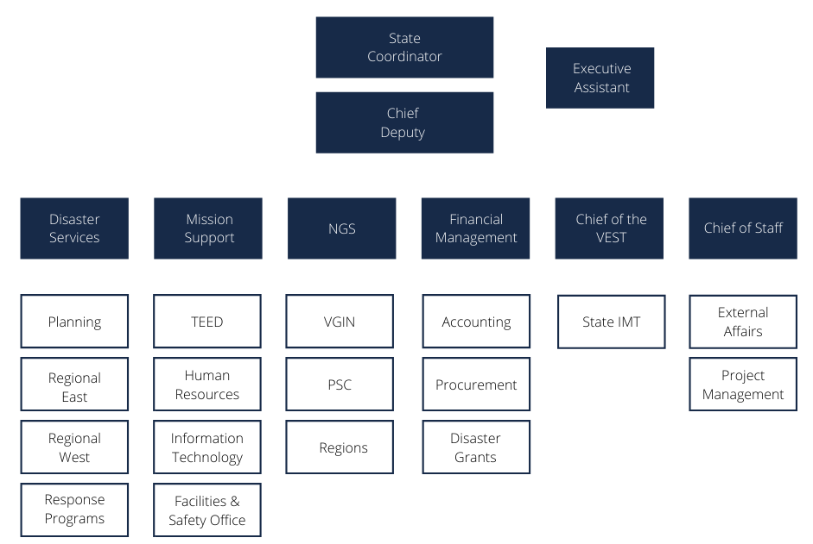

Slide 6
VDEM Disaster Services - John Northon, VDEM
Consists of Planning, Response Programs, Regional Support East, and Regional Support West
Search and Rescue
Hazardous Materials
Provide support to local partners

Slide 7
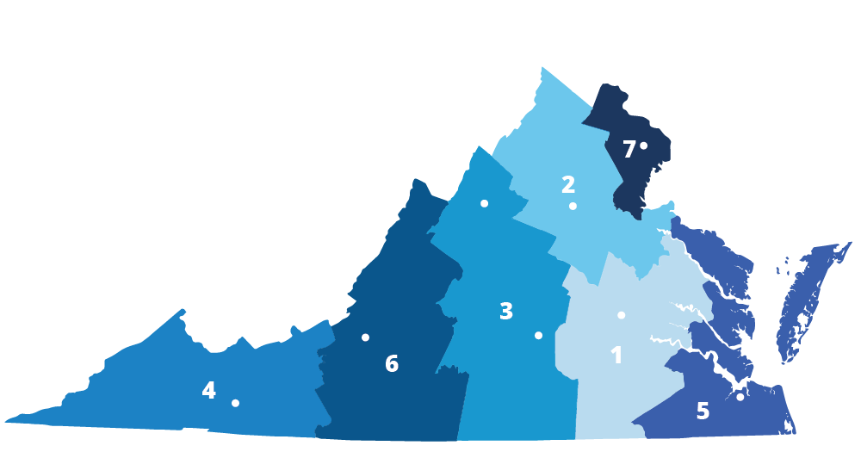
VDEM Regions

Slide 8
Operational Awareness and Tips - John Northon, VDEM
Localities using WebEOC to place resources and supply request prior to event
Having staff trained and using Crisis Track software
Know your neighboring jurisdictions resources and have MOU’s in place
Understand your local evacuation clearance times to allow adequate time for residents to evacuate
Inland regions need to be aware of inland flooding with tropical systems

Slide 9
Planning Assumptions – John Northon, VDEM
Personnel limitations are likely
Resource limitations likely (in-state mutual aid & EMAC)
Health protection measures add complexity and cost
Economic impact of COVID-19 will increase dependence on government services
Traditional sheltering strategies not preferred
Coordination with public health is essential at every level of response
Partnership with local businesses may help fill gap
Many aspects of response and recovery will be virtual

Slide 10
Sheltering Considerations in the COVID Environment – Michelle Pope, VDSS
State Health Commissioner issued Order of Public Health Emergency
Directs non-congregate sheltering of populations temporarily displaced due to evacuation orders
Where non-congregate sheltering is not possible, congregate emergency shelters may operate and shall adhere to social distancing recommendations, enhanced sanitizing practices on common surfaces, and other appropriate guidance

Slide 11
Sheltering Considerations in the COVID Environment – Michelle Pope, VDSS
The CDC has indicated that the highly infectious nature of COVID-19 coupled with “the potential for pre-symptomatic transmission underscores the importance of social distancing, including the avoidance of congregate settings, to reduce COVID-19 spread.”
The use of non-congregate evacuation sheltering is preferred because it, unlike congregate evacuation sheltering, sufficiently separates individuals from both the imminent hazard and the COVID-19 virus.
Due to COVID-19, FEMA has pre-approved reimbursement for non-congregate sheltering for populations seeking emergency shelter in the Commonwealth of Virginia under Public Assistance (PA) Category B – Emergency Protective Measures.

Slide 12
Sheltering Considerations in the COVID Environment – Michelle Pope, VDSS
VDSS, DGS, and VDEM are actively working to establish contracts to support non-congregate sheltering during the 2020 hurricane season.
We recognize that in the event of a catastrophic event, congregate sheltering may be necessary. Shelter capacity (space) and capability (staff, services, supplies) for such a large-scale or catastrophic event in the Commonwealth is an ongoing concern. As such, VDSS is working to adapt the existing State Coordinated Regional Shelter Plan and its supporting procedures to ensure they meet federal and state health guidance and restrictions such as physical distancing and the use of personal protective equipment.
VDSS is actively coordinating with VDEM and VDH to ensure state coordinated regional shelter planning will meet the needs of the Commonwealth and minimize the impacts that COVID-19 might have on sheltering operations

Slide 13
Virginia Emergency Support Team – Michelle Oblinsky, VDEM
Central organization that coordinates disaster collaboration for the Commonwealth
Led by VDEM personnel
Comprised of over 40 state agencies and 250 people
Commonwealth of Virginia Incident Management Team
Voluntary Agency Liaison
Training for state agencies
EO 41 – involvement of all state agencies and employees in disaster response
Private sector engagement

Slide 14
Diversity, Equity, and Inclusion Efforts – Dr. Lauren Powell, HEWG
Working Groups
-Health Equity Task Force
-Health Equity Working Group
-Access and Functional Needs Working Group
-Overarching Communications Working Group
Targeted DEI social media/TV/radio messaging
DEI review of 2020 Hurricane Guide in the COVID-19 environment

Slide 15
Public Communications Efforts – Lauren Opett, VDEM
ASL interpreter for all press conferences
ASL translation of all Executive Orders
Translation of Executive Orders and guidance into top 6 languages
Spanish, Korean, Mandarin, Arabic, Vietnamese, Tagalog
Live Spanish translation of Governor's press conferences hosted on VDEM Facebook page
Accessibility review of state digital properties supporting COVID-19 response

Slide 16
Public Communications Efforts – Lauren Opett, VDEM
PIO meetings before, during, and after disasters
Sharing of graphics, example here: https://www.vaemergency.gov/hurricanes/storm-season-graphics/
Want to develop more robust PIO list across the Commonwealth
Need to build relationships early and often
Partners in preparedness
Partnering with non-profit organizations to reach and support vulnerable populations
Allows residents to receive information from sources they trust in their communities

Slide 17
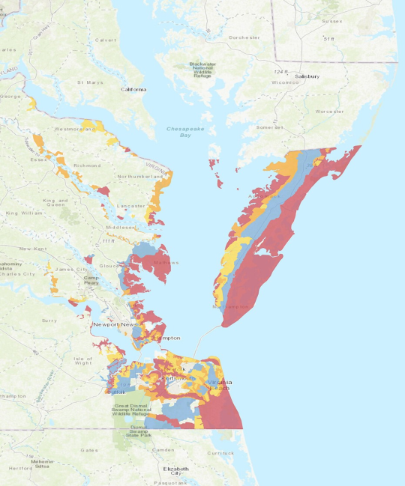
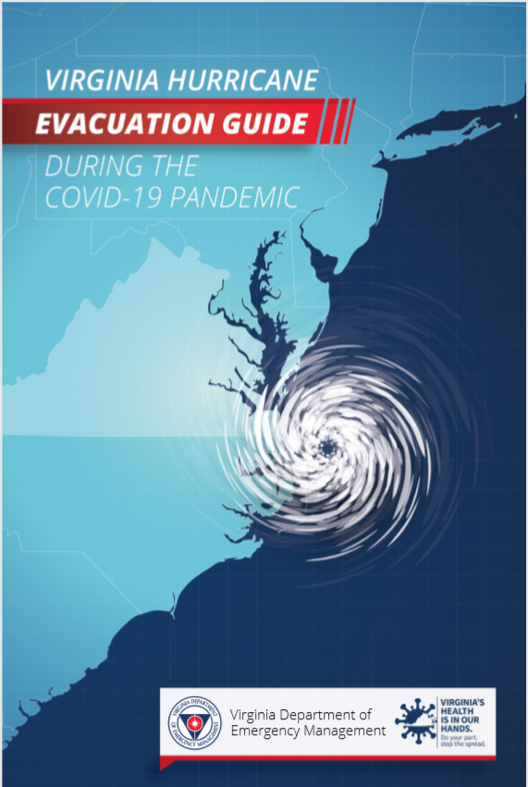
Know Your Zone (KYZ) and Hurricane Guide During COVID-19 Pandemic
Know Your Zone is an awareness initiative that applies to roughly 1.25 million residents in 23 localities along Coastal Virginia, the region of the state most vulnerable to hurricanes and other tropical storms

Slide 18
Virginia Sales Tax Holiday August 7-9, 2020
Eligible Items: https://www.tax.virginia.gov/virginia-sales-tax-holiday
Hurricane and emergency preparedness products
Portable generators - $1,000 or less per item
Gas-powered chainsaws - $350 or less per item
Chainsaw accessories - $60 or less per item
Other specified hurricane preparedness items - $60 or less per item
School supplies, clothing, and footwear
Qualified school supplies - $20 or less per item
Qualified clothing and footwear - $100 or less per item
Energy Star™ and WaterSense™​ products
Qualifying Energy Star™ or WaterSense™ products purchased for noncommercial home or personal use - $2,500 or less per item

