Slide 1
Economic development update to vml
July 30, 2020

Slide 2
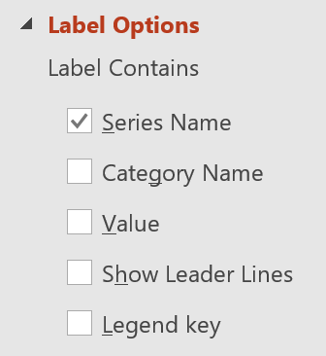
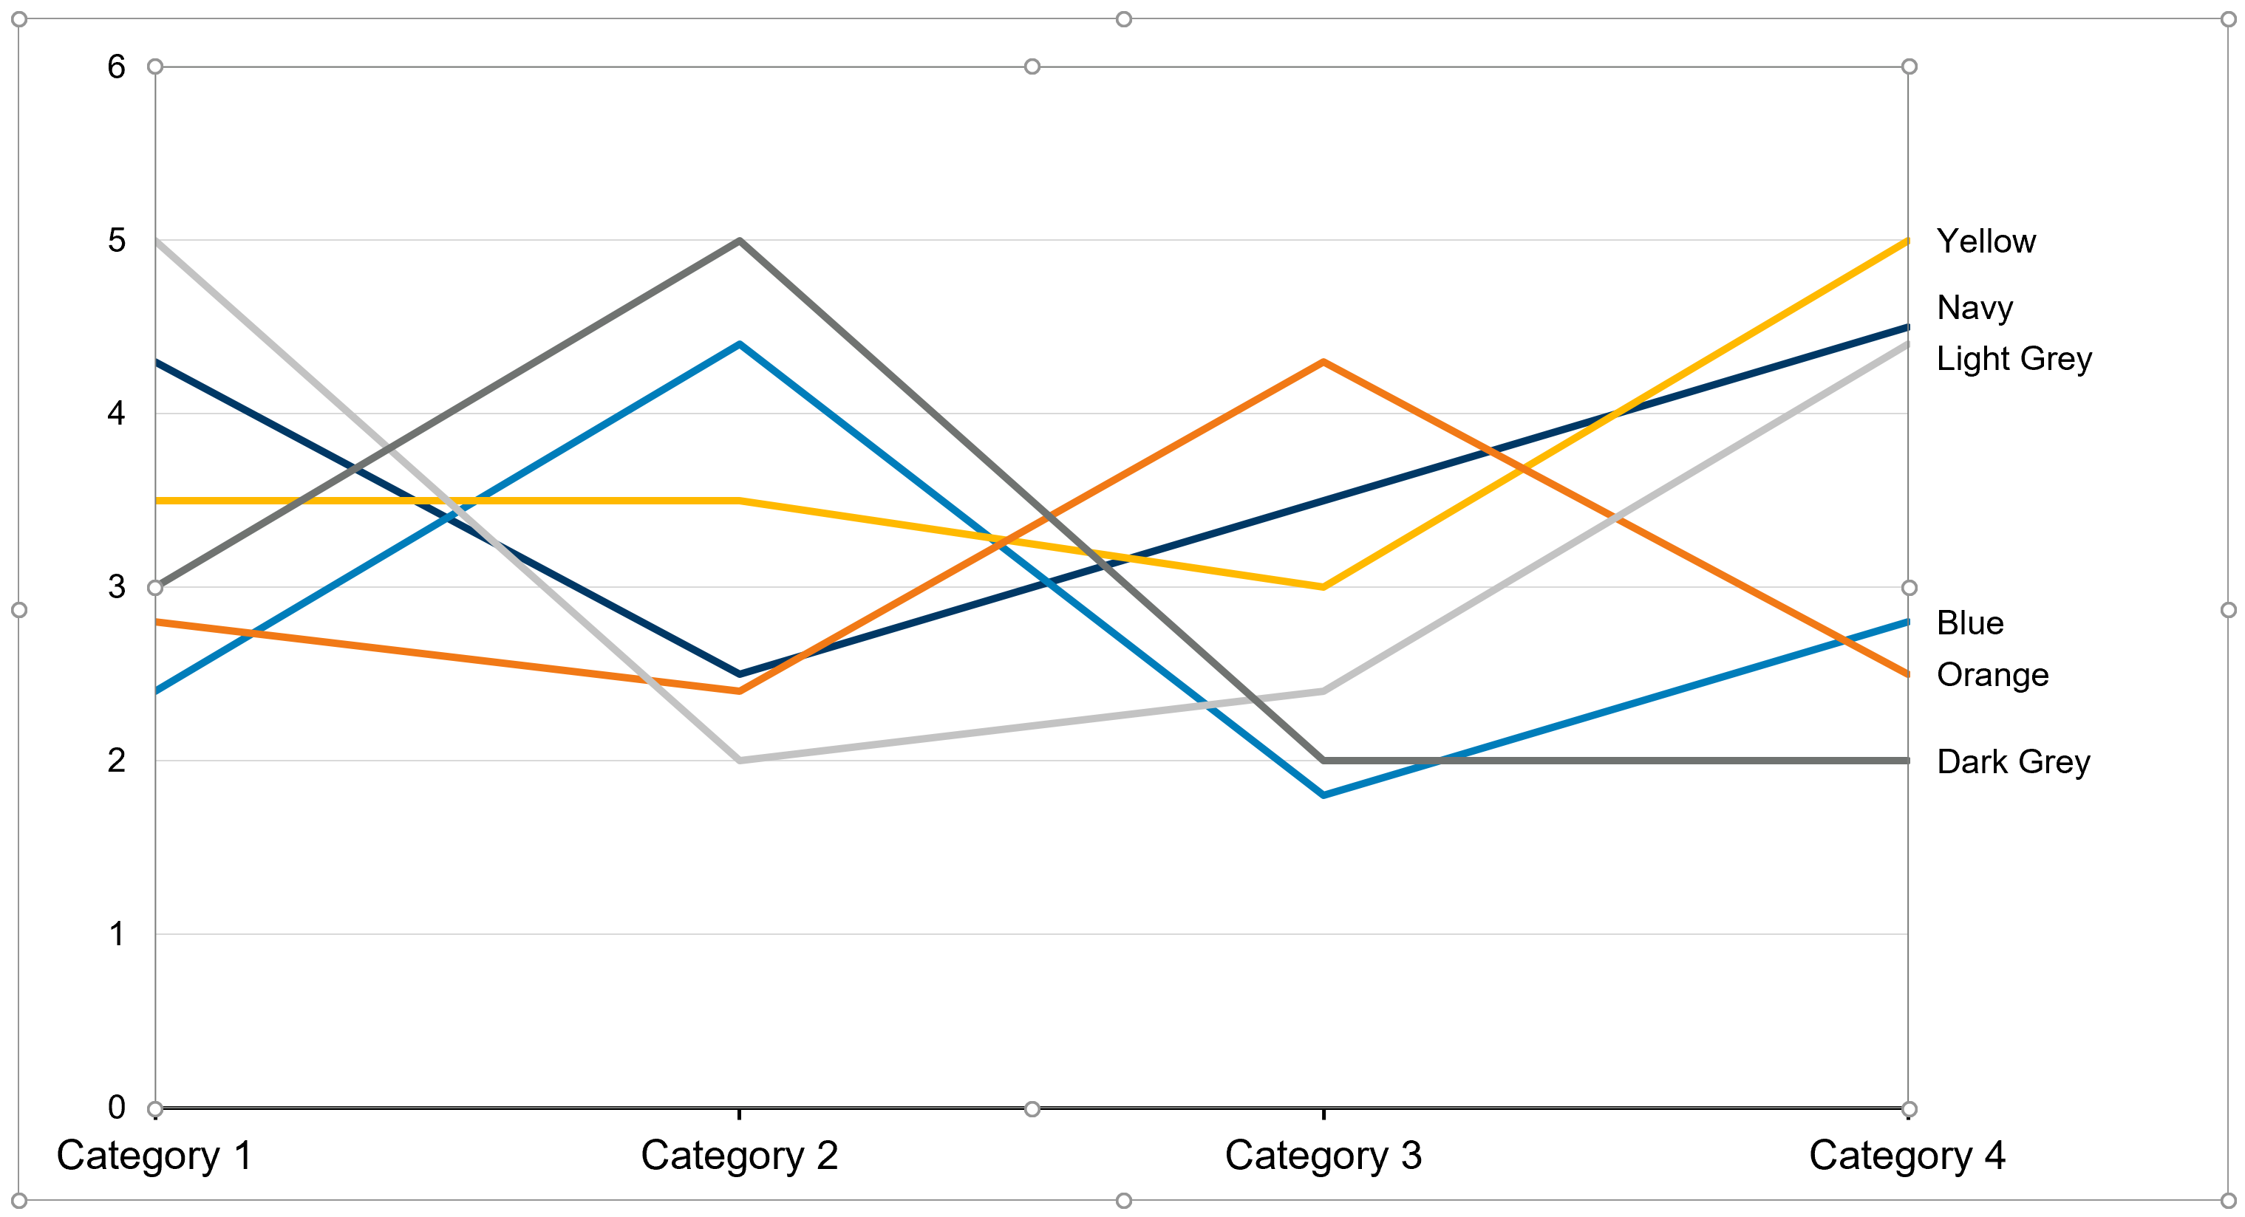
Unprecedented economic impact of covid-19 could leave many Virginians out of work for several years
HOW TO USE THIS SAMPLE CHART
1
Copy this slide into your presentation.
2
Update the sample data in Excel.
Click on the sample chart.
Click ‘Edit Data’ in the Chart Design tab.
Replace the sample data.
Impact of COVID-19 on employment forecast in Virginia
Actual and projected monthly nonagricultural employment (in thousands)
3
Remove any series you don’t need.
Adjust the data area in the Excel window to remove extra data series and legend entries from the chart.
2019 actuals 4,060K jobs
Jobs deficit w/o further action
ALTERNATE LEGEND STYLE: Replace legend with series labels
Follow these steps to add the series name to the last data point of each line:
1
Click twice on the last data point on the line.
Note: Clicking just once will select all the data points in the series—we only want the last point.
2
Right-click on the selected data point and choose “Add Data Label”
3
Click twice on the data label to select it.
Note: One click selects all labels for the series (and has 4 blue handles), while the second click selects only that label (and has 8 white handles).
1 Click
2 Clicks
4
Right-click on the selected label and choose “Format Data Label…”
5
In the Label Options panel that opens, change the label contents to include the series name, and remove the value.
Source: Moody’s Analytics (November 2019, July 2020 forecasts); VEDP analysis
6
Repeat this process for the last data point of each series.
7
Delete the legend box and (if needed) reposition the chart area to ensure the new labels have enough space to display.
TIP: Re-apply chart style
In case of error, return legend entries, data labels, and/or chart formatting by applying the matching VEDP chart style template.
Right-click the chart and choose “Change Chart Type”
Then choose the matching VEDP chart style from the ‘Templates’ category.
TIP: The chart style template names match the slide titles of the chart sample slides.

Slide 3
The Commonwealth’s Strategic Economic opportunities for the future is designed around four big opportunities
 | Capture manufacturing reshoring and new supply chain opportunities Industry analysis and surveys indicate a significant share of manufacturers will likely bring production and sourcing back to the United States in response to the COVID-19 pandemic Additionally, as businesses around the world reconfigure their global supply chains and increase resiliency, many new opportunities will emerge for Virginia exporters Virginia can capture these job-creation opportunities by investing in targeted business investment, international trade, and related support activities
 | Accelerate Digital Virginia (cloud computing, software, data centers) The COVID-19 pandemic has accelerated the transition towards a digital economy for businesses and consumers around the world As an established U.S. tech leader, Virginia is well positioned to capitalize on these opportunities in software development, cloud computing, data centers, and other technologies Virginia can capture a larger share of this post-COVID tech wave by complementing existing efforts (e.g., TTIP) with targeted enhancements in our incentive programs, tax policy, and broadband infrastructure
 | Seize telework transition opportunities, with special focus on rural and small metro regions With the widespread shift to telework during the pandemic, industry experts and business leaders are signaling that telework will become the (permanent) new normal for a much larger share of workers Virginia can capture these talented professionals (and the tax revenue they generate) by deploying creative incentive and marketing approaches that focus on both businesses and individuals that telework
 | Retool and reskill Virginia's (unemployed) workforce for post-COVID career opportunities Low-skill workers, women, and racial minorities were disproportionately impacted by the economic shock resulting from COVID-19, and likely will make up a significant share of the long-term unemployed in the absence of targeted efforts In addition to new job creation opportunities for the Commonwealth, we have an opportunity to connect displaced workers with higher-wage employment opportunities through workforce initiatives such as “Get Skilled, Get a Job, Give Back” (G3), Virginia Talent Accelerator Program, Virginia Jobs Investment Program (VJIP), and targeted investments in sub-baccalaureate fields
Impact
Secures roughly 10,000 new direct jobs each year (~20,000 total jobs per year)
Generates roughly $50-75 million per year in additional state general fund revenue

Slide 4
Budget update
Virginia State Flag

Slide 5
VEDP OPERATIONAL BUDGET initiatives
Initiative | Impact comment | Additional investment ($M) |  | Funding status in Biennium Budget
 |  | FY21 | FY22 | Allotted | Unallotted | Not incl.
Expansion of the Virginia Talent Accelerator Program | Expansion of program enables projects to be completed in every region of VA. Program will be ranked in the top 3-5 states in the country within 3 years. VA will secure projects with 1,500-2,500 additional rural/small metro jobs/year by 2021. | 0.0 | 4.7
Majority restoration of the Virginia Jobs Investment Program | The VJIP program is VA’s most commonly used economic development incentive program, providing grant funding for workforce training needs for new and expansion projects in Virginia. | 2.0 | 2.0
Expansion of Virginia Business-Ready Sites Program | This initiative addresses one of the most common reasons Virginia loses projects (often no. 1). The program is structured to build a portfolio of project-ready sites in every region of the Commonwealth, specifically to fill the lack of industrial sites over 100 contiguous acres. | 12.5 | 0.0
Trade development initiatives in new VA International Trade Plan | Proposal envisions a four-year implementation (FY21-FY24) of the VEDP trade development services initiatives included in the Governor’s international trade plan. Virginia will increase export activity ($200MM or more annually), diversify our economy, and modestly increase well-compensated jobs. | 1.3 | 2.3

Slide 6
Other initiatives
Virginia State Capitol

Slide 7
Local government resources
Current initiatives
Virginia Economic Review
Quarterly Partner Report
Local and Regional Competitiveness Initiative
impactED sessions with VEDA
ED 101 session geared toward Chief Administrative Officers
Virtual VEDP Orientation

