Slide 1
VEC Unemployment Benefits Update for Virginia Municipal League
July 17, 2020
Presented by:
Jason Padgett

Slide 2
Overview of Unemployment Benefit Programs
Benefit Type | Purpose | Duration | Additional Info
UI: Virginia Unemployment Insurance | Benefits ranging from $60 to $378 per week. Determined by wages earned during the applicable base period. | Varies from 12 to 26 weeks. | 1-week waiting period and weekly job search requirements are currently suspended for those receiving UI.
PUA: Pandemic Unemployment Assistance | Provides a UI type benefit payment for individuals who are not eligible for traditional UI where the individual cannot work for a COVID-19 related reason. Benefits start at $158 and will be adjusted based on earnings at a later date. | Available from January 27, 2020 through December 26, 2020. Lasts 39 weeks, including any week of UI already received. Program started April 10 | Excludes individuals who can telework or are receiving paid sick leave or receiving regular UI benefits.
FPUC: Federal Pandemic Unemployment Compensation | Adds $600 to all UI, PUA and PEUC benefit payment for which an individual qualifies. | Ends July 25, 2020. Program started April 19 | Must receive at least $1 in state or federal benefits.
PEUC: Pandemic Emergency Unemployment Compensation | Extends the length of UI by up to 13 weeks. | Program started July 2. Payments began week of July 6. Extension is available through December 26, 2020. | Individuals must have exhausted all other UI benefits.

Slide 3
VEC Update for week ending July 11
 | 2019 | Current
VEC Unemployment Claims | 11,000/month | Over 300,000/month 970,000+ since March 15
VEC Staff | 432 | 700+ as of July 15
Overtime Hours for UI | Less than 1,000 hours/month | Over 13,000+ hours/month
VEC Call Center Employees | 82 | 450 (and growing)
Benefit Claims Paid | Less than $25 million per month | $6.2 Billion since Mar.15
Administrative Hearings | 59,000+ conducted in 2019 | 60,000+ currently pending as of July 15
Notes:
Need statistics

Slide 4
Status on Payments & Claims – Week ending July 11
More than $6.2 Billion in benefits have been paid since March 15
1,002,516 initial claims filed since January 2020. This exceeds all claims collected from mid 2014 – thru 2019, more than 5.5 years
970,851 claims filed since March 15, 2020
32,292 initial claims filed last week, an increase of 467
372,070 continued claims, a decline of 6,537 from the prior week
75 percent: The percentage of all unemployment benefits claims resulting in payment by VEC during the pandemic
42 percent: The previous all-time high percentage of unemployment benefits claims resulting in payment by VEC (Great Recession, 2007-2009)
91 percent: The percentage of monetarily eligible claims resulting in payment within 14 days
60,000+ flagged pending determinations or administrative hearings

Slide 5
Pandemic Emergency Unemployment Compensation (PEUC)
Extends the length of Unemployment Insurance up to 13 weeks as a result of the federal CARES Act. Payments are retroactive to qualifying applicants dating to the week ending April 4, 2020.
Your PEUC weekly benefit amount is the same as your regular UI weekly benefit rate.
The federal pandemic unemployment compensation (FPUC) program will automatically add an additional $600 to the weekly benefit amount under the PEUC claim until FPUC payments expire on the week ending on July 25, 2020.
PEUC applies to claims by individuals whose benefit year ended on July 6, 2019, or after.
PEUC benefits are taxable, like regular UI and FPUC payments.

Slide 6
PEUC Application Portal
In late June, VEC issued text and voice messages to more than 41,000 individuals identified as potentially eligible for benefits under the PEUC program.
Application portal launched on July 2, 2020, ahead of California, Pennsylvania, Florida and several other states.
As of July 15, VEC has processed more than 18,000 applications for PEUC and paid $18.2 million.
Payments are retroactive to the week ending April 4, 2020 or the first week after an individual has exhausted his or her regular UI.
PEUC benefits are available through the week ending on December 26, 2020.

Slide 7
Review Process for Applications/Hearings
Approximately 60,000 applications have been flagged, resulting in an initial delay of benefits to applicants.
VEC must adhere to state and federal laws governing eligibility, applications and distribution of benefits. When an application is flagged:
A VEC deputy/hearing officer will review facts and statements from the applicant and previous employer before rendering a decision. The applicant is notified by mail of the decision. VEC has quadrupled reviews, VEC has increased decisions from 1,600 per week in June to 5,000 per week in July, with 10,000 per week targeted.
The applicant may appeal the decision online or by mail.
If an applicant is denied and doesn’t want to appeal, they may be eligible to apply for Pandemic Unemployment Assistance (PUA) provided through the federal CARES Act.
If appealed, the case will get a new hearing with an appeals examiner (outside of the Unemployment Insurance division). Currently, 4,000 applications are at this level.
If the original decision is upheld and benefits remain denied, the applicant may appeal to the agency’s highest level, the Commission Appeal, which is staffed by administrative law judges. Currently, 500 applications are at this level.
If the decision is upheld and benefits remain denied, the applicant may appeal to Circuit Court.

Slide 8
Our goal is to help every single customer
We understand the interest in immediate constituent response. VEC’s focus is on attacking these challenges we face with unprecedented claim volume amid the pandemic. Attacking the problem and not the symptoms will get us all to where we need to be.
This means focusing staff on processing claims and getting customers a final decision as quickly as possible.
We have a dedicated team working long hours and days to respond to every single inquiry from your offices, overwhelming numbers many of which are repeat inquiries.
We have also added significant resources to VEC call centers and have seen significant improvement in call throughput, to include some customers connecting to an agent multiple times in a single day. Which indicates that people are getting through.
Our call centers are equipped with staff to resolve many issues over the phone in addition to providing updates on claims.
Our goal is to continue building out VEC’s outdated infrastructure and capacity in order to directly engage with every customer instead of managing the multi-person labor intensive process of handling these through constituent inquiries. With over 1 million claims this year, we recognize even a small percentage of inquiries is overwhelming, but our goal is to build capacity so that these types of inquiries are more rare and by exception only.

Slide 9
Top Reasons Why Benefits Are Denied or Delayed – and Require Review
Not everyone qualifies for benefits. Multiple factors determine whether a person is eligible and/or if additional review is needed before a claim is approved.
Failure to file a weekly certification can result in delay or denial of benefits.
If a former employer reported an applicant was fired for misconduct, or if the applicant took a leave of absence or quit without good cause, benefits may be delayed or denied.
If an applicant reported wages that were equal to or exceeded the weekly benefit amount, benefits may be delayed or denied.
If an applicant filed an incorrect Social Security number or provided incorrect banking information, benefits may be delayed or denied.
If an applicant previously has been disqualified during his or her current benefit year, benefits may be delayed or denied.
Those who are called back to work by their employer generally must go back to work, or their benefits may be delayed or denied.

Slide 10
Communications with Claimants since Pandemic
Additional Call Center Expansion
RFP is out and expected to award contract for additional support soon
Call Center Update
Increase in employees from 82 to over 450 and growing
Total call volume in 2019: 521,756
Jan. 1, 2020 – July 15, 2020: 660,000+ calls
Answered 28,000 a week in April, Now answering over 60,000 a week
148,00 Emails answered by Customer Service
6,744 total emails total in 2019
332,478 Automated Calls completed
April – 177,794
May – 25,627
June 129,057
July – N/A
Over 6 Million Text messages sent (6,343,310) - 90% open rate
April - 2,874,708
May – 547,975
June – 2,920,627
July – N/A
4.4 Million Direct Mail pieces sent since March 15
These include: Monetary determination letters, PIN letters, Separation reports and decisions.

Slide 11
Our Ongoing Challenges:
Administrative Hearings & Determinations – 60,000 applications with issues flagged for review.
6-8 week backlog, but VEC has increased decisions from 1,600 per week in June to 5,000 per week in July, with 10,000 per week targeted.
Returning to Work – 15,000+ refusals – individuals not going back to the jobs they had previously and benefits have stopped.
Fraud –Working with federal and state partners to combat fraud.
PIN Issues – Letters with updated PIN or new PIN information were mailed in late June/early July, effective July 11 for additional security measure.
FPUC - $600 Additional Benefit ENDS! – The additional $600 will end July 25 unless Congress acts. A communication will be made to that universe of claimants.
PUA Update – claimants are not able to upload salary history yet. PUA document upload functionality is in work, claimants will be notified through the Gov2go website by email or app notifications.

Slide 12
Additional Resources
How to report Fraud: visit https://www.vec.virginia.gov/unemployed/fraud
Statewide Virtual Job Hiring Event on July 28th– Employers and workers can participate in a virtual hiring event. This event is focused on companies wanting to hire directly. Please share this information on your social media platforms.

Slide 13
Unemployment Insurance Tax Background
There are three components that make up Virginia's unemployment insurance tax:
The first is the base tax rate which is experience rated and unique to each employer depending on their individual loss history.
The second is the pool charge, which is the socialization across all covered employers of all benefit charges that cannot be charged to individual employers.
The final component is the fund builder, which is imposed on all covered employers when the trust fund balance factor defined in Code Section 60.2-533 falls to or below 50%. The fund builder assessment is an additional 2%. Employers also pay federal unemployment tax of $420 per employee.
Because Virginia's unemployment laws conform to federal law, Virginia employers receive a 90% reduction in their federal unemployment tax. If Virginia borrows from the federal government and does not repay within the terms set by the federal government, the Commonwealth could be considered out of conformity and our employers would lose this reduction.

Slide 14
Unemployment Insurance Tax Forecasts
Below are the forecasts for average Virginia unemployment tax rates under low end and high end scenarios.
These projections are based on certain modeling assumptions that may change given the fluid nature of the COVID-19 crisis circumstances.
These are average rates and individual employers' rates will vary, but could reach as much as $550 per employee, for employers that become rated at the maximum of 6.20%.
For context, the average tax rate paid by Virginia employers in 2020 is 0.87% which equates to $69.92 per employee. There is currently no fund builder tax imposed and the pool charge is so small that it does not impact employers taxes.
Low End | Fund Builder |  | POOL |  | AVG Tax |  | Tax Per Emp
2021 | 0.20% | $ 16.00 | 0.531% | $42.45 | 1.78% | $142.11 | $200.56
2022 | 0.20% | $ 16.00 | 0.534% | $42.73 | 1.70% | $136.38 | $195.11
2023 | 0.20% | $ 16.00 | 0.526% | $42.10 | 1.48% | $118.58 | $176.68
High End | Fund Builder |  | POOL |  | AVG Tax |  | Tax Per Emp
2021 | 0.20% | $ 16.00 | 0.531% | $42.45 | 2.22% | $177.60 | $236.05
2022 | 0.20% | $ 16.00 | 0.534% | $42.73 | 2.35% | $187.60 | $246.33
2023 | 0.20% | $ 16.00 | 0.526% | $42.10 | 2.34% | $187.40 | $245.50

Slide 15
VEC Trust Fund Expenditures and Balance*
*Projections, Does not include PUA
Millions
2020 Q1
2020 Q2
2020 Q3
2020 Q4

Slide 16
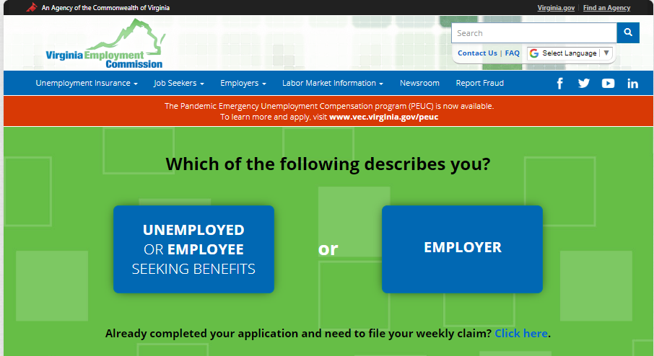
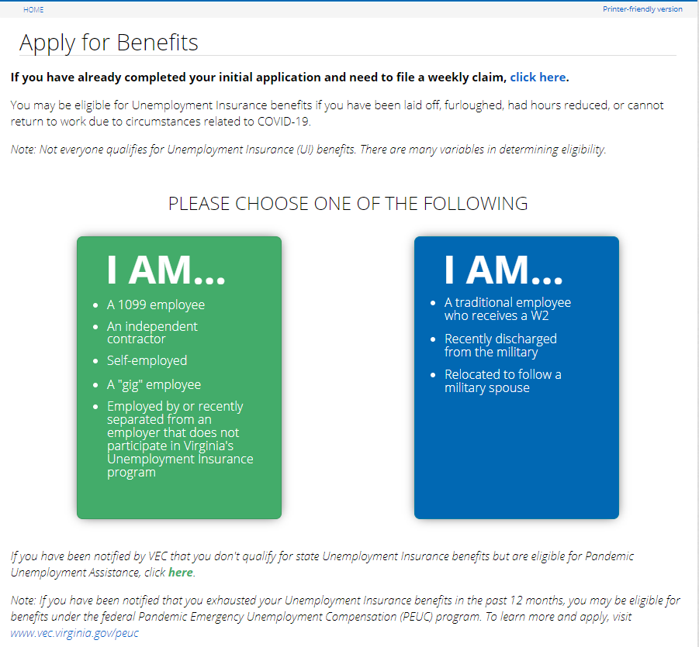
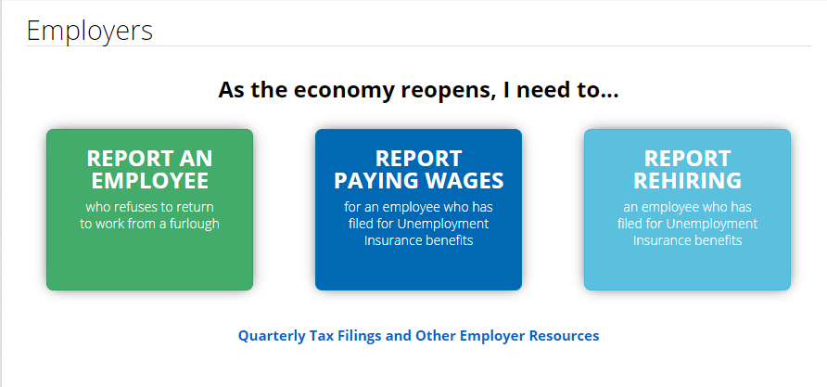
Updated VEC Website is Now Live!

Slide 17
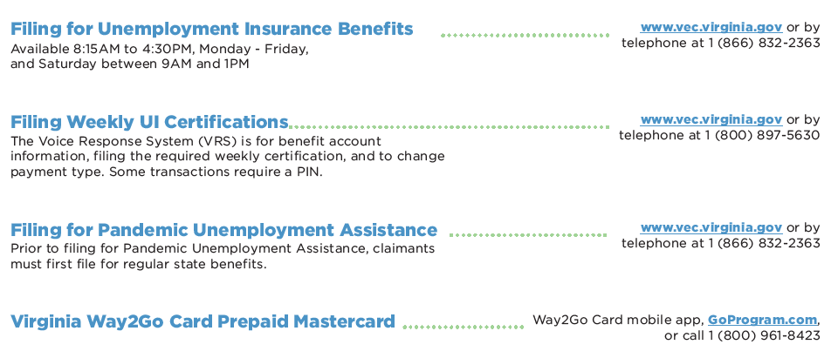
Quick Reference Guide
For information about fraud, including how to report it, visit https://www.vec.virginia.gov/unemployed/fraud.
VEC staff at Virginia Career Work Centers across the state can help people get a new PIN letter, provide status of a claim, change an address and answer general questions. Office addresses, hours, phone numbers and email addresses can be found at vec.virginia.gov/find-a-job/vec-local-offices.

Slide 18
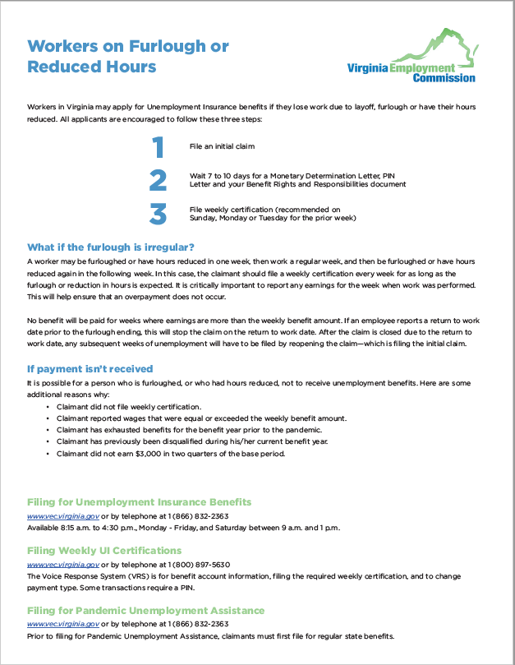
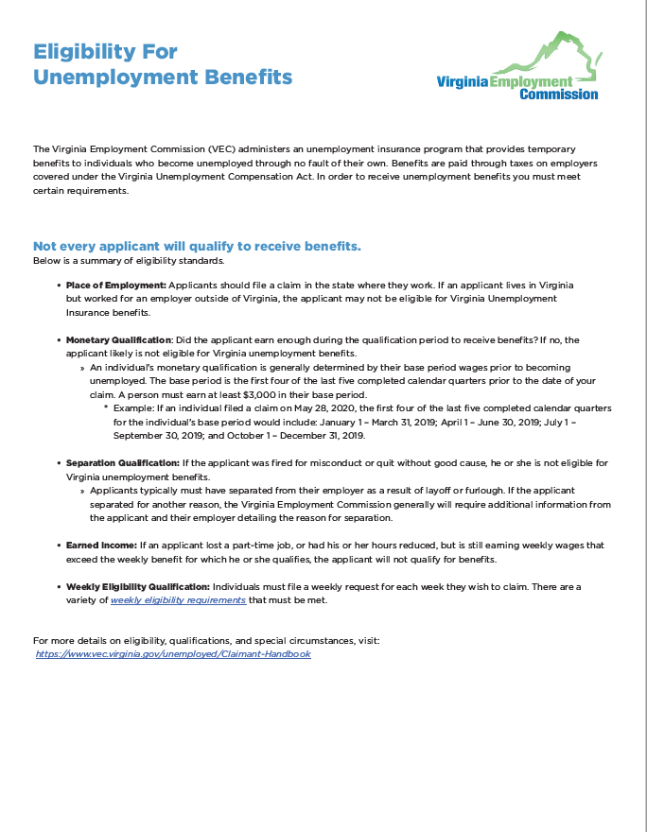
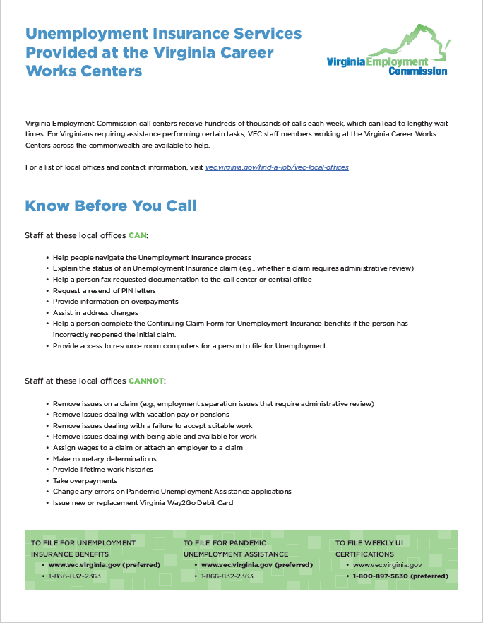
VEC will continue to provide materials and updates

Slide 19
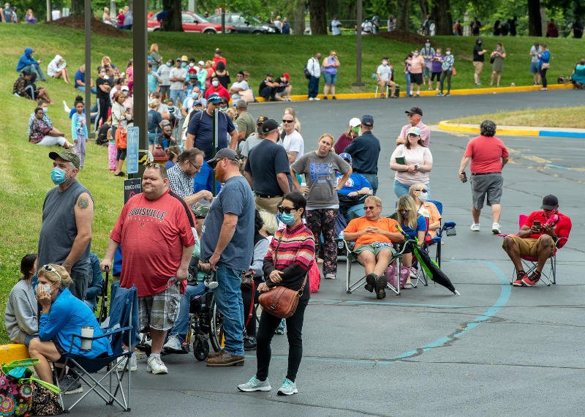
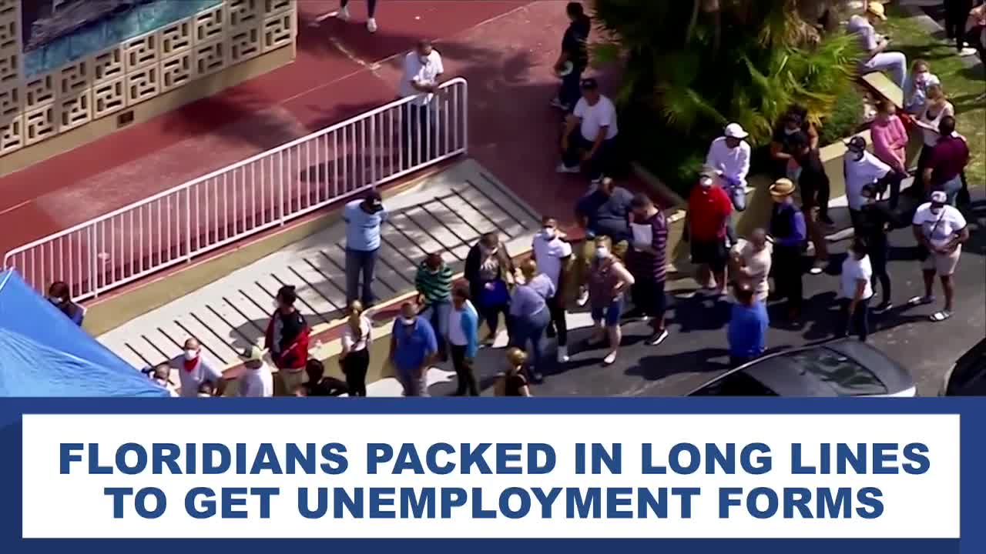
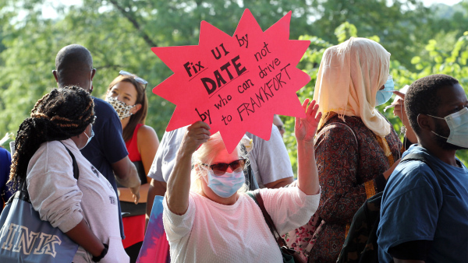
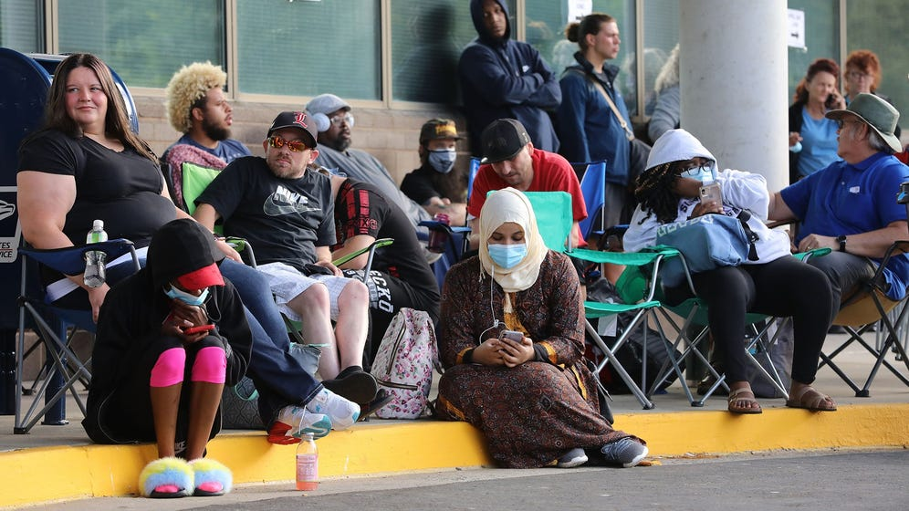
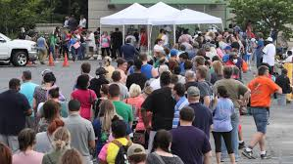
Over $6.2 Billion in benefits distributed without Virginians having these experiences – 127 days since March 15

