Slide 1
HEALTH CARE
VIRGINIA
COVID-19 MODELS
Carter C. Price, Ph.D. April 21, 2020

Slide 2
Background
The various models forecasting the spread of COVID-19 are being updated frequently and new models have recently been released
Results are changing in response to new data and analysis including on the efficacy of initial policy responses
Most modeling is indicating that Virginia is at or near the peak hospitalization levels
Focus is shifting from estimating the peak to the relaxing of physical distancing
The results will be highly sensitive to the policies and behavioral responses
The various models have different strengths and weaknesses
The initial data were biased because too few people were getting tested
Some of the models were highly volatile because of the lack of data

Slide 3
What constitutes a suitable model?
We won’t know how accurate a model is until after the fact
Models should behave in explainable ways
Policy changes should produce results that move in the direction we expect
The magnitude of the response to these changes should be based on data and analysis
Resource constraints are real but there is an asymmetric risk with modeling COVID-19
One too many ICU beds or ventilators costs a few thousand dollars; one too few costs lives
Assumptions and biases should reflect this concern

Slide 4
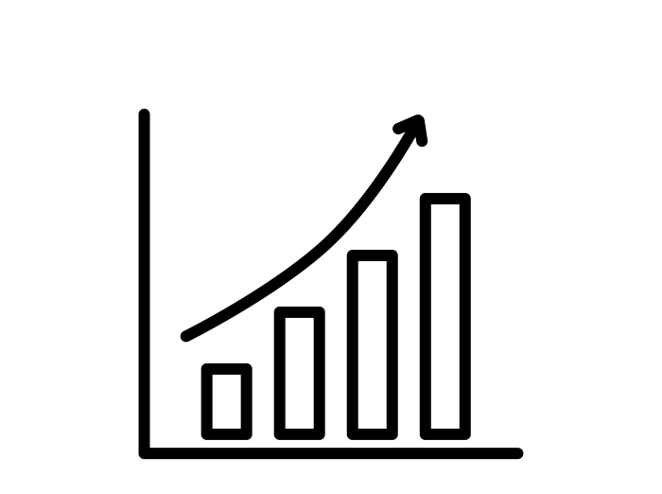
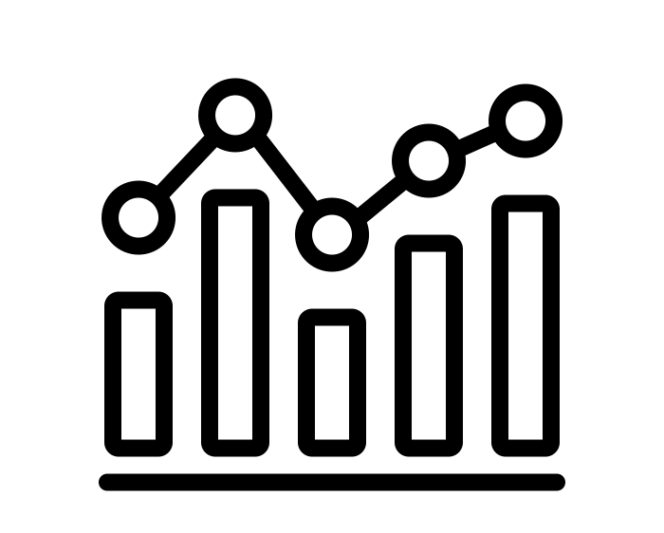
Models fell into two types
Statistical Models
Systems Dynamics Models
Projections based on curves that are fitted to historic data
Include other factors as controls, such as policy responses
IHME model is of this type
Assume exponential growth in the number infected
Rely on estimates of the rate of spread
UVA model and CHIME model are based on this

Slide 5
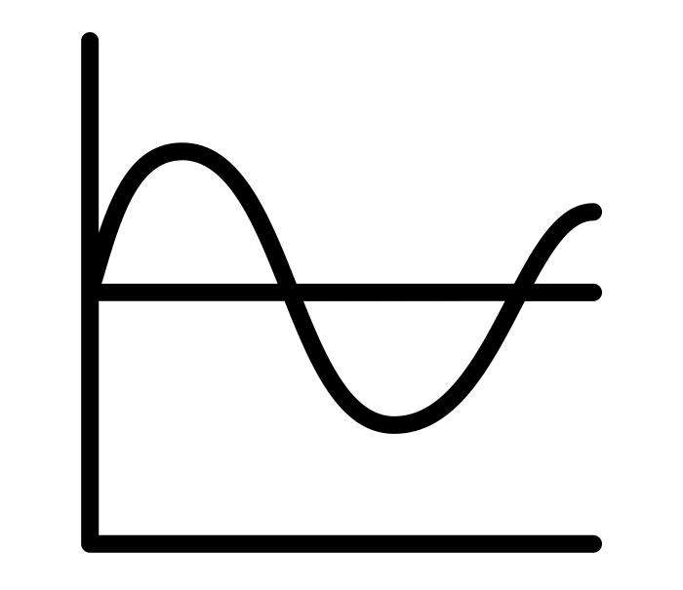
Advantages of modeling approaches
 | Systems Dynamics | Statistical | Alternative
Degree of a Threat |  |  | Surveillance
Rate of Spread |  |  | Surveillance
Extent of Spread |  |  | Experts
Timing of the Peak |  |  | Experts
Severity |  |  | Experts
 | Highly Suitable |  | Somewhat suitable
 | Suitable |  | Not Suitable
Derived from: Manheim, David, Margaret Chamberlin, Osonde A. Osoba, Raffaele Vardavas, and Melinda Moore, Improving Decision Support for Infectious Disease Prevention and Control: Aligning Models and Other Tools with Policymakers' Needs. Santa Monica, CA: RAND Corporation, 2016. https://www.rand.org/pubs/research_reports/RR1576.html.

Slide 6
Penn Medicine’s CHIME Model
Susceptible Infected Recovered = SIR
A Systems Dynamics Model where people transition between three states
The population starts in the susceptible state, the infection spreads exponentially, and people recover (or die) at a defined rate
Hospital bed and ICU bed utilization is based on fixed ratios
Each infected person is modeled as infecting some number of people (based on the rate) on average
Conceptually, these methods reflect a realistic spread for the early to middle phase of an epidemic
Easy to implement and fast to run
policy
Because this model is simple, there are only a few ways to model policy responses
See the case of social distancing
Notes:
Source: https://penn-chime.phl.io/

Slide 7
Choices about how to model policies can drive results
hospitalization
Comparison of Modeling Choices
For CHIME, social distancing is modeled as a reduction in the number of contacts
This lowers the rate of spread
Lowering the spread flattens the curve
In practice, social distancing may be better modeled as a sequestration of a segment of the population that is no longer susceptible
This lowers the peak but doesn’t push the peak forward
Which result you should believe depends on how you think social distancing functions in practice
The best option is likely in between
No response
Reduced exposure
Sequestration
Notes:
Source: https://penn-chime.phl.io/

Slide 8
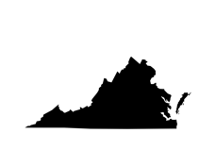
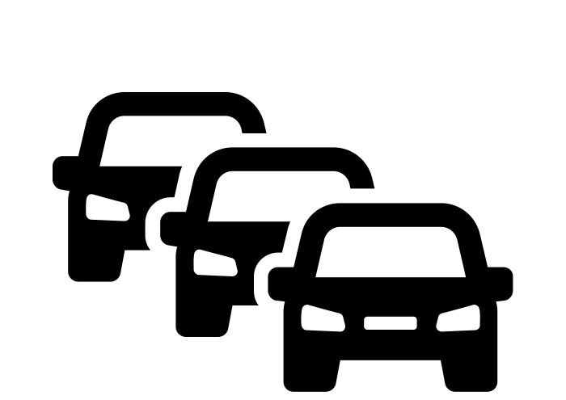
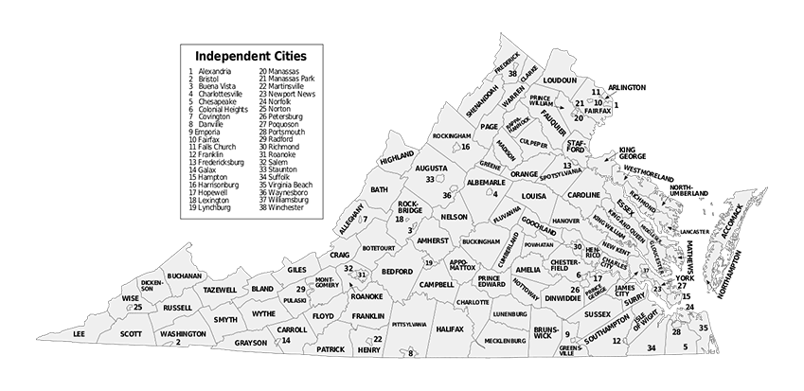
University of Virginia Model
UVA uses PatchSim to model
Spread between geographic areas is explicitly modeled using travel data
Disease dynamics inside an area are simulated with a variant of an SIR model that allows for a lag between exposure and onset of infection
The model is calibrated on actual flu spread to refine model of spread
The use of county data allows for detailed projections
Calibration means that results are better tuned to different regions
policy
The results are sensitive to choices on how to model policy changes
Notes:
Source: Email from Virginia Department of Health and https://github.com/NSSAC/PatchSim

Slide 9
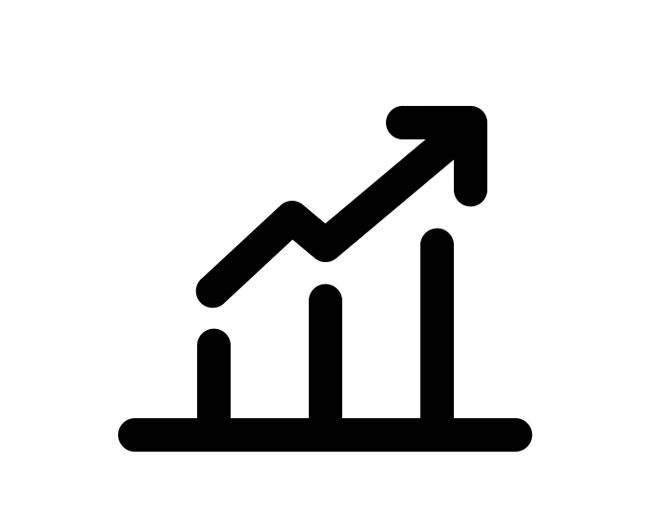
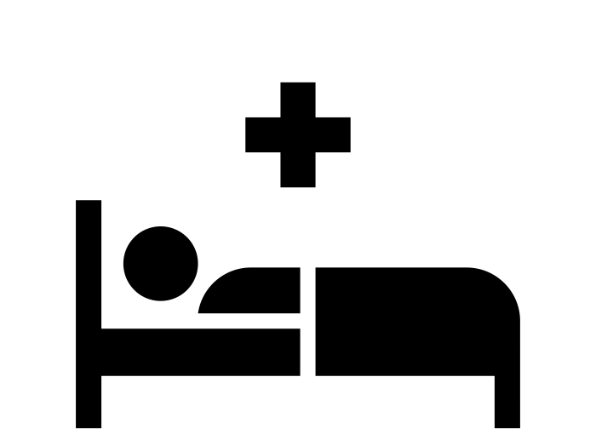
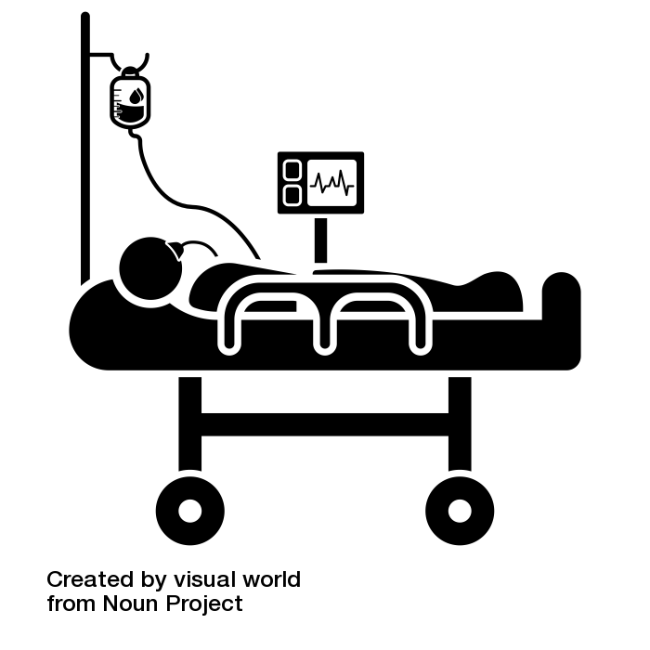
University of Washington’s IHME Model
IHME fits a statistical model for the trajectory of
confirmed COVID-19 deaths and then projects it forward
Hospitalization rates and the utilization of both ICU beds and ventilators are estimated using a simulation based on the estimated death rate
Based on data not just from Virginia, but also China, Italy, Washington State, and other areas
This is not an SIR/SEIR-model and will behave independently from those
This model provides a different perspective from the other types of models
The model is likely biased though it should improve with more and better data
Model results are not stable—the difference between the current and previous runs differ by 25% for VA
Because of the lack of testing, many COVID-19 deaths may not be confirmed, which could bias the trends
Policy interventions are treated equally (i.e., how many recommended policies does the locale implement?)
Notes:
Sources: https://covid19.healthdata.org/united-states-of-america/virginia
https://www.medrxiv.org/content/10.1101/2020.03.27.20043752v1.full.pdf

Slide 10
Ending Physical Distancing
IHME is producing estimates of when the physical distancing phase can safely end
Based on when they estimate rate is below 1 infected person per 1 million people
This number is based on a rule of thumb and they did not model the results
They are estimating that June 8th would be appropriate to end the physical distancing
Assumes there is adequate testing, a robust contact tracing, isolating for those with positive tests, and large groups ban remains
This date should be treated as preliminary and likely to change
UVA model has begun testing reopening scenarios
Initial estimates assume activity returns to 50% of previous levels
Second peak in late September or October but does not reach levels that overwhelm hospitals statewide

Slide 11
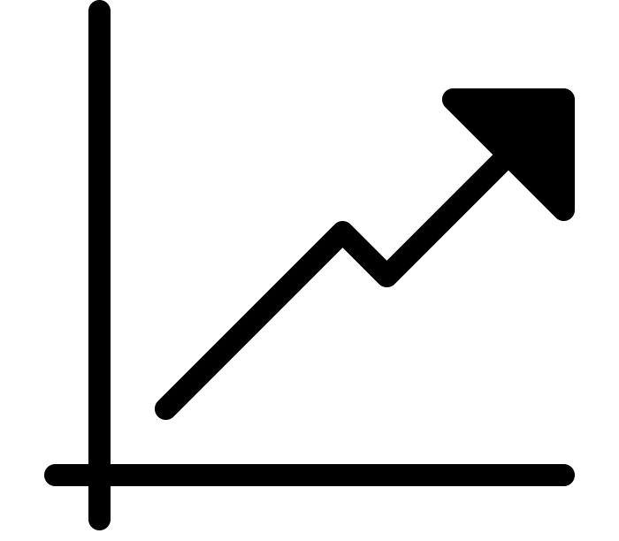
Key Takeaways
There is substantial uncertainty in these results, but the estimates have been stabilizing as more and better data have become available
Virginia is likely at or very near the peak hospitalization rate for the physical distancing phase
Statewide hospital capacity is unlikely to be reached in the near term
Initial analysis of phasing out physical distancing indicates
IHME is estimating that June 8th would be appropriate to reopen with extensive testing and follow up
This is preliminary and not grounded in deep analysis
UVA model should be used to more robustly explore this timing

Slide 12
HEALTH CARE
Questions and Discussion
Carter C. Price, Ph.D.
Senior Mathematician
price@rand.org

