Slide 2
VML Transportation Committee meeting
JULIE BROWN, DIRECTOR LAD
TODD HALACY, ASSISTANT DIVISION ADMINISTRATOR LAD
July 18, 2019

Slide 3
Today’s Agenda
Special Funding Programs
  Revenue Sharing
  Transportation Alternatives
Urban Maintenance Program
SGR/Primary Extension
Performance Reporting
Other VDOT Initiatives

Slide 4
Local Assistance Division
Revenue Sharing
Access Programs (EDA, Rec, Airport)
Transportation Set-Aside Block Grant Program (TAP)
Rural Rustic Roads
Virginia Byways
Local System (Urban/ Secondary)
Federal Lands Access Program
Coal Severance
Urban Construction Initiative (UCI)
SGR/Primary Extension
Locally Administered Projects (LAP)/
Programs
ARC Access
Compliance Assessments
LAP
High Volume Unpaved Roads
Maintenance Payments
Outreach

Slide 5
  Mid-June: CTB SYIP Approval (SGR, Rev Share, TAP, HSIP)
  7/1 CTB SYIP Funding Available when Agreement Executed
  June: Obtain SMART SCALE Resolutions of support
  August 1: SMART SCALE Final Application Deadline
  June 1: SMART SCALE Pre-application Deadline
  8/1 Portal opens for HSIP
  April: Draft SYIP released
  (SGR, Rev Share, TAP, HSIP)
  9/1: SMART SCALE
  Resolutions Due
  Spring: SSYP (Tele-fee, Unpaved Roads)
  Discussion/Prioritization
Jan – Feb – Mar – April – May – June – July – Aug – Sep – Oct – Nov – Dec
  Sept/Oct: Obtain HSIP Resolutions of support
  3/1: SMART SCALE
  Pre-Application Period Begins
  11/1 HSIP Applications Due
Jan – Feb – Mar – April – May – June – July – Aug – Sep – Oct – Nov – Dec
Even Years
  October SGR Portal Opens
  1/31: SGR Applications Due
SMART SCALE
Six Year Improvement Program
(SYIP)
Secondary Six-Year Program
(SSYP)
State of Good Repair (SGR)
Highway Safety Improvement Program (HSIP)
Revenue Sharing
Transportation Alternatives (TA)
Two-Year Funding Planning Cycle
Odd Years
  WINTER - Consideration of
  Upcoming SMART SCALE apps
  January - SMART SCALE Scores Released
  October SGR Portal Opens
  1/31: SGR Applications Due
  11/1 HSIP Applications Due (TBD)
  10/1 Rev Share, TA Applications Due
  Spring: SSYP (Tele-fee, Unpaved Roads)
  Discussion/Prioritization
  Sept: Obtain HSIP, Rev Share, TA Resolutions of Support
  April: Draft SYIP released
  8/1 Portal opens for HSIP (TBD for 2019)
  May: Portal Opens for Rev Share & TA Pre-applications
  7/1 CTB SYIP Funding Available when Agreement Executed
  Mid-June: CTB SYIP Approval (Smart Scale, HSIP, SGR)

Slide 6
Revenue Sharing Program Overview
  50/50 matching program
  Open to Counties and Cities and Towns in the Urban System
  Program allocation up to $100 million
  Projects prioritized based on Code
    Project previously received Revenue Sharing funds
    Project meets Statewide Transportation need or receipt of funding will accelerate project in locality’s capital plan
    Project addresses pavement or bridge deficiency
  Locality Limit $5M/Year-Lifetime Project Limit $10M
  Stricter Transfer Limits in Place
  Policy modifications resulting in more deallocations available statewide

Slide 7
FY 2020 Update Approved by CTB
June the Board approved the FY 20 allocations (year 2 of two year cycle)
Board reallocated funds that were deallocated this past year
The $16.9M available through deallocation allowed Board to complete funding on priority 2 projects pro-rated last year and fully fund priority 3 projects

Slide 8
Revenue Sharing Program Application Details for FY21/22
Applications submitted for two year cycle
MANDATORY Pre-application submission that closed July 1st
Total of 279 pre-applications submitted
Districts will be more involved in Application Reviews and additional emphasis this year on better estimates and scope
Localities can modify applications based on feedback received through pre-application process
Final Applications due October 1, 2019 at 5pm

Slide 9
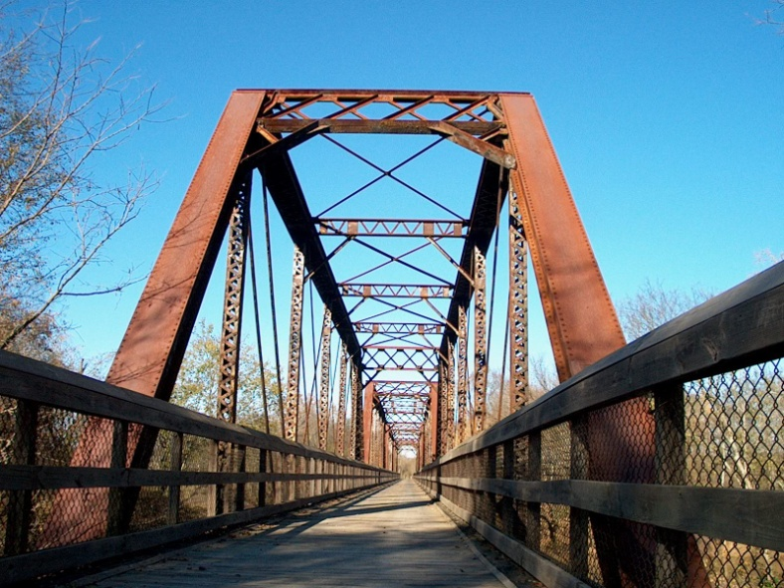
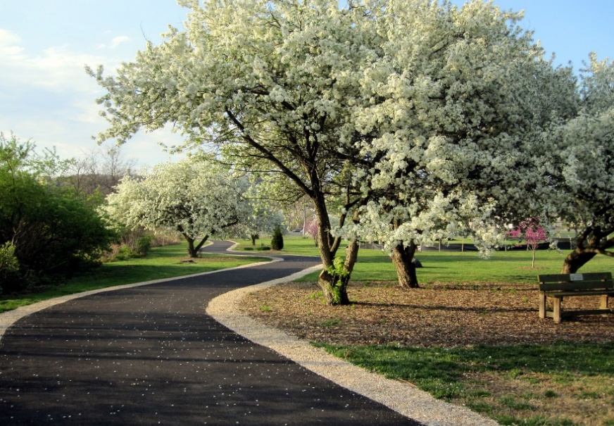
Surface Transportation Block Set-Aside Grant Program
(Transportation Alternatives)
Intended to improve non-motorized transportation, enhance the public’s travel experience, revitalize communities and improve the quality of life.
Application Deadline – October 1st every (now on a 2-year cycle)

Slide 10
Transportation Alternatives Program
Available funding includes Transportation Alternatives (TA), Safe Routes to Schools (SRTS), and a Recreational Trail Programs mandatory set-aside
Federal-aid
10 eligibility categories
The program requires a 20% local match
Donations for match acceptable (upon VDOT review and approval) and can include professional services, land value, and donated materials
These are typically locally administered projects
  VDOT is modifying process to allow for more VDOT administration

Slide 11
Transportation Alternatives Application Details for FY21/22
Applications submitted for two year cycle
MANDATORY Pre-application submission that closed July 1st
Total of 165 pre-applications submitted
Districts will be more involved in Application Reviews and additional emphasis this year on better estimates and scope
Localities can modify applications based on feedback received through pre-application process
Final Applications due October 1, 2019 at 5pm

Slide 12
FY19/20 Application Summary - TA
Allocation Distribution
MPO/TMA Areas | $12.2M
District Members | $18M ($2M per District)
At-Large Members/Secretary | $10M
Total | $40.2M

Slide 13
TAP Emphasis Areas
Project Progress and Completion
  CTB Policy for Construction within four years of allocation
  FHWA Regulation requiring advancement within 10 years (10-year Rule)
  Projects will need justification and possible FHWA concurrence to continue and avoid payback
Project Scope Creep/Modifications
  Tendency for TA Projects to Change Scope and Modify beyond original application request
  Federal Approval is based on Submitted Scope
Future Initiatives
  Improve Dashboard/Completion Rates
  Policies to improve Delivery
  Ensure Completed Projects continue to serve intended use

Slide 14
FAST Act Rescission
$7.569 Across Many Program Areas Across All States
  Reduces Unobligated Balances across Funding Categories
  “competition across states”
Outreach: November 6, 2018 Commissioner Letter to Localities; VDOT Presentations to MPOs; LAD Spring 2019 Newsletter
Local Assistance Division Impact: Transportation Alternatives
  Impact TA Funding Categories Separately – TA Statewide and Population Areas
  Strategies to Mitigate Impacts

Slide 15
Urban Maintenance Program Local Maintenance Payments
Eligibility Requirements for Maintenance Payments:
  Urban street acceptance criteria established in Code Section 33.2-319
  CTB approves mileage additions/ deletions
Payment - General
  Payments based on moving lane miles (available to peak-hour traffic)
  CTB approves payment amounts to localities
  Localities annual growth rate is based upon the base rate of growth for VDOT’s maintenance program
  Payments to localities made quarterly
  Payment Categories – Based on Functional Classifications
  Principal and Minor Arterial Roads
  Collector Roads and Local Streets

Slide 16
FY20 Urban Local Maintenance Payments
Urban (84 Cities and Towns)
  Overall Urban Budget ≈ $ 387M
  Payment Rates:
    Principal and Minor Arterial Roads = $21,689 per lane mile
    Collector Roads and Local Streets = $12,735 per lane mile
  Arterial Lane Miles: 5,968
  Collector/ Local Miles: 20,184
  FY20 Overweight Permit Fee Urban Distribution ≈ $179,780; Equivalent to $6.87 per lane mile
Continue $1M to Chesapeake to address additional costs associated with movable bridges (payments began 2005)

Slide 17
Local Maintenance Program Adjustment
This year’s maintenance payment rates are equal to last year’s rates
There have been planned reductions in maintenance funding for the past three years. As is practice, the same growth factor is applied to VDOT Maintenance and Locality Maintenance Payments. The reductions planned in FY 2019 and 2020 were scaled back last year from the original plan.
Initially presented to the CTB in January 2017, reductions were proposed to the Maintenance Program after applying CPI growth
  FY 2018 $25 million one-time
  FY 2019 $12 million one-time (reduced to $2.26M)
  FY 2020 $75 million base reduction (reduced to $67M)
Adjustments were applied to the VDOT Maintenance Program and to City and County Street Maintenance Payments based on pro rata shares.
Efforts have been made to lessen the impacts of these reductions which included an additional allocation in FY 2020 of $2,504,018 to normalize this year’s maintenance payment rates

Slide 18
RIMS/UMIS Georeferencing Project Update
A project was initiated in 2008, referred to as the Urban Conversion Project (UCP).
The project was intended to replace a manual Urban Maintenance Inventory System (UMIS) and allow the urban street data to be georeferenced. Combining the VDOT Urban Maintenance Inventory System (UMIS) into a geospatial layer with a centerline dataset on the Roadway Network System.
The UCP project was intended to correct defects that would make segments unmappable. The UCP project was completed in 2016.
The RIMS Conversion project placed the segments on a public map. It was completed in 2018.
We are now reaching the final stages of this effort. The remaining effort is focused on fixing the remaining segments whose mileage doesn’t match the GIS measured mileage, or those which were placed incorrectly.

Slide 19
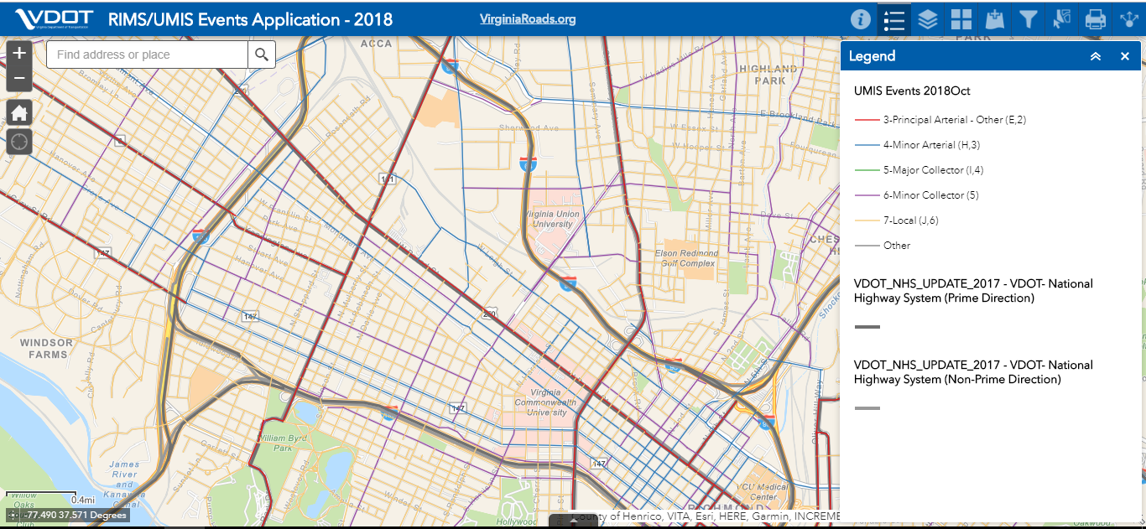
Public UMIS Map
http://vdot.maps.arcgis.com/apps/webappviewer/index.html?id=966db05d0c0744b389d7791b9fb987c8

Slide 20
State of Good Repair (SGR)/Primary Extension Paving Program Criteria
Accept applications on an annual basis to support pavement overlay, rehabilitation, or reconstruction projects
  Maximum request of $1M per locality, per year
  Roadway must have Combined Condition Index (CCI) rating of less than 60
  Projects must be advertised within 6 months of allocation
  Maintenance of Effort Certification required
Prioritize projects for funding based on technical score that considers pavement condition, traffic volume, and past expenditures
  Pavement condition (CCI) – 45%
  On the National Highway System (NHS) – 10%
  Traffic volume – 30%
  Prior expenditures – 15%
Same criteria used to select projects for CTB Formula and State of Good Repair funding
The SGR local program is currently exempt from the federal process until FY2021

Slide 21
FY20 SGR/ Primary Extension Paving Applications:
General Information
Call for applications on November 1, 2018
All applications due by January 7, 2019
Second year applications were entered using VDOT’s Smart Portal
Scored 122 applications with requests over $30.3M
Applications received from 45 localities representing all 9 districts
Funding for locality’s primary extensions available from both State of Good Repair (SGR) funds and CTB formula funds
(NOTE: $22.2M available for FY20)
Prioritized and selected primary extension projects using SGR funds first followed by the CTB formula funds
84 total paving projects have received FY20 funding representing 35 localities

Slide 22
SGR – Scoring Process – Bridges (Locally Owned)
Accept applications on an annual basis to support bridge rehabilitation, or reconstruction projects
  Bridge must be structurally deficient
  National Bridge Inventory Only
  The bridge must not have been replaced or undergone a deck and/or superstructure replacement during the ten (10) years prior to the date of application
  Proposed work must take bridge out of structurally deficient status
  Localities must be current on bridge inspections
  Starting in 2021, the prior fiscal year bridge maintenance expenditures, as reported to the Weldon Cooper Center, to be a minimum of 2%
  Project receiving funding under this program must initiate the Preliminary Engineering or the Construction Phase within 24 months of award of funding or become subject to deallocation
Prioritize projects for funding based on technical score that considers bridge prioritization and cost effectiveness

Slide 23
Statewide LAP Program Snapshot
District | Projects | % of LAP CN Projects | CN $ | % of LAP CN $
Bristol | 154 | 4.8% | $ 95,518,037 | 0.7%
Culpeper | 66 | 2.1% | $ 98,962,052 | 0.7%
District-Wide | 2 | 0.0% | $ 175,692 | 0.0%
Fredericksburg | 38 | 1.2% | $ 28,866,613 | 0.2%
HR | 276 | 8.6% | $ 804,560,177 | 5.6%
Lynchburg | 74 | 2.3% | $ 63,912,772 | 0.4%
Northern VA | 274 | 8.6% | $ 994,816,516 | 6.9%
Richmond | 213 | 6.7% | $ 425,071,715 | 3.0%
Salem | 104 | 3.3% | $ 144,462,506 | 1.0%
Statewide | 12 | 0.4% | $ 2,162,727 | 0.0%
Staunton | 127 | 4.0% | $ 123,005,953 | 0.9%
Total | 1340 | 42% | $2,781,484,760 | 19.3%
*Table values represent all current “Active” projects in VDOT’s Project Pool application

Slide 24
Dashboard Score by District
As of 5/22/2019 | On-Time Development | On-Budget Development
Bristol | 67% | 67%
Culpeper | 59% | 82%
Fredericksburg | 75% | 100%
Hampton Roads | 65% | 61%
Lynchburg | 92% | 83%
Northern Virginia | 44% | 70%
Richmond | 68% | 64%
Salem | 74% | 77%
Staunton | 58% | 67%
Statewide | 64% | 70%
On Delivery Goal 70%
On Budget Delivery Goal 74%

Slide 25
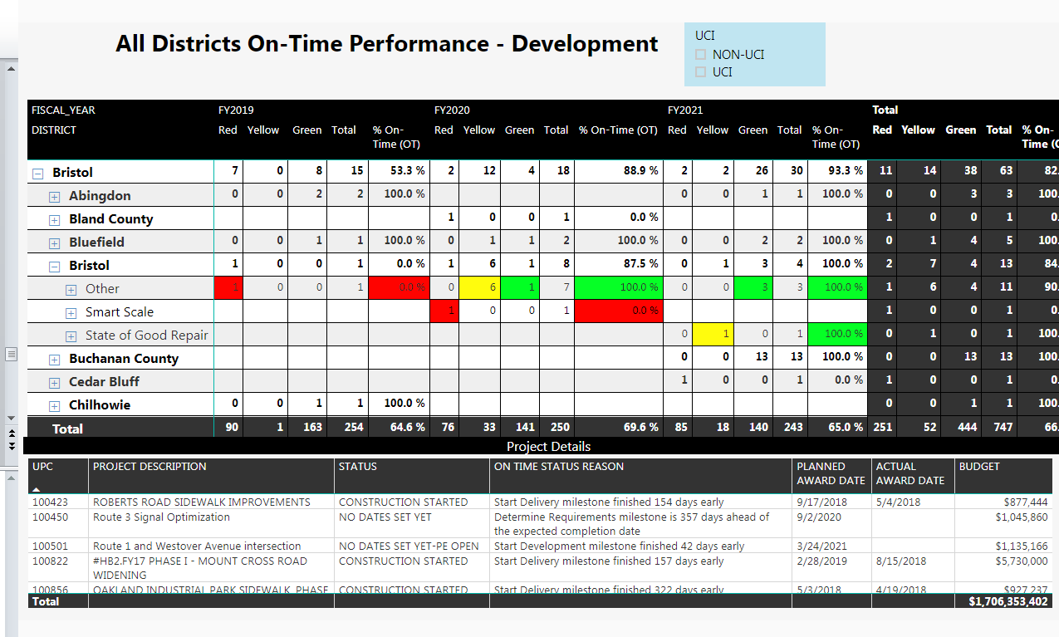

Slide 26
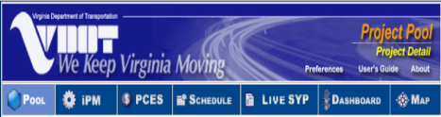


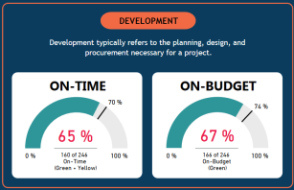
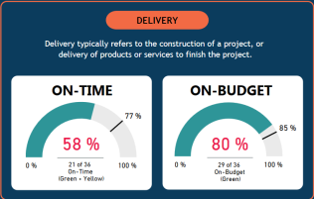
Non-VDOT Administered Projects
(NVAP)
NVAP Introduced July 1, 2018
Locality Enters UPC Specific Data
Data Displays on Dashboard “Projects”
Monitor LAP Development/Delivery
Initial UPC Data from VDOT POOL
Filter by UPC, Administered By, Status

Slide 27
VDOT INITIATIVES
BUSINESS PLAN UPDATE
PILOT FOR ELECTRONIC SIGNATURES FOR AGREEMENTS
UTILITY COORDINATION
SPECIAL HAULING VEHICLES/ EMERGENCY VEHICLE POSTING
PRE-AWARD EVALUATION TEMPLATES
EXTERNAL ACCESS TO VDOT SYSTEMS
QUALIFICATIONS PROGRAM

Slide 28
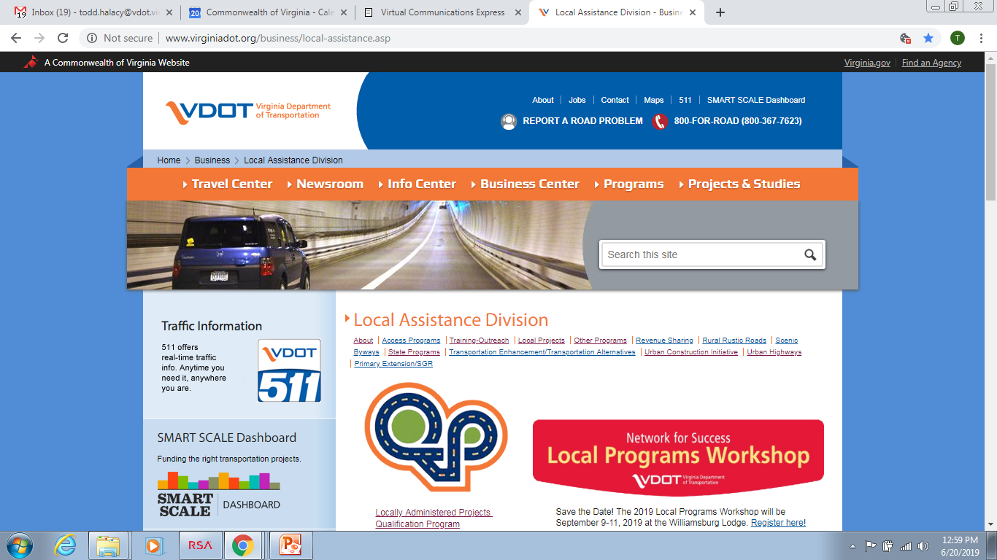
Local Programs Workshop

