Slide 1
DRPT Update
VML Transportation Committee – July 18, 2019
Chris Smith, Director Policy, Communications and Legislative Affairs
Department of Rail and Public Transportation

Slide 2
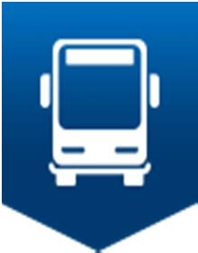
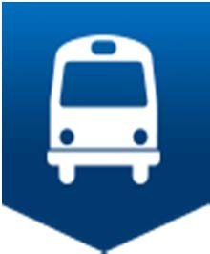
State of Transit in the Commonwealth
MERIT reforms are bringing greater accountability and transparency to DRPT funding programs
Dedicated funding created for WMATA, VRE and PRTC ensures largest commuter systems can continue to move more people daily, and do not come at the expense of other systems doing the same
Transit services and ridership are growing in small-urban and rural communities
Leveraging of new and increased funding sources is yielding the stability for transit systems to serve and grow in their communities
DRPT is piloting new innovations and technologies to enhance the transit industry

Slide 3
Changing the Transit Funding Landscape
In 2014: DRPT predicted a major shortfall for transit capital funds by FY 2021 due to expiration of bonds
By 2019: New and enhanced funding sources have reduced the gap:
Making transit and TDM projects eligible for SMART SCALE funds
Ability to use transit capital as match to SMART SCALE funds
Additional $40 million in transit capital funding in 2015
Set-aside of WMATA funds removed major variations in funding for other agencies, and allows NOVA jurisdictions to use funds for capital OR operating needs
I-395 and I-66 toll revenues dedicated to new transit services, and allows local agencies to determine these needs
Increased statewide transit capital match to 68% for high priority projects
DRPT has funded $77M in VRE capital needs through statewide rail funds

Slide 4
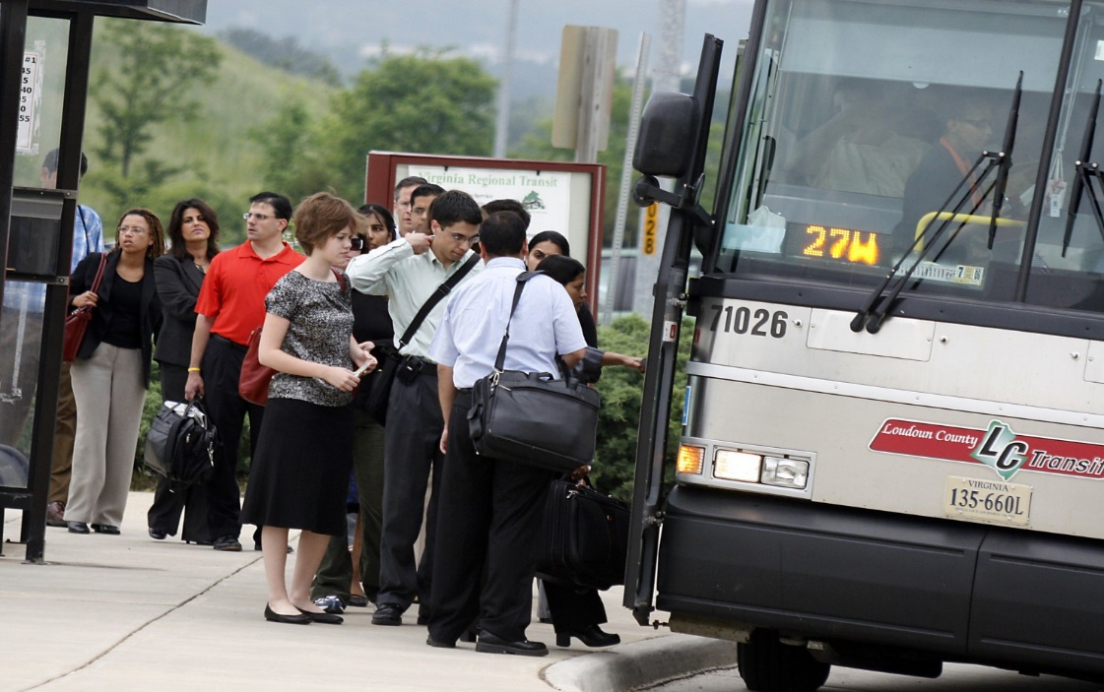
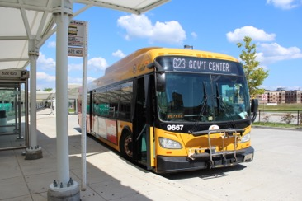
Increased and Dedicated Funding
$386M: SMART SCALE for 33 primary transit and TDM projects
$40M annually: HB1887 (2015)
$154M annually: WMATA Capital Fund
$15M annually: C-ROC
$20M annually: I-66 Inside the Beltway dedicated toll revenues
$800M/50 years: I-66 Outside the Beltway dedicated toll revenues
$15M annually: I-95/I-395 HOT Lanes dedicated toll revenues
$200M: set aside of $2B Interstate 81 revenues include multimodal eligibility
Increased Section 5307 apportionments: Inclusion of vanpools in statewide ridership

Slide 5
Accountability & Transparency
MERIT reforms to the statewide capital program prioritize the most important needs
Higher 68% state match guaranteed to meet all SGR needs
Requires better transit asset management and enhanced strategic planning
Increases accountability and transparency in order to meet critical needs
More accountability and transparency in the statewide operating program rewards lower operating costs and higher ridership to promote more efficient systems
Reforms demonstrate that statewide transit funds are going to those projects and systems that best meet the Commonwealth’s goals

Slide 6
WMATA
Legislative Action
2017: Metro Safety Commission enacted
2018: $154M additional annual capital funding dedicated to WMATA
2019: Returned $20M annually to NVTA for WMATA Capital Fund
Platform Improvement Program
First major rehabilitation program financed with new dedicated funding
$3.6M: state funding for to local transit mitigation
Governance Reform and Compliance
Limit role of Board alternates
3% annual cap on increase to Virginia operating subsidy
Strategic Plan and Capital Improvement Plan (CIP)
Technology
Fairfax County-CAV Shuttle Pilot
First/last mile connection with Metro

Slide 7
Ridership Growth

Slide 8
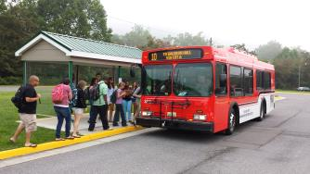
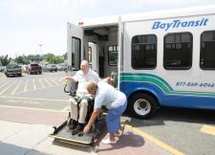
FY 2020-2025 Transit SYIP Highlights
Improved Transparency and Accountability
MERIT Reforms
Prioritized statewide transit capital allocations
Performance-based statewide operating allocations
WMATA capital and operating set aside with increased accountability
Urban area strategic planning
MERIT Results
243 state of good repair needs received full 68% state match
112 replacement vehicles
37 rehabilitated 40’ vehicles
11 minor enhancement vehicles

Slide 9
Technology and Expanded Services
Chesterfield County- Route 1 Mobility Services
New service for an eight mile corridor from Chesterfield County/City of Richmond boundary to John Tyler Community College
Albemarle County-Crozet Connex
New regional commuter express service between Crozet and Charlottesville operated by JAUNT
Fairfax County-CAV Shuttle Pilot
One year pilot for autonomous multi-passenger shuttles
First/last mile connection with Metro
Leverage DRPT funding with statewide Innovation and Technology Transportation Fund (ITTF) program
Hanover County 5310 Human Service Pilot
One year pilot for transportation to non-Medicaid services
More affordable access for elderly and disabled citizens
Turn key services from private vendor

Slide 10
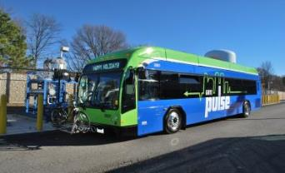
Statewide Transit Operating Assistance
FY 2020
$2.5 million increase in available operating assistance revenues
Reforms
$3 million operating reserve available in FY2020 for eligible transition assistance
Review of performance data for 2015-2018
New year of performance data
Changes in individual agency performance relative to statewide trends
Results
33 of 41 agencies see increase over FY19
Some decreases due to performance relative to statewide average
7 agencies eligible to receive transition assistance

Slide 11
Major Expansion Scoring
Project | Total Benefit Score | Transit Capital | MERIT Score (Project benefit /$10M)
Potomac Yard Metro South Entrance | 47.7 | $25m | 19.1
Crystal City Metro East Entrance | 37.3 | $41.4m | 9.1
CCPY Transitway Extension | 23.5 | $14.6m | 16.1
Route 1 Alexandria Transitway Extension | 17.6 | $2.5m | 70.5

Slide 12
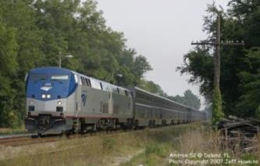
FY 2020 -2025 Rail SYIP Highlights
Intercity Passenger Rail Operating and Capital (IPROC) program and Rail Enhancement Fund (REF) – $1.5 Billion
Supports Virginia passenger and freight needs
Funding decisions include benefit-cost analysis and evaluation criteria
Railway Preservation Fund (RPF) - $103.5M
Partners with VA Shortline railroads by prioritizing needs
Supports regional economies and local businesses
CTB Rail Sub-Committee continually evaluates rail programs

Slide 13
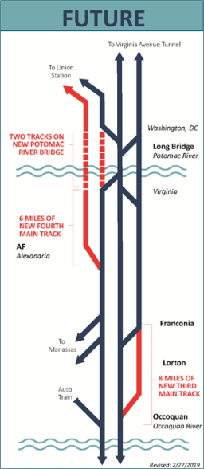
Long Bridge: Unlocking the I-95 Corridor
Existing bottleneck
98% capacity during peak travel
Speed restrictions
3 track approaches on each side of 2 track bridge
Traffic volume 70% passenger and 30% freight
34 daily VRE trains; 24 daily Amtrak trains
No rail network redundancy for 70+ miles
New two-track bridge for corridor needed
$1.3B-$1.6B estimated cost (2019 Dollars)

Slide 14
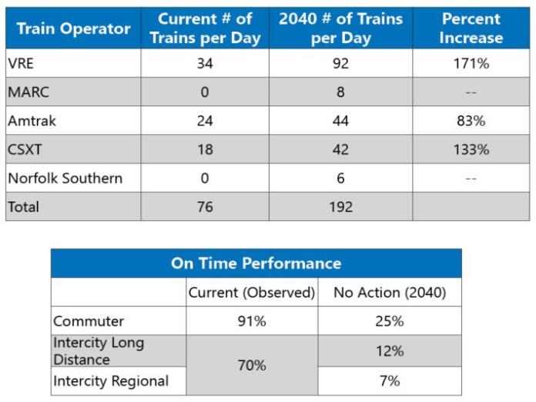
Train Volume Over Long Bridge
Source: DDOT, Long Bridge Draft EIS

Slide 15
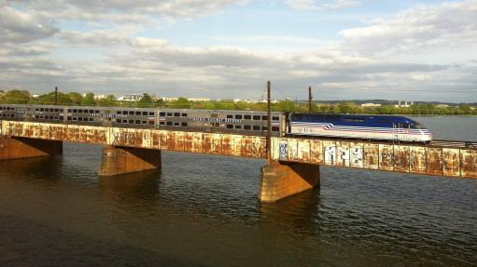
Next Steps: Long Bridge
Develop funding plan including federal, state, regional and local sources
$776M over the next 6 years currently programmed for Long Bridge, I-95 Corridor Improvements and Related Statewide Improvements
New Long Bridge: Public Ownership
Long Term Goal of separation of freight and passenger rail

Slide 16
Looking Ahead: Transportation Funding
Sustainability of Transportation Funding Study
OIPI investigating long-term stability of gasoline taxes as a revenue source
I-81 Dedicated Revenues: $2 billion
$200M set-aside includes eligibility for multimodal projects in the corridor
$20M annually returned to NVTA for WMATA Capital Fund diversion
I-95 Corridor Study
Economic Analysis of Public Transportation Benefits
Review of Statewide Demonstration, Technical Assistance and Intern programs
Access to ITTF funding
Funding for innovation/technology projects to leverage with DRPT demonstration funds

Slide 17
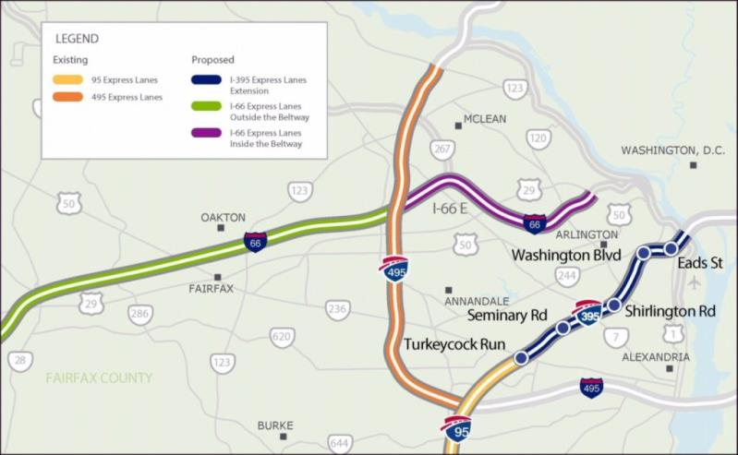
Generating New Transit and Rail Revenue
HOV to HOT Conversions

Slide 18
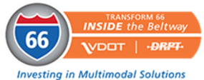
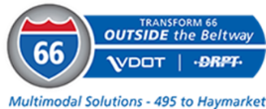
Generating New Transit and Rail Revenue
I-66 Inside the Beltway
$10M annually for transit, TDM, bicycle, pedestrian, and roadway options to improve throughput
Tolling began December 2017
NVTC recommends projects
Two rounds: $21.8M for 25 multimodal projects
I-66 Outside the Beltway
$800M over next 50 years to support enhanced transit/commuter rail service
Additional $178M in 2018 for transit & park-and-ride
I-95/395 HOT Lanes Extension
$15M annual transit investment (escalated 3% over 66 years) to fund new and improved choices
Projects prioritized based on person-throughput benefits

Slide 19
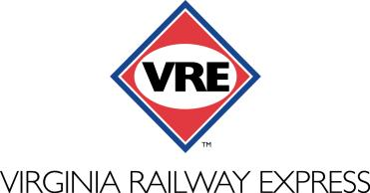
Generating New Transit and Rail Revenue
SMART SCALE: $58.3M
Crossroads Service Yard Expansion
Station Improvements for
Brooke & Leeland Road
Quantico
Alexandria including tunnel
I-66 Outside the Beltway: $128.5M
Broad Run Station Maintenance & Storage Facility Expansion
Expanded platforms at Manassas Station
Manassas Parking Garage
Real-Time Parking Information
New Rail Cars
C-PROC: $15M Annually
Dedicated funding from NOVA regional gas tax

Slide 20
Looking Ahead: SMART SCALE
Public Transportation scores well!
Round 1:
8 Projects: $31M
Round 2:
17 Projects: $168M
Round 3:
8 Projects: $187M
Round 4
DRPT providing technical assistance
Eligible applicants include: PDCs, MPOs, localities, and transit agencies
Eligible projects include: transit, rail, and multimodal
Deadline for DRPT technical assistance requests: September 1, 2019

Slide 21
DRPT Update
VML Transportation Committee – July 18, 2019
Chris Smith, Director Policy, Communications and Legislative Affairs
Department of Rail and Public Transportation

