Slide 1
Improving the Chesapeake Bay and Virginia Rivers: Our Progress and Path Forward
VIRGINIA’S Phase iii watershed implementation plan
Vml, Environmental quality policy committee
July 18, 2019

Slide 2
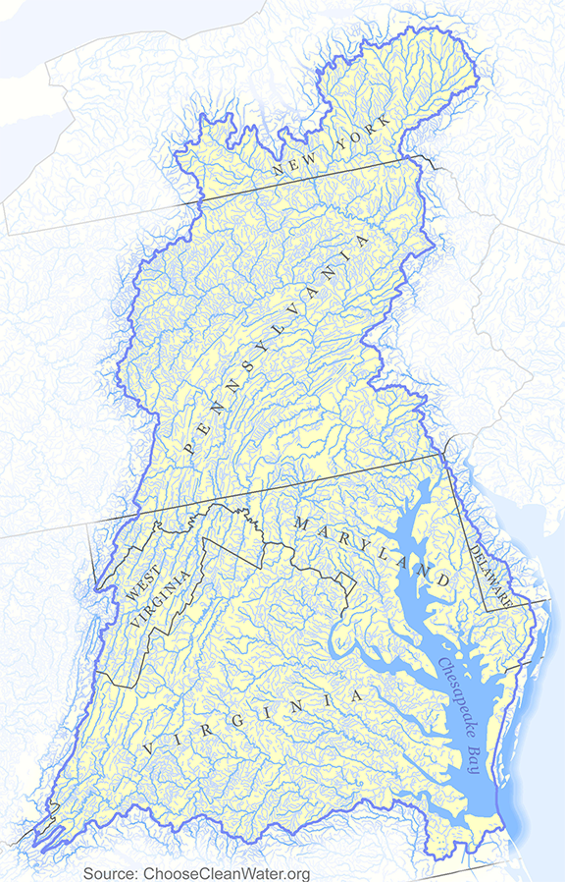
CHESAPEAKE BAY WATERSHED
6 States & DC
(MD, VA, PA, NY, DE, WV)
64,000 square miles
Mean depth = 21 ft.
(excluding channel = 6 ft.)
180,000 miles of rivers, creeks and streams
18.2 million people
3,600 Plants and Animals

Slide 3
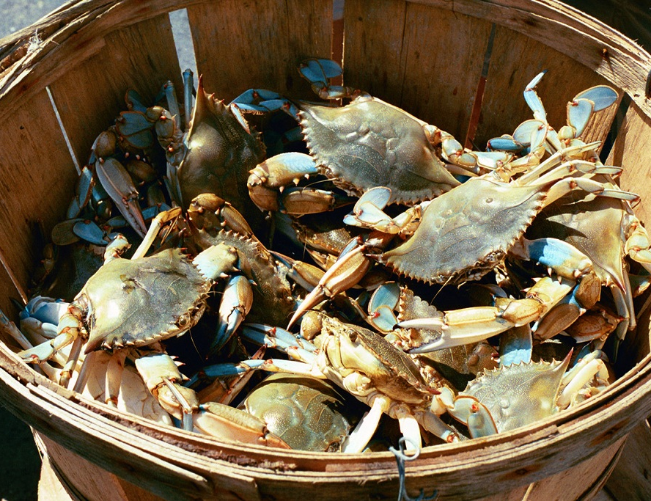
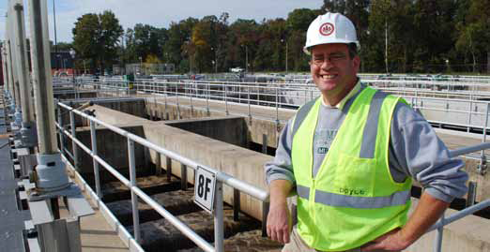
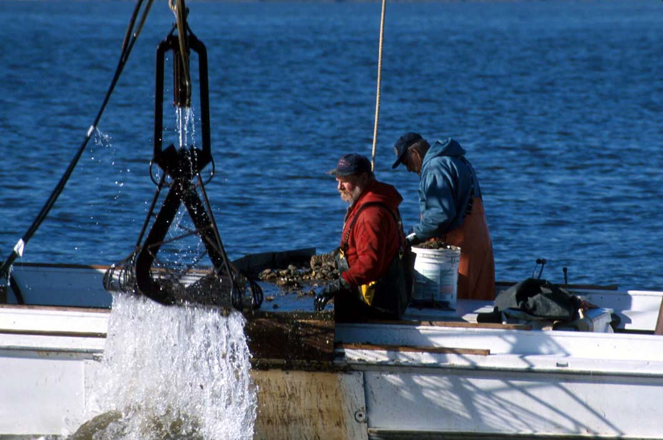
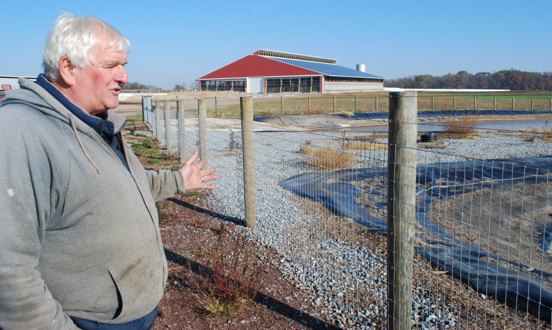
Restored Chesapeake Bay
Robust Virginia Economy

Slide 4
Notes:
4

Slide 5
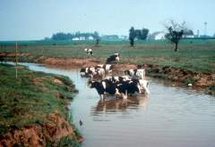
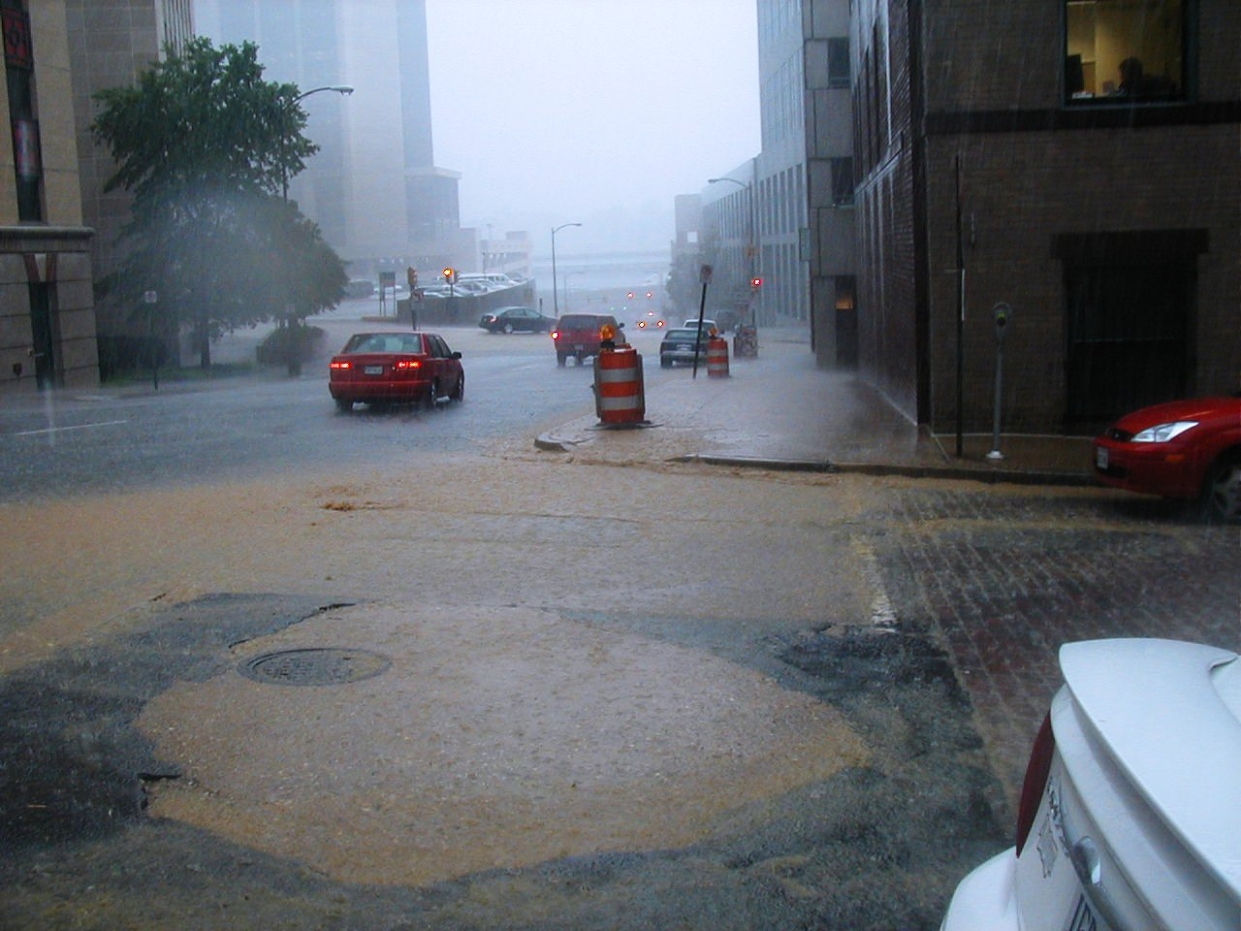
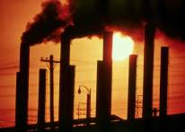
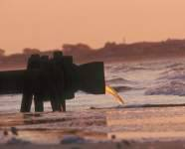
Nitrogen, Phosphorus, Sediment:
Overall, the biggest problems plaguing Virginia rivers and the Chesapeake Bay.

Slide 6
THE CHESAPEAKE BAY RESTORATION TIMELINE
1960s-70s Visible decline in Bay resources
1982 EPA completes 5-year Bay study
1983 First Bay Agreement - Bay Program created
1987 Second Bay Agreement – WQ Goals
1992 Amendments to Agreement – Tributary Strategies
2000 Third Bay Agreement (C2K)– Precursor to TMDL
2008 Water Quality Impairments Acknowledged
2010 Chesapeake Bay TMDL established
2010 Phase I Watershed Implementation Plans
2012 Phase II Watershed Implementation Plans
2014 Chesapeake Bay Watershed Agreement
2017 Mid-Point Assessment
2019 Phase III Watershed Implementation Plans
1960s
2019
6

Slide 7
Chesapeake Bay Total Maximum Daily Load (TMDL)
The TMDL sets numeric goal for each jurisdiction for N, P and S
The TMDL is accountable -
      requires transparency
      requires verification
      requires EPA oversight
      potential for EPA “backstops”
The TMDL requires reasonable assurance that target will be achieved
The TMDL sets deadlines of 60% by 2017 and 100% by 2025
Notes:
.

Slide 8
Virginia Major Basin Planning Targets
Geography | Planning Target
Major Basin | Nitrogen | Phosphorus
Eastern Shore | 1.43 | 0.164
James (Does not include ChlA) | 25.92 | 2.731
Potomac | 16.00 | 1.892
Rappahannock | 6.85 | 0.849
York | 5.52 | 0.556
VA | 55.73 | 6.192

Slide 9
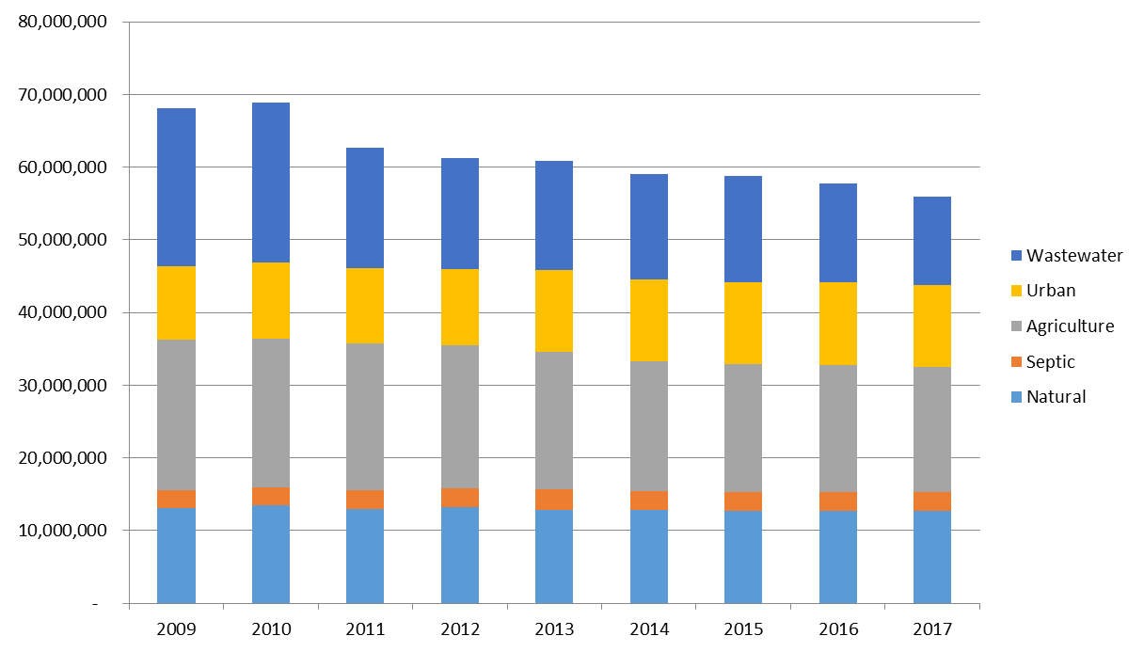
Virginia Achieved Midpoint Clean Water Goals for Nitrogen
3
2017 60%
2025

Slide 10
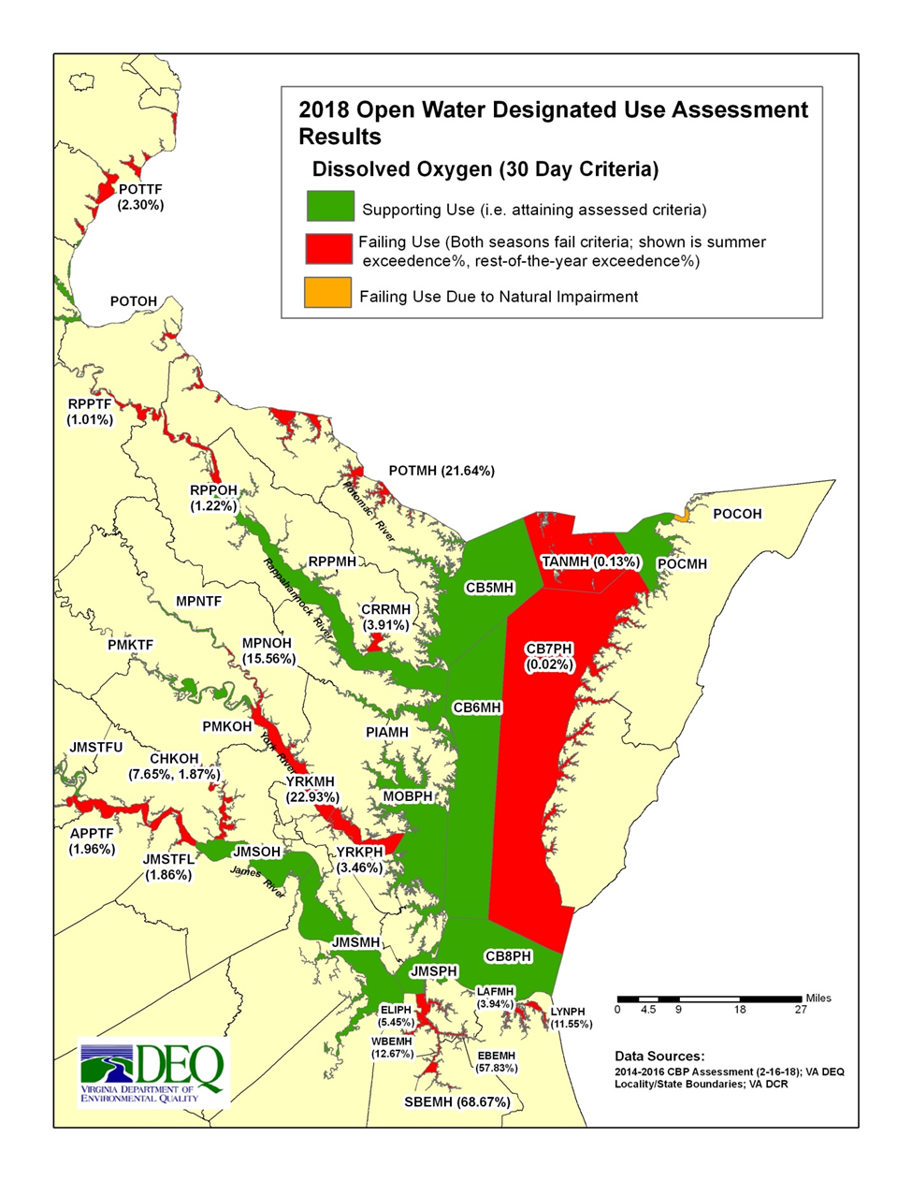
Virginia’s 2018 Water Quality Assessment
Improvements seen in the several Bay segments, James and Rappahannock
Hypoxia continues to be an issue in portions of the Bay

Slide 11
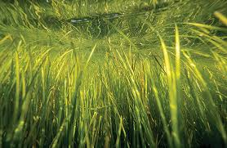
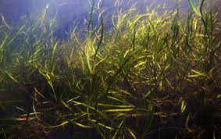
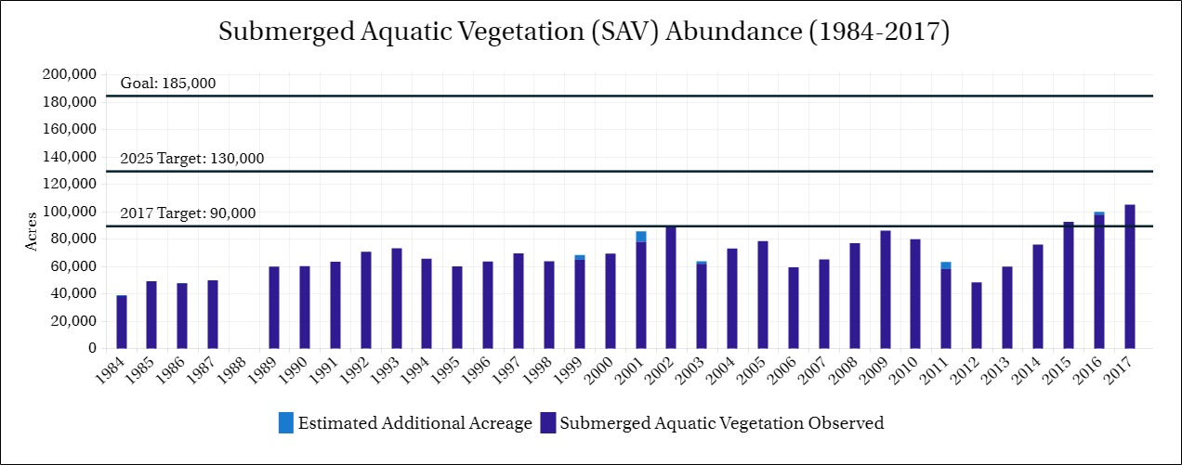

Slide 12
VIRGINIA’S GOALS FOR THE
PHASE III WATERSHED IMPLEMENTATION PLAN
Restore the Chesapeake Bay.
Achieve state basin planning targets for the Potomac, Rappahannock, York, and James Rivers and the Eastern Shore.
Achieve our goals no later than December 31, 2025.
Tackle additional pollution expected from growth.
Tackle the impacts of climate change.
Continue to engage partners, including local governments, planning district/regional commissions, and soil and water conservation districts.
Develop a plan that is practical and cost effective.
Maximize the potential for co-benefits.
Meet the Environmental Protection Agency’s expectations.

Slide 13
Virginia Secretary of Natural Resources
Chesapeake Bay Stakeholders Advisory Group
Soil and Water Conservation
Districts:
1) Adjust template bmp input decks
2) Identify funding and policy needs
Planning District Commissions:
1) Adjust template bmp input decks
2) Identify funding and policy needs
3) Convene all sector stakeholders
Virginia Interagency
Chesapeake Bay TMDL Team

Slide 14
Soil and Water Conservation Districts
31 of the 47 Districts in Virginia assisted with development of the Draft Phase III WIP.
Each District was provided with a workbook containing local area planning goals, draft agriculture and forestry best management practice (BMP) input decks, BMP definitions and cost effectiveness.
Each District was asked to provide revised input decks based upon their local community and farmer needs as well as recommendations on program improvements, capacity, and funding.
Public meetings were held with these Districts in their four “areas” in May and August, 2018 to review their revised input decks. Two public meetings were held with the Districts again in October, 2018 prior to finalizing their recommendations.
In addition, four farmer outreach meetings were held with the Virginia Farm Bureau Federation in the Shenandoah Valley, Remington, Northern Neck and Eastern Shore.

Slide 15
Planning District and Regional Commissions
14 of the 15 PDCs in Virginia’s Bay watershed assisted with development of the Draft Phase III WIP.
Utilizing federal Chesapeake Bay Program funding, the Department of Environmental Quality awarded grants to 14 Planning District/Regional Commissions (PDCs) to work with localities and stakeholders on development of the Draft Phase III WIP.
PDCs were asked to provide recommendations on revised best management practice (BMP) input decks for the unregulated, urban sector as well as programmatic actions, capacity, and funding.
The PDCs held 50 meetings to engage their local communities in addition to four concluding meetings held in collaboration with their local Districts.

Slide 16
Virginia’s Phase III WIP –
Priority Best Management Practices
Agricultural and Urban Nutrient Management
Cover Crops
Forest Buffers, Tree Canopy, Forest Retention
Livestock Stream Exclusion and Pasture Management
Shoreline Management
Stormwater Management BMPs
Wastewater Treatment Technologies

Slide 17
VIRGINIA’S PHASE III WATERSHED IMPLEMENTATION PLAN
AGRICULTURE: FUND/IMPROVE VIRGINIA AGRICULTURE BMP COST SHARE PROGRAM
REQUIRE NUTRIENT MANAGEMENT PLANS IF 2025 GOAL UNMET
REQUIRE LIVESTOCK STREAM EXCLUSIONS IF 2025 GOAL UNMET
MARKET CLEAN WATER FARMS
URBAN: RETAIN MS4 LIMITS ESTABLISHED IN 2010 WIP
FUND VCAP AND SLAF; ASSESS SLAF NEEDS
PARTNERSHIP WITH LOCAL PDC’S
STRENGTHEN CERTIFIED FERTILIZER APPLICATOR PROGRAM
EXPAND DOF TREE CANOPY AND BUFFER RESTORATION
EVALUATE CHESAPEAKE BAY PRESERVATION ACT EXTENTION
WASTEWATER: ACHIEVE ADDITIONAL REDUCTIONS EQUIVALENT TO TN AND TP LIMITS
FOCUS STATE EFFORTS ON WASTEWATER ISLANDS
SHIFT OVERSIGHT OF SEPTIC MAINTENANCE TO DOH

Slide 18
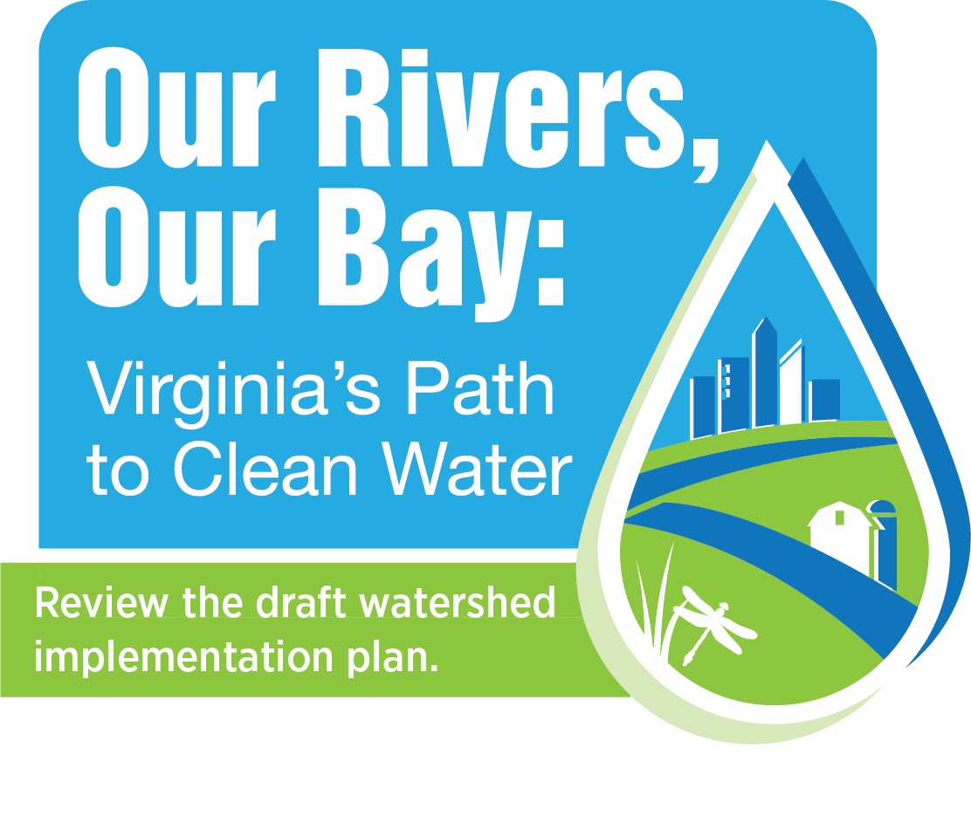
Public Comment Period: April 5 – June 7, 2019
Two public webinars held on May 13 (9 a.m. and 6 p.m.) with over 130 participants.
During March to June, presentations on the Draft Phase III WIP provided to – District Area Spring Meetings; Virginia Water and Waste Authorities Association; Virginia Water Monitoring Council; Virginia Water Environment Association; Virginia Forestry Summit; Chesapeake Bay Commission Virginia Delegation; Virginia Municipal Stormwater Agencies; Chesapeake Bay Foundation Public Forum; Southern States; Potomac River Fisheries Commission; Rappahannock River Basin Commission; Virginia Association of Wetland Professionals, Chesapeake Executive Council Local Government Advisory Committee – Virginia Delegation; Virginia Conservation Network; Watershed Roundtables (Shenandoah, Potomac, York, Rappahannock, Upper James, and Middle James); and the Virginia Agribusiness Council.
Multiple Briefings Scheduled:
SWCD Area Spring Meetings; VA Assoc. of SWCDs; Soil & Water Conservation Board
Rappahannock River Basin Commission
Watershed Roundtable Meetings
Virginia Forestry Summit
Associations: VWMC & CVW, VWEA , VWWAA

Slide 19
Improving the Chesapeake Bay and Virginia Rivers: Our Progress and Path Forward
QUESTIONS?

