Slide 1
Stormwater Local Assistance Fund
State Money for Localities to Help Address Water Quality Mandates
Virginia Municipal League
Environmental Quality Policy Committee
Richmond, Virginia
July 18, 2019
L. Preston Bryant, Jr.

Slide 2
Why Is the State Requiring Localities to Reduce Stormwater Runoff Pollution?
U.S. Clean Water Act regulates the discharge of pollutants into the nation’s waters – streams, lakes, rivers, bays
U.S. Environmental Protection Agency delegates CWA enforcement to states
Virginia Department of Environmental Quality and State Water Control Board enforce CWA
Watershed Improvement Plan – an agreement between Virginia and EPA – established certain pollution reductions goals that, as a matter of law, must be met
Wastewater treatment plants
Agricultural runoff
Stormwater

Slide 3
Why Is the State Requiring Localities to Reduce Stormwater Runoff Pollution?
Virginia has made great progress in pollution reduction from Wastewater treatment plant and Agricultural runoff
Stormwater remains a strong focus
EPA would like Virginia to do a better job on stormwater progress
Stormwater infrastructure improvements are expensive (especially urban retrofits)

Slide 4
General Assembly Helps Localities
General Assembly in 2013 established the Stormwater Local Assistance Fund
A State-Local partnership
Competitive grants
Locality must put up dollar-for-dollar match

Slide 5
SLAF Appropriations since 2014
The General Assembly appropriates money to the Stormwater Local Assistance Fund (almost) every year
FY 2014 $35 M
FY 2015 $20 M
FY 2016 $ 5 M
FY 2017 $20 M
FY 2018 $ 0 M
FY 2019 $20 M
FY 2020 $10 M
TOTAL $110 million
With local, dollar-for-dollar match … $220 M since FY 2014 for stormwater improvements.

Slide 6
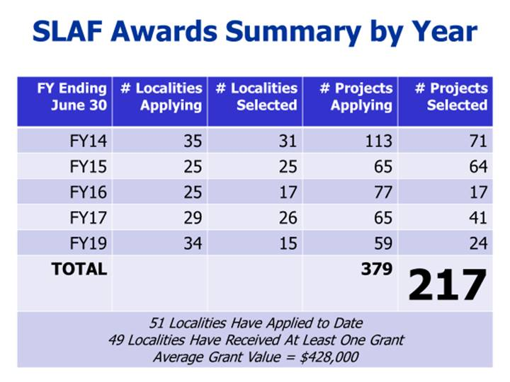
Number of SLAF Awards Since 2014

Slide 7
What is the Stormwater Local Assistance Fund?
Established by the General Assembly in 2013 Va. Code § 62.1-44.15:29.1
Purpose “ … to provide matching grants to local governments for the planning, design, and implementation of stormwater best management practices that address cost efficiency and commitments related to reducing water quality pollutant loads.”

Slide 8
Who’s Eligible to Apply for SLAF Grants?
Any political subdivision of the Commonwealth
Local governments – any town, city, county
Authorities
Planning districts
Commissions
For the most part, it’s towns, cities, and counties who have applied.

Slide 9
How is Application for SLAF Grants Made?
Submit SLAF application to Department of Environmental Quality
Grant program is competitive
Applications are scored – up to 600 points
Pollutant Reduction 100 points
Cost Effectiveness 200 points
Impaired Water Bodies 100 points
Fiscal Stress 75 points
Readiness to Proceed 100 points
Phase II (Small) MS4 25 points

Slide 10
How Can SLAF Grants be Used?
Grant funds may be used for …
meeting obligations related to Chesapeake Bay TMDL
requirements for local impaired stream TMDLs
water quality requirements of the Chesapeake Bay Watershed Improvement Plan
water quality requirements related to the permitting of small municipal stormwater sewer systems

Slide 11
SLAF – For Capital Infrastructure Projects Only
Grants are only for capital projects
New stormwater best management practices
Stormwater best management practice retrofits
Stream restoration
Low impact development projects
Buffer restoration
Pond retrofits
Wetlands restoration

Slide 12
Local Funding Match is Required
The Department of Environmental Quality will authorize grants in the amount of 50% of the eligible project costs
Planning
Design
Installation (construction)
Recipient (local government) must provide a 50% match.
Minimum grant amount per locality $50,000 Maximum grant amount per locality $5,000,000 Thus, eligible project costs must be at least $100,000. If a project exceeds $10,000,000, the most a locality will receive is $5,000,000.

Slide 13
How Does Locality Receive Its Grant Funds?
Reimbursement basis
DEQ provides grant funds to local government on a periodic reimbursement basis
Locality submits receipts and invoices of eligible costs – submissions must fully substantiate the request for reimbursement
Reimbursement requests are reviewed and approved by DEQ staff

Slide 14
Eligible and Ineligible Expenses
Eligible expenses (reasonable and necessary)
Planning
Design
Permitting
Inspection
Construction
Ineligible expenses
Salaries and other expenses of municipal employees
Administrative costs
Changes in the approved project scope (without DEQ approval)
Change orders not attributable to the project
Costs or expenditures deemed unnecessary and/or unreasonable
Operation and Maintenance costs
Interest costs associated with borrowed funds for the project
Post-construction monitoring costs

Slide 15
Who Has Been Receiving SLAF Grants?
Towns Ashland Leesburg Broadway Purcellville Christiansburg Warsaw Dumfries Wytheville Elkton Vienna Kilmarnock

Slide 16
Who Has Been Receiving SLAF Grants?
Cities Alexandria Lynchburg Charlottesville Manassas Chesapeake Manassas Park Fairfax City Newport New Falls Church Petersburg Hampton Portsmouth Harrisonburg Richmond Hopewell Staunton Lexington Suffolk Lynchburg Waynesboro Virginia Beach

Slide 17
Who Has Been Receiving SLAF Grants?
Counties Albemarle Prince William Arlington Roanoke Chesterfield Stafford Fairfax York Goochland Hanover Henrico Isle of Wight James City Loudoun Prince George

Slide 18
For Additional Information …
Contact Department of Environmental Quality Clean Water Financing Assistance Program Department of Environmental Quality 1111 East Main Street Richmond, VA 23219 (800) 592-5482 Chris Pomeroy
Virginia Association of Municipal Stormwater Agencies AquaLaw 6 S. 5th Street Richmond, VA 23219 (804) 716-9021

Slide 19
Questions or Comments?
www.mcguirewoodsconsulting.com
/McGuireWoodsConsulting @MWConsulting
© McGuireWoods Consulting LLC

