Slide 1
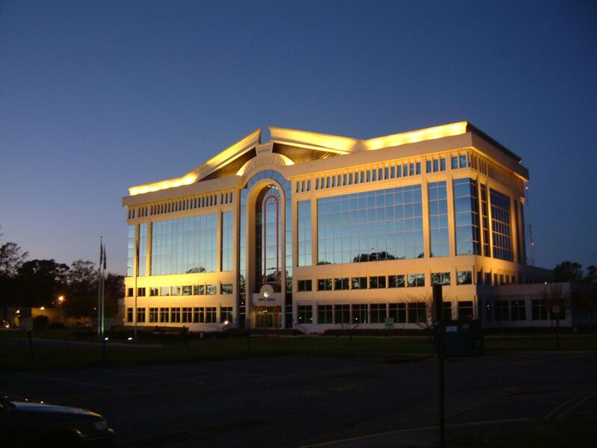
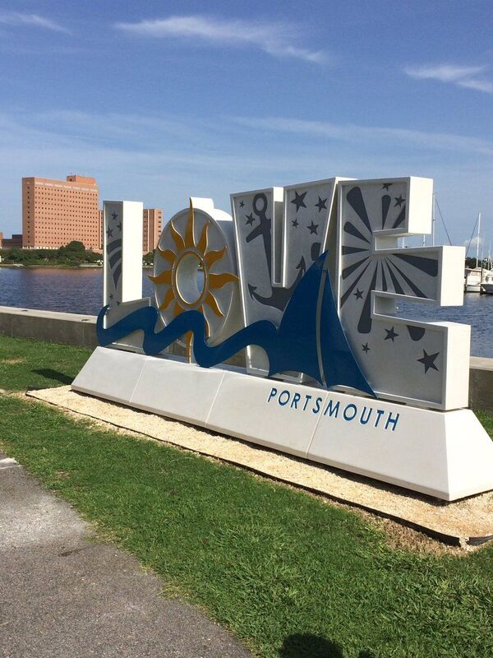
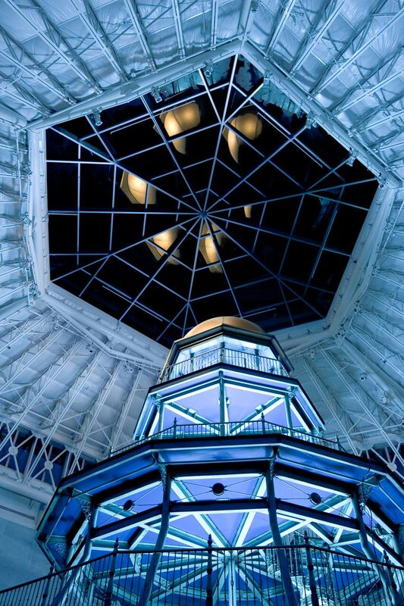
HAMPTON
ROADS, VIRGINIA
REGIONAL CONNECTIVITY RING
July 2019
Jeff Beekhoo
Regional Broadband SME

Slide 2
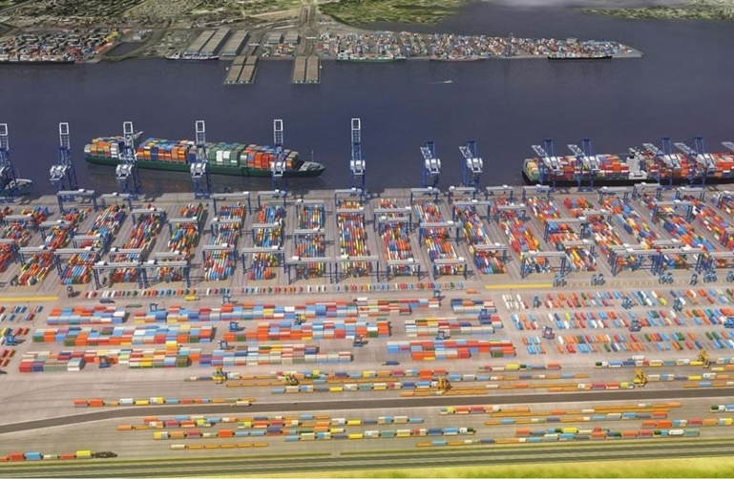
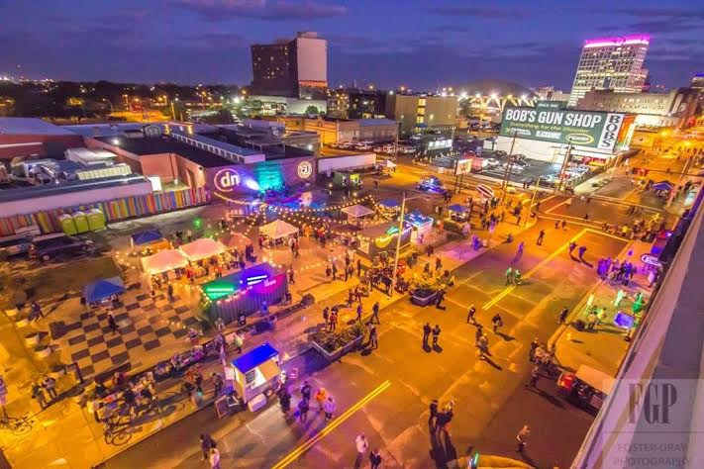
THE HAMPTON ROADS REGION
A vibrant, Mid-Atlantic region which has flourished through national defense, international shipping, and the tourism industry. It is one of the most important regions in the world.
HAMPTON ROADS
IN NUMBERS:
17 diverse localities
1.7 million residents
37th largest metropolitan area in the United States
3 pillars of economy: federal defense, the ports, and tourism

Slide 3
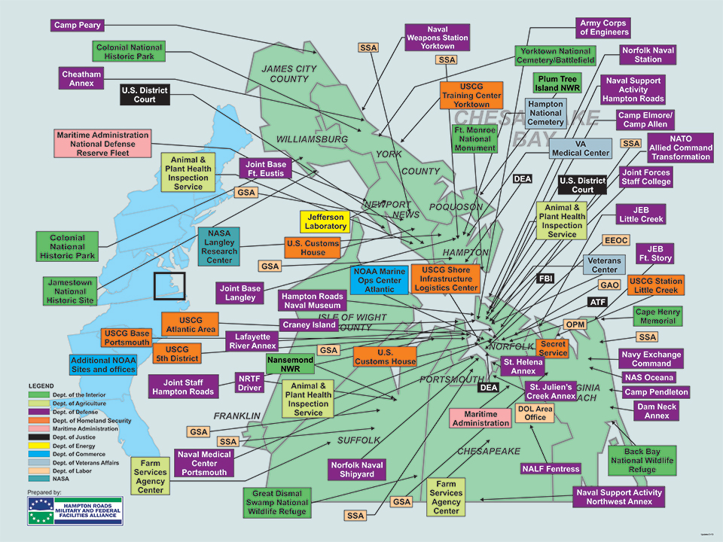
THE HAMPTON ROADS REGION
A vibrant, Mid-Atlantic region which has flourished through national defense, international shipping, and the tourism industry. It is one of the most important regions in the world.
LARGEST CONCENTRATION OF MILITARY AND FEDERAL ASSETS IN THE NATION
75+ Federal Facilities
and
Defense Installations
Notes:
The Hampton Roads area has the largest concentration of military bases and facilities of any metropolitan area in the world. Nearly one-fourth of the nation's active-duty military personnel are stationed in Hampton Roads, and 45% of the region's $81B gross regional output is Defense-related.^{[66][67]} All five military services' operating forces are there, as well as several major command headquarters: Hampton Roads is a chief rendezvous of the United States Navy, and the area is home to the Allied Command Transformation, which is the only major military command of the North Atlantic Treaty Organization (NATO) on U.S. soil. Langley Air Force Base is home to Air Combat Command (ACC). The Norfolk Navy Base is located at Sewell's Point near the mouth,
News Shipbuilding
Massive coal piers and loading facilities were established in the late 19th and early 20th century by the Chesapeake and Ohio Railway (C&O), Norfolk and Western Railway (N&W), and Virginian Railway (VGN). The latter two were predecessors of the Norfolk Southern Railway, a Class I railroad which has its headquarters in Norfolk, and continues to export coal from a large facility at Lambert's Point on the Elizabeth River. CSX Transportation now serves the former C&O facility at Newport News. (The VGN's former coal facility at Sewell's Point has been gone since the 1960s, and the property is now part of the expansive Norfolk Navy Base).
Almost 80% of the region's economy is derived from federal sources. This includes the large military presence, but also NASA and facilities of the Departments of Energy, Transportation, Commerce and Veterans Affairs.
(ANDRIA)

Slide 4
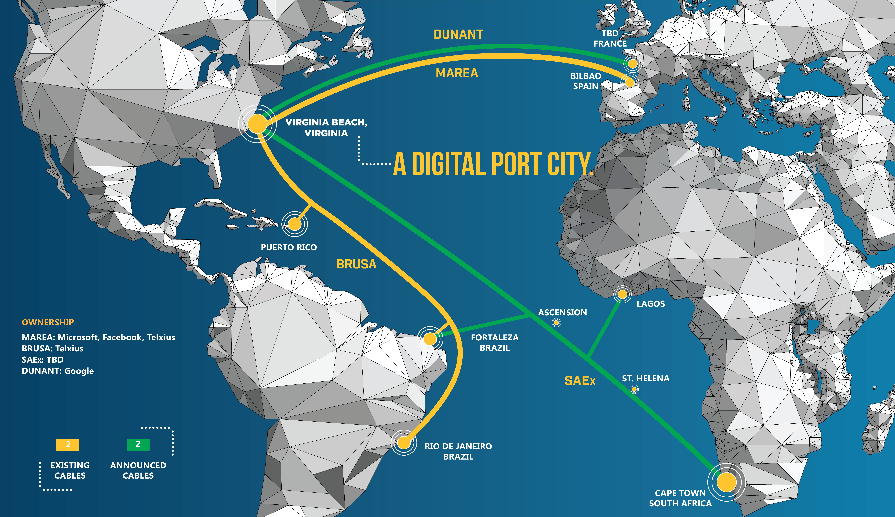
Transatlantic Fibers
Notes:
MAREA
Led by Facebook and Microsoft
MAREA is the highest-capacity subsea cable to ever cross the Atlantic, with a design capacity of 160 Terabits/sec.
A 6,600 km submarine cable connecting the United States to southern Europe: from Virginia Beach
Provides greater diversity of connections and enhanced reliability for customers
Provides optimal connectivity to data centers on the East Coast of the United States.
BRUSA
BRUSA is fully owned and operated by TELXIUS
11,000 km in length linking Rio de Janeiro and Fortaleza (Brazil) with San Juan (Puerto Rico) and Virginia Beach (USA)
Ultrafast transmission capacity reaching up to 138 Tbps
Increased end-to-end connectivity and the availability of ultrahigh-speed broadband services
Will address the exponential growth of data transmission generated by its B2B customers, telecom operators, OTT players and end-consumers
Improves communication reliability and delivers enhanced resilience by increasing the number of USA landing points
Provides the lowest latency communication links between the two largest economies in the region, Brazil and USA
DUNANT
Led by Google
Dunant will consist of twelve fiber pairs, with a total design capacity of 25 Tb/s per fiber pair
Dunant will have a single segment between Virginia Beach and Saint-Hilaire-de-Riez, a total length of 6,600 kilometers
Will provide new and replacement capacity on the U.S.-European routes
Will use the existing cable landing station in Virginia Beach, Virginia, owned by TELXIUS Cable USA, Inc.

Slide 5
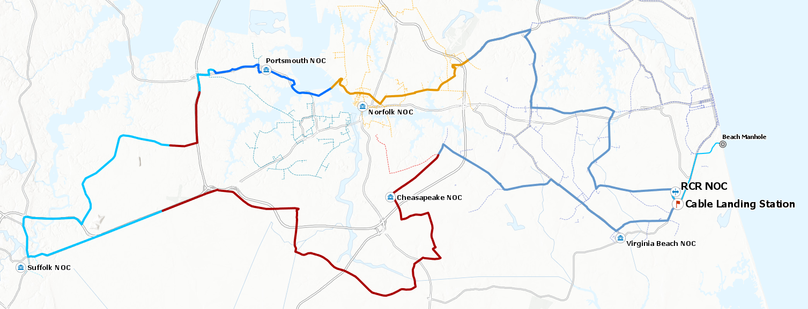
REGIONAL CONNECTIVITY RING OVERVIEW
Middle-Mile:
To Enable, Not Compete
The Regional Connectivity Ring is a 103.11 mile dark fiber, open access ring, which will serve as the foundation for smart region development and digitally-empowered communities.
5 Southside cities collaborated together and funded the 30% design for the Regional Connectivity Ring.
Notes:
Overview:
Leverages the transatlantic fiber capabilities to bring unprecedented broadband speeds to the region
Serves as a foundation for Smart City and IoT development in each connected city
Connects regional critical infrastructure, including higher education facilities, to a network that provides top-of-the-line cybersecurity
Uses cutting-edge analytics to constantly learn and iterate local projects, as well as creates overall efficiency through multi-project last-mile analytics
Gives easier access to high-speed broadband for underserved/unserved areas, spurring economic development at all levels
Middle-Mile: Enable, not compete

Slide 6
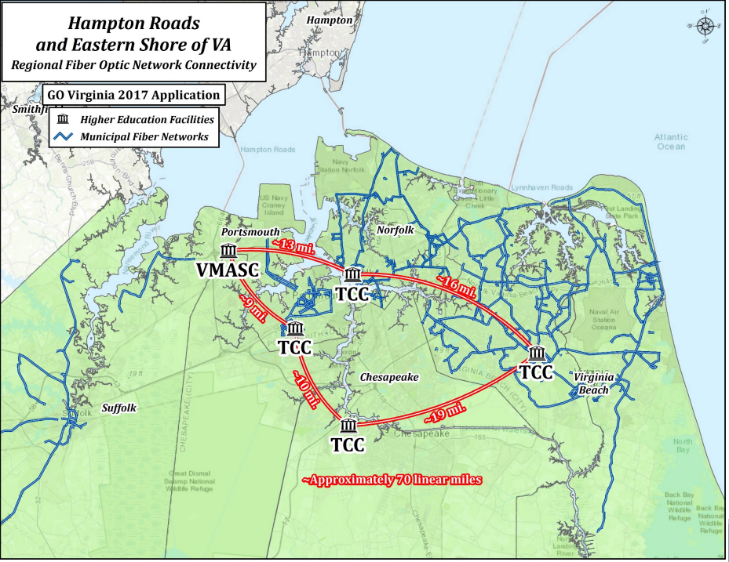
REGIONAL NETWORK EXPANSION PLAN
Notes:
Overview:
Leverages the transatlantic fiber capabilities to bring unprecedented broadband speeds to the region
Serves as a foundation for Smart City and IoT development in each connected city
Connects regional critical infrastructure, including higher education facilities, to a network that provides top-of-the-line cybersecurity
Uses cutting-edge analytics to constantly learn and iterate local projects, as well as creates overall efficiency through multi-project last-mile analytics
Gives easier access to high-speed broadband for underserved/unserved areas, spurring economic development at all levels
Middle-Mile: Enable, not compete

Slide 7
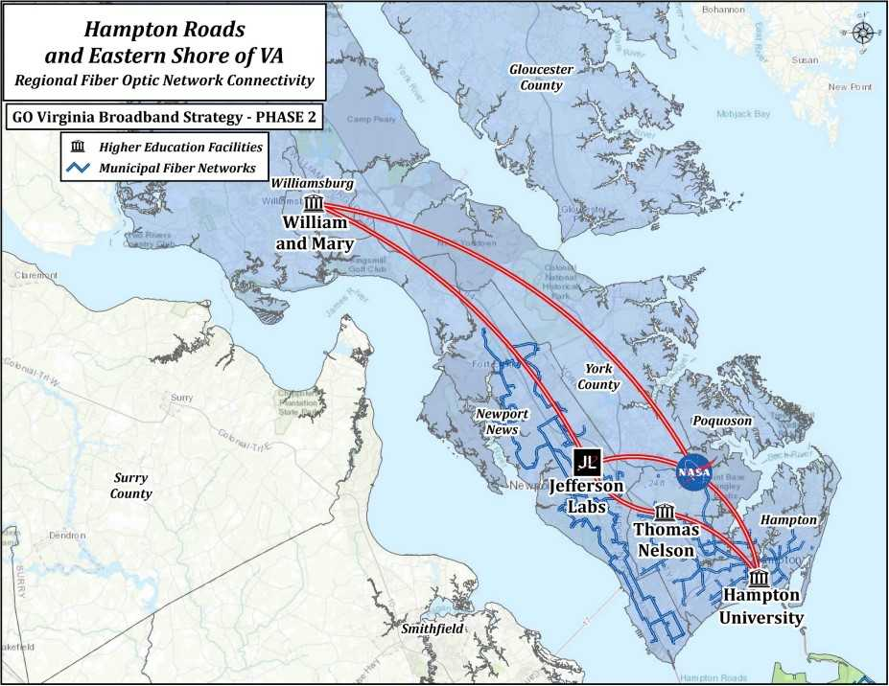
REGIONAL NETWORK EXPANSION PLAN
Notes:
Overview:
Leverages the transatlantic fiber capabilities to bring unprecedented broadband speeds to the region
Serves as a foundation for Smart City and IoT development in each connected city
Connects regional critical infrastructure, including higher education facilities, to a network that provides top-of-the-line cybersecurity
Uses cutting-edge analytics to constantly learn and iterate local projects, as well as creates overall efficiency through multi-project last-mile analytics
Gives easier access to high-speed broadband for underserved/unserved areas, spurring economic development at all levels
Middle-Mile: Enable, not compete

Slide 8
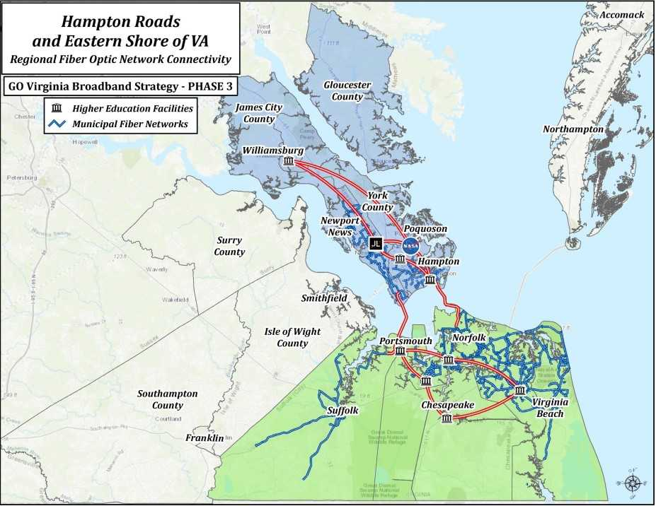
REGIONAL NETWORK EXPANSION PLAN
Notes:
Overview:
Leverages the transatlantic fiber capabilities to bring unprecedented broadband speeds to the region
Serves as a foundation for Smart City and IoT development in each connected city
Connects regional critical infrastructure, including higher education facilities, to a network that provides top-of-the-line cybersecurity
Uses cutting-edge analytics to constantly learn and iterate local projects, as well as creates overall efficiency through multi-project last-mile analytics
Gives easier access to high-speed broadband for underserved/unserved areas, spurring economic development at all levels
Middle-Mile: Enable, not compete

Slide 9
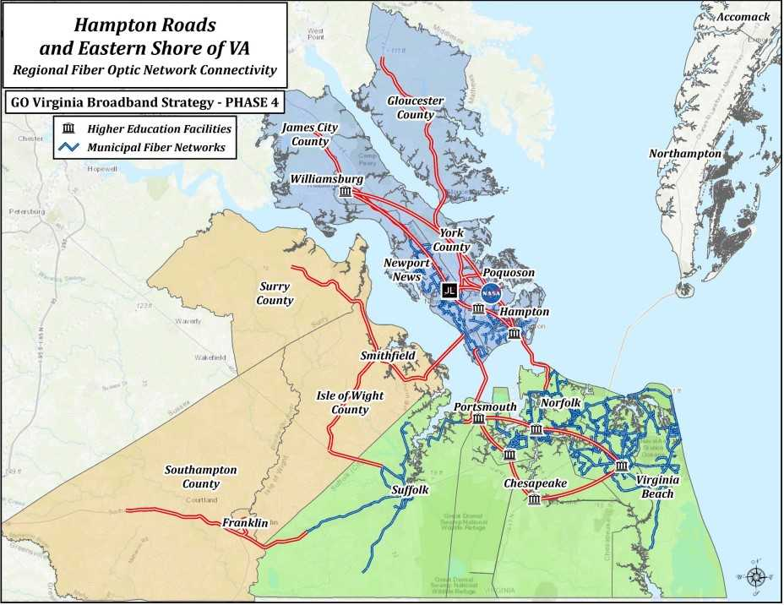
REGIONAL NETWORK EXPANSION PLAN
Notes:
Overview:
Leverages the transatlantic fiber capabilities to bring unprecedented broadband speeds to the region
Serves as a foundation for Smart City and IoT development in each connected city
Connects regional critical infrastructure, including higher education facilities, to a network that provides top-of-the-line cybersecurity
Uses cutting-edge analytics to constantly learn and iterate local projects, as well as creates overall efficiency through multi-project last-mile analytics
Gives easier access to high-speed broadband for underserved/unserved areas, spurring economic development at all levels
Middle-Mile: Enable, not compete

Slide 10
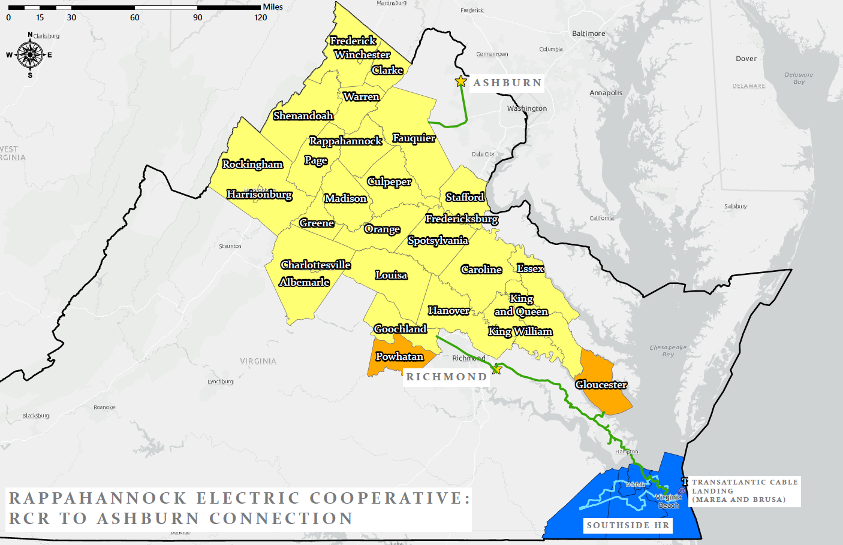
REGIONAL NETWORK EXPANSION PLAN
Notes:
Overview:
Leverages the transatlantic fiber capabilities to bring unprecedented broadband speeds to the region
Serves as a foundation for Smart City and IoT development in each connected city
Connects regional critical infrastructure, including higher education facilities, to a network that provides top-of-the-line cybersecurity
Uses cutting-edge analytics to constantly learn and iterate local projects, as well as creates overall efficiency through multi-project last-mile analytics
Gives easier access to high-speed broadband for underserved/unserved areas, spurring economic development at all levels
Middle-Mile: Enable, not compete

Slide 11
BENEFITS OF REGIONAL CONNECTIVITY
Leveraging Middle-Mile Infrastructure
Public Safety
Create regional interoperability for first responder platforms
Build robust Public Safety infrastructure
Establish unified and redundant 911 centers, allowing remote facilities access to same network
Next Gen 9-1-1 platforms enable shared data between all departments
Regional Disaster Recovery
Middle-Mile: To Enable, Not Compete
Notes:
Public Safety – NG9-1-1

Slide 12
BENEFITS OF REGIONAL CONNECTIVITY
Leveraging Middle-Mile Infrastructure
Education
Integration of higher education for collaborative research
Provide bandwidth to support growing educational needs (e.g., virtual classrooms)
Increase enrollment, retention and graduation rates
Affordable access for underserved and unserved citizens to address the residential Digital Divide
Middle-Mile: To Enable, Not Compete

Slide 13
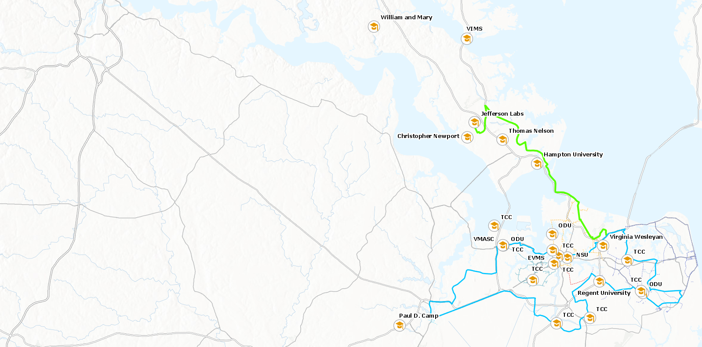
HIGHER EDUCATION IN HAMPTON ROADS
18 higher education facilities in the region, as well as NASA-Langley affiliate, Jefferson Labs.
Regional Enrollment: 130,973 (34% of state enrollment)
Regional Research Spending: $200,000,000+
Notes:
18 higher ed facilities
2 Norfolk critical facilities
2 and 4 year institutions

Slide 14
BENEFITS OF REGIONAL CONNECTIVITY
Leveraging Middle-Mile Infrastructure
Economic Development
Attraction and retention of new businesses
Expansion and support of local industries
Job creation to combat regional ‘brain-drain’
Enables Internet-of-Things integration for processes and manufacturing
Lowers barriers to entry by fostering competition
Middle-Mile: To Enable, Not Compete

Slide 15
BENEFITS OF REGIONAL CONNECTIVITY
Leveraging Middle-Mile Infrastructure
Healthcare
Provides rural communities access to doctors and specialists remotely
Healthcare professionals can extend the range of their services
Enables the ability to quickly transmit large amounts of data to other facilities
Provides access to secure cloud storage of medical records and other data
Middle-Mile: To Enable, Not Compete
Notes:
Time saved through broadband are lives saved

Slide 16
REGIONAL CONNECTIVITY RING TIMELINE
September 2017
The Transatlantic Cable, MAREA, completes its connection to Virginia Beach
May 2018
Regional Collaboration is established and RCR is pursued, starting with RFP for 30% Design
December 2018
30% Design and Master Plan submitted
November 2019
RFP detailing specs for 100% design open
Oversight authority for RCR is established
April/May 2020
100% design complete, will inform build requirements
June 2020
RFP for construction open, will look for 5 respondents to build each city’s portion separately
June/July 2021
RCR Construction is complete. Cities will start utilizing and dark fiber will be leased under the authority

Slide 17
Thank you for attending.
Jeff Beekhoo
Regional Broadband SME
Broadband Telecom
851 Seahawk Circle, Suite 103
Virginia Beach, VA 23510
jeffb@broadband-telecom.com
Ph: 757-505-0126 Ext:301
Broadband-Telecom. Com

