Slide 1
Are You Prepared for Next Generation 9-1-1 (NG9-1-1)???
www.vita.virginia.gov
1
Notes:
The technology of 9-1-1 is currently in an evolution, and Virginia is working to implement a new solution for the system. This presentation will describe the current limitations of the system, what next generation 9-1-1 is and what the benefits of migration to a new system are. It will also review the options and recommended path for moving forward.

Slide 2
Challenges to Existing 9-1-1 System
9-1-1 now
Nine, independent networks
Limited ability to process data
Decades old technology
CORE ANALOG TECHOLOGY IS GOING AWAY
Evolving telecommunications
Multiple service providers/technologies
New technologies/applications continually developed
Increased flexibility/mobility of citizens
Notes:
Why do we need to implement next generation 9-1-1. There area a lot of reasons and they surround the fact that there are currently limitations inherent in the existing 9-1-1 system.
The current 9-1-1 network utilizes forty year old, analog technology. It functions on nine independent networks and this often causes issues with call processing throughout the commonwealth especially when call transfers are necessary, and the current network isn’t capable of delivering or processing data. But most importantly, is that this dated analog technology will be going away.
The 9-1-1 community must also make this transition to newer technology, or we will be left with limited communications abilities in an increasingly mobile and technologically advantaged society. Moreover, we will be left paying for an infrastructure that is not going to be used by the telecommunications companies for other customers or services. WE cannot afford to do nothing about this. The safety, health and well-being of our citizens and our emergency responders will be better served by a system that is capable of consuming the technologies in use today and that will allow us to have accurate information and thus respond faster and more accurately.

Slide 3
What is Next Generation 9-1-1?
NG9-1-1 is the solution to existing challenges
Migration from circuit (analog) to packet switched (IP) technology
Unified network among PSAP; data transferability
Required to meet the demands of new telecommunications technologies
Makes data available
About the caller, the incident, and among PSAPs and first responders
Notes:
The solution to those challenges is NG9-1-1. It starts with the deployment of an emergency services IP network (ESInet) that is dedicated to 9-1-1 and public safety, is used by all PSAPs and on which all 9-1-1 call traffic will flow.
This network will enhance interoperability across the Commonwealth and will allow the system to receive calls and information from the technologies in use by society today.

Slide 4
Migration to NG9-1-1 in Virginia
Has begun
Fairfax County and AT&T contract
Deployment of an ESInet and NG9-1-1 core services
Contract available to all localities
Recommendation of VA 9-1-1 Services Board
Choice of NG9-1-1 provider is a local decision
Code of Virginia section 56-484.16 requires migration by July 1, 2023
Notes:
The migration to NG9-1-1 has begun and that’s most apparent in the northern Virginia area. After an exhaustive RFP process Fairfax County entered into contract with AT&T to provide NG9-1-1.
All NoVa localities are using that contract and it is available for use to all Virginia localities. A few other localities in the state have signed on to that solution as well as several counties in Maryland and other parts of the country.
The Va 9-1-1 Services Board is recommending use of that existing contract as a well vetted and appropriate solution and contract vehicle,
but please know that the choice of how to move forward with this migration is a local decision.

Slide 5
Planning and Recommendation
NG9-1-1 Migration Proposal
VITA-ISP developed document based on the Fairfax County contract
Includes information on:
The AT&T solution
PSAP’s existing systems and readiness for NG9-1-1 deployment
Description of network availability, redundancy and diversity for each locality
Associated costs and financial support offered by the Virginia 9-1-1 services board
Notes:
One of the things to help us make that decision is our NG9-1-1 deployment migration proposal, created by state staff and based on the Fairfax contract with AT&T which is in place for up to a ten year term beginning August of 2017
One was developed for each locality, or 9-1-1 center, and that document provides information about the AT&T solution, it evaluates our current systems and equipment in place today, it describes prerequisite work needed within the PSAP or with local GIS data, and then it details the expected costs and associated funding that will be provided by the Virginia 9-1-1 Services Board.

Slide 6
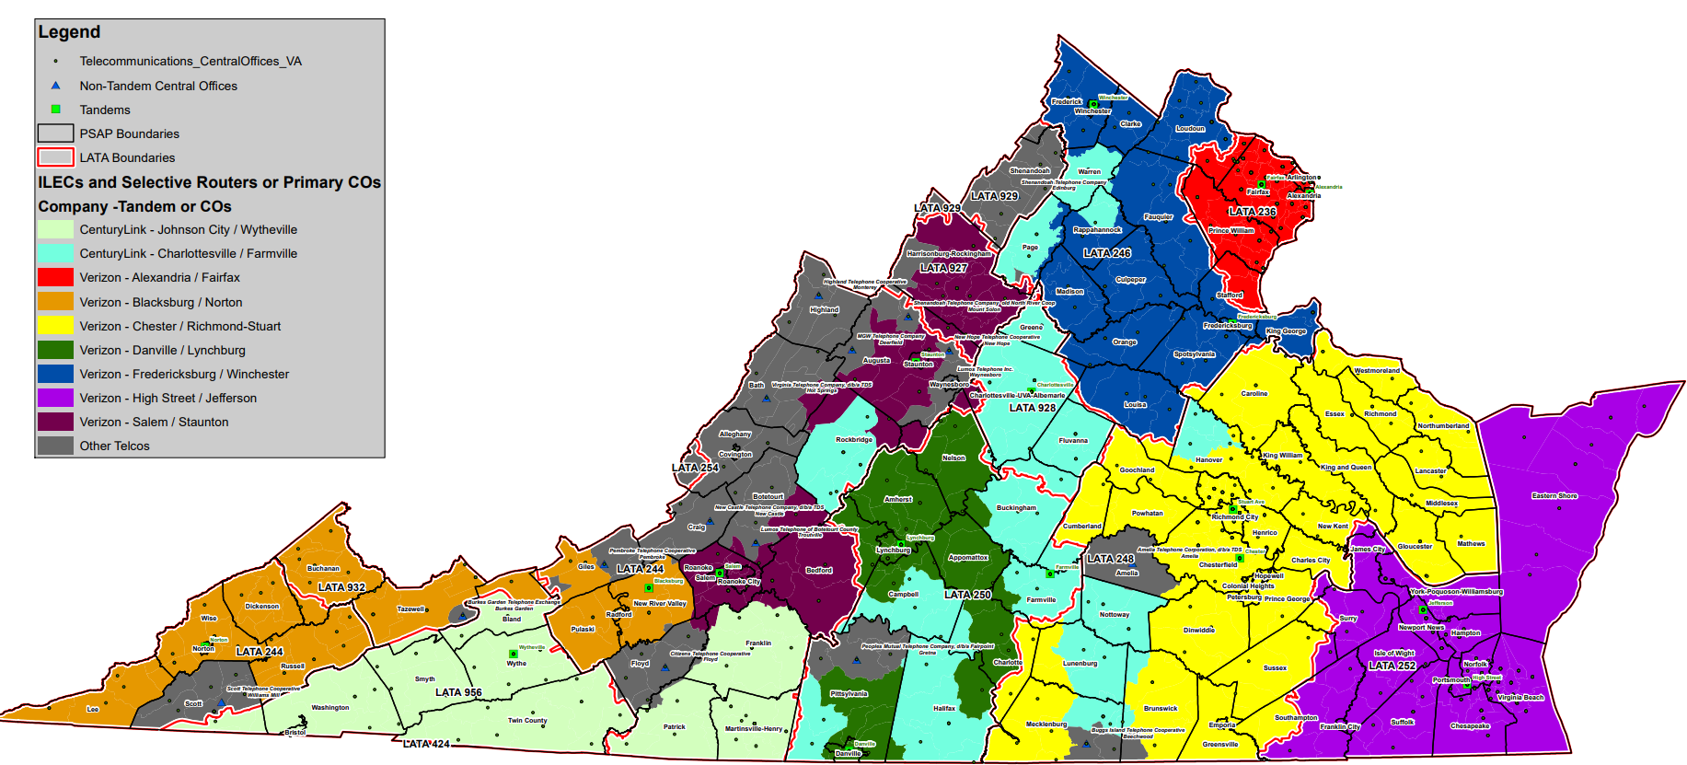
Proposed Deployment Schedule
Notes:
This map and table lay out the proposed deployment schedule. It is planned to deploy the state in an order that is dependent on the 9-1-1 selective routers.
As you can imagine this is a very big undertaking and needs to be done in a systematic order that manages costs and assures success in appropriate transition.
Looking at the map you can see that <<PSAP/locality name>> is proposed for transition in the x to x timeframe of 20xx.

Slide 7
Benefits of the AT&T ESInet™
Nationally distributed architecture
Increased reliability of the network
Interoperability among PSAPs
Allows data transfer with calls
Integrated text to 9-1-1
Dedicated Network Operations Center, management team and support
Customer management portal
Initiate alternate routing plans
Able to support future media; photos & video
Notes:
Your migration proposal details, on page 2, many of the benefits of the AT&T ESInet. The network rides off 6 data centers distributed across the nation which provides a lot of reliability to the system.
It allows for that data transfer among PSAPs and with calls.
Text to 9-1-1 is a base service of their solution.
It has dedicated operational management and system surveillance.
There is a customer portal that users can log into to check the network or even automatically reroute calls to another center in case of an outage at your current site.
And of course the system is put in place with the capacity to carry many more services and data in the future.

Slide 8
Role of GIS in NG9-1-1
One of the most time consuming efforts of moving to an NG9-1-1 system will be the preparation of GIS data
Used to provide location validation and routing of 9-1-1 calls to the appropriate PSAP
Synchronization of the MSAG with the GIS centerline and address point data
MSAG/ALI analysis
Notes:
GIS data is central to the success of 9-1-1 call routing in the Next Gen environment. We have done an assessment of the <<locality name>> GIS data and it’s viability for use in this location validation and call routing process. The results show that <<insert appropriate wording here based on your GIS assessment>>.

Slide 9
Deployment Funding
Equipment and systems
Funding provided by the 9-1-1 Board
Connectivity
Funding provided by the 9-1-1 Board
Legacy 9-1-1 charges
Covered by the 9-1-1 Board
Monthly recurring charges
Difference between current and future charges covered by 9-1-1 Board for 24 months
Refer to your migration proposal for specific costs
Notes:
On page 13 of your proposal there is a table that details the costs for deploying NG9-1-1.
Current monthly recurring charges will be validated based on billing by current 9-1-1 service provider at time of deployment.

Slide 10
NG9-1-1 Budget
Based on Fairfax County Contract
“Worst Case Scenario”
NG9-1-1 Cost per FY
FY19 | $7,295,005.20
FY20 | $27,867,943.87
FY21 | $11,171,231.74
FY22 | $6,138,711.84
FY23 | $1,142,122.38
Total | $53,615,015.03

Slide 11
NG9-1-1 Budget
NG9-1-1 Cost by Type
NG9-1-1 Costs | $452,000.00
CHE i3 | $2,925,000.00
CHE Replacement | $10,650,000.00
Text to 9-1-1 | $2,220,000.00
ECaTS Expansion | $117,000.00
Racks | $24,000.00
Diversity | $22,533,751.15
GIS Data | $160,100.00
Legacy 9-1-1 | $991,320.60
Monthly Delta | $13,541,843.28
Total | $53,615,015.03

Slide 12
NG9-1-1 Monthly Recurring Cost
Currently Monthly Recurring Cost
$743,997.88 per month
$8,927,974.56 annualized
AT&T Monthly Recurring Cost
$1,254,640.28 per month
$15,055,683.36 annualized
Difference
$510,642.40 monthly
$6,127,708.80 annualized

Slide 13
Path Forward
Documents to review
NG9-1-1 Migration Proposal
Existing Fairfax County contract
Proposal Acceptance Letter (PAL) = funding request
AT&T Participation Agreement (PA)
Decisions and Options
Proceed utilizing the Fairfax contract
Execute an RFP
Search for & review other procurement options

Slide 14
9-1-1 Board’s Guiding Principles
9-1-1 is an essential, local/regional service
Need to address ALL of 9-1-1 not just NG
Full stakeholder engagement is needed
Services must be not be degraded
Economies need to be leveraged
Doing nothing is NOT an option (legislation)
Notes:
These principles were developed through two recent 9-1-1 planning initiatives: NG9-1-1 and a 9-1-1 Comprehensive Plan.
Change must occur because the analog network is going away.
Virginia SB 513 was approved by the 2018 General Assembly and enacted in the code of VA section 56-484.16 Enhanced Public Safety Telephone Services Act establishes requirements regarding the implementation of next generation 9-1-1 (NG9-1-1) service by July 1, 2023.

