Slide 1
Medicaid Expansion
Preparing Local Departments of Social Services
Toni Blue Washington, Director
Division of Benefit Programs
Virginia Department of Social Services

Slide 2
Agenda
  Overview
  Interagency Collaboration
  Application Path
  Timeline
  Systems Development
  Outreach Efforts
  Training Plan
  Local Investment

Slide 3

Interagency Collaboration
Partner with DMAS, local agencies, workforce development entities and other stakeholders as ME is implemented in 2 phases.
  Virginia League of Social Services Executives (VLSSE)
  Benefit Programs Organization (BPRO)
  Virginia Community College Workforce System (VCCS)
  Virginia Employment Commission (VEC)
  Department of Corrections (DOC)
  Department of Behavioral Health and Developmental Services (DBHDS)

Slide 4






Application Paths
How to apply for Medicaid coverage
Cover Virginia/VDSS Enterprise Call Center
Federally-Facilitated Exchange (FFE) (healthcare.gov)
fffkjkfjkjkkfjkjkdjksjkksjkjkjksjjfkjdk
Local Department of Social Services (LDSS)
Online Application Portal
(Common Help)

Slide 5
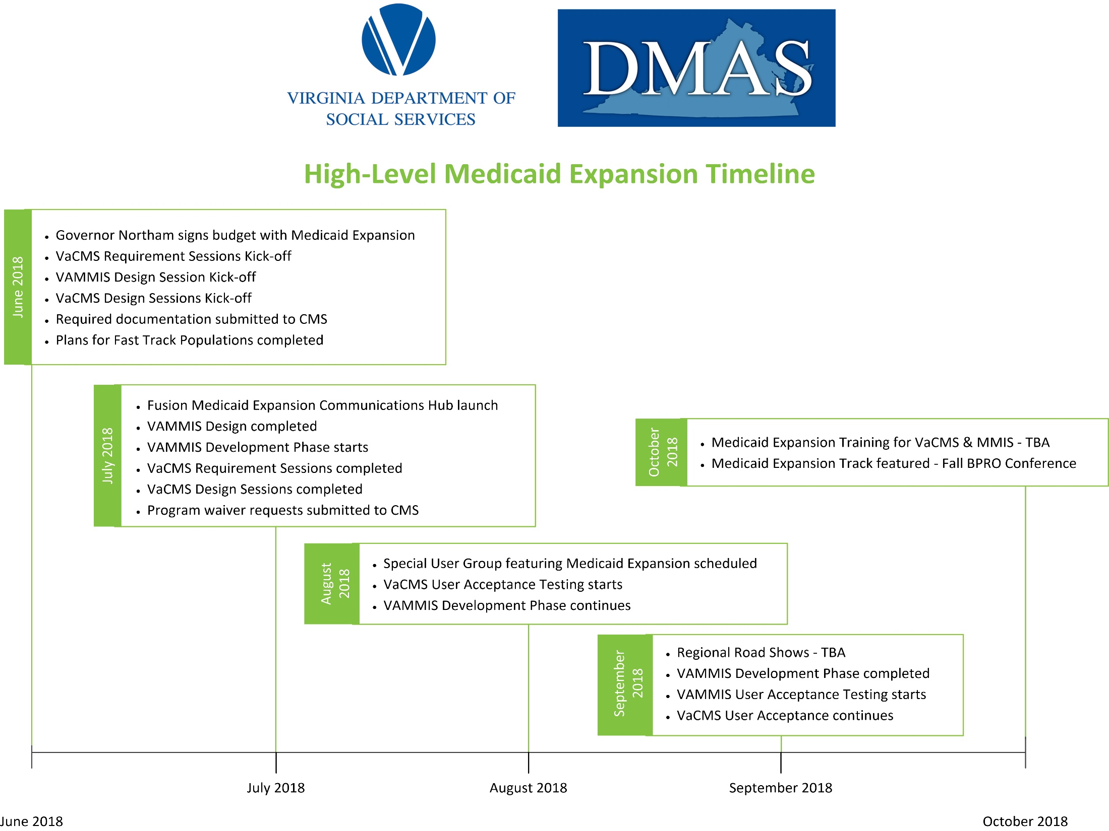
Next Steps to Success

Slide 6
Systems Development - VACMS
Work Stream
1
Work Stream
2
Work Stream
3
Work Stream
4
New Applications
This work stream addresses changes to process new applications..
System changes are being made to:
Intake ( Worker entry and CommonHelp online application)
Data Collection
MMIS transactions
New Aid Categories
Streamlined/Expedited
This work stream addresses changes to enroll streamlined and expedited populations:
Streamlined
Governor's Access Plan (GAP)
Plan First
Expedited
Supplemental Nutrition Assistance Program (SNAP)
Parents of Enrolled Children
Batch Processes
This work stream addresses changes to streamline existing automated processes within the system:
Enhanced automation to electronically determine eligibility
Automated renewal processes
New Correspondence and Notices
Additional Reports
Changes to FFE Applications
This work stream addresses changes to accommodate the decision become a Determination State through the Federally Facilitated Exchange (FFE). This includes:
Accepting eligibility determination decisions made by the FFM
Routing of applications between LDSS and CoverVA

Slide 7
Technology Infrastructure
Partnership With VITA
  IPAD for Eligibility
    LDSS
    DBHDS
  Laptop Work Request (300 housed at VDSS)
    New local agency staff
  Additional data storage
  Ensuring Application Performance (VITA/VACMS/Local Government)

Slide 8

Outreach and Communication
To assist local agencies with increasing their awareness and optimizing ME enrollment, VDSS created a Medicaid Expansion HUB (MedEx) to support state and local agencies.

Slide 9
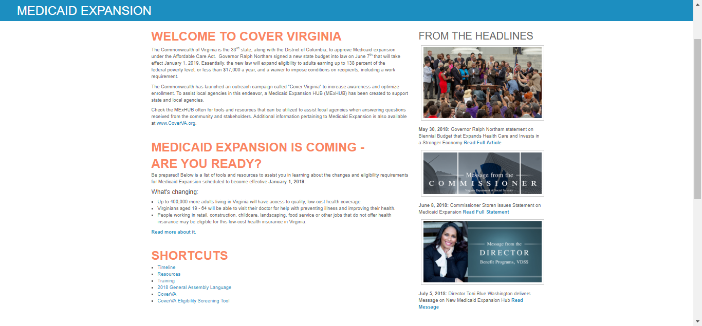
Medicaid Expansion Hub (MedEx)
Notes:
The HUB has list of tools and resources to assist local agencies in learning about the changes and eligibility requirements for Medicaid Expansion scheduled to become effective January 1, 2019.

Slide 10
Stakeholder Communication
Goals
  Provide frequent, coordinated communications to interested stakeholders.
  Promote message discipline through intentional coordination and establishment of authoritative sources.
  Empower interested stakeholders to relay the coordinated message to their networks, achieving a scale not otherwise available to state government.
Accomplishments/Efforts
  Established series of constant contact emails to over 1,000 community partners (included brochures/posters/FAQ)
  Conduct In-Person Trainings and Webinars

Slide 11
Training Plan
Target Audience
VDSS Medicaid Consultants and LDSS trainers
Marketing
Survey to determine number of workers and in-house trainers from each agency will require training.
Announced via numerous communication channels and tracked through Virginia Learning Center.
Training Paths
Multiple training paths are planned to include eLearning, webinars, User Group forums, face to face classroom opportunities across each region.
BP Specialists (those that are currently processing Medicaid applications and renewals)
CoverVA & VDSS Enterprise Call Center staff

Slide 12
Local Investment
Funding for the equivalent of 300 new local eligibility workers
Estimated New ME dollars for LDSS in FY 2019 = $21.5 million
Federal Share = $16 million

Slide 13
Virginia Department of Social Services
“People helping people triumph over poverty, abuse and neglect
to shape strong futures for themselves, their families and communities”

