Slide 1
2018 Transit Funding and Reforms
Chris Smith
Director of Policy, Communications, and Legislative Affairs
Virginia Municipal League – Transportation Committee
July 19, 2018

Slide 2
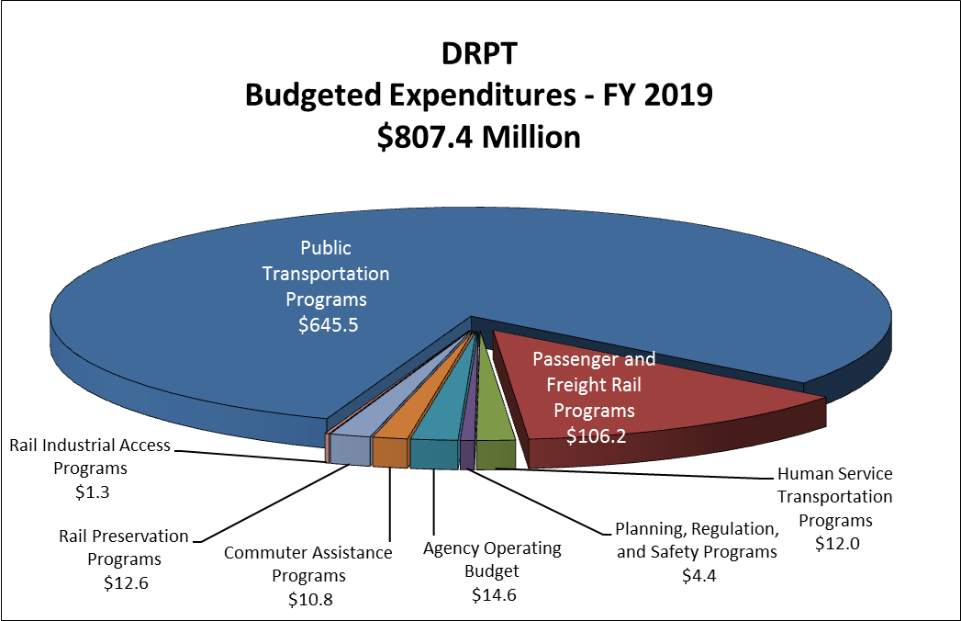
FY 19-FY 24 SYIP

Slide 3
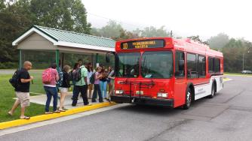
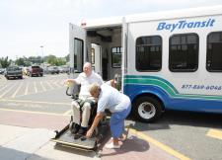
Transit
Programming
Highlights
Focus on State of Good Repair
  706 Replacement Revenue Vehicles
  120-125 Rehabbed/Rebuilt Buses
  164 Replacement Railcars
  234 Railcars to be Rehabbed
  WMATA PRIIA Match: $50M/year through 2020
Limited Capacity Expansion
  31 Service Expansion Buses
  Multimodal Improvements at Ballston Metrorail Station
  Completion of funding for two new Silver Line Metrorail Parking Garages (Herndon and Innovation Station)
Notes:
Light Rail - $450,000 – enhanced rail, traffic, and pedestrian control systems to address conflicts with rail operations through intersections in business district
Union Station - $5M – track, signal, platform, and passenger facility upgrades (part of Northeast Corridor plan, of which VRE has a share of cost)
WATA $400,000 – engineering/design for transfer facility in Northern JCC.

Slide 4
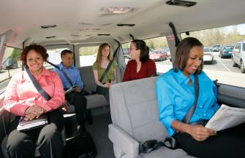
Transit
Programming
Highlights
Safety Enhancements
  Light Rail Advance Warning Intersection Control System (HRT)
Facility/Fleet Improvements
  Bus Stop & Shelter Improvements (NVTC – Arlington/Fairfax Counties)
  Design of new Bus Operations & Maintenance Facility (NVTC – Arlington County)
  Engineering/Design for Transfer Facility (WATA)
Demonstration/Travel Demand Management
  Vanpool Assistance Programs
  Stafford-Quantico Bus Service
  Pedestrian Collision Avoidance System
  for Bus Systems

Slide 5
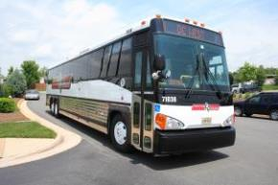
Transit Funding
Allocation Process
Review existing grants (federal & state), project progress, transit development plans and state of good repair in making recommendations for capital funding
Capital Funds:
  Allocated based on TSDAC funding tiers
Operating Funds:
  $54.0 M allocated on operating costs
  Remainder allocated with performance metrics
    Net Cost per Rider – 50%
    Riders per Revenue Mile – 25%
    Riders per Revenue Hour – 25%
Notes:
Increase in MTF (14.7% of TTF) due to tax increases and GF transfer and MEA, etc.

Slide 6
Projected
Transit Capital
State Match Rate

Slide 7
Transit Capital Project Case Study: City of Alexandria
Purchase Six Replacement Buses | 2018 | If Transit Capital Revenues Are Not Replaced
Total Project Cost | $3.9 million | $3.9 million
Federal Pass-Through | $0 | $0
DRPT Transit Capital | $2.652 million (Tier I-68%) | $1.053 million (Tier I-27%)
Local Required Match (Minimum 4%) | $1.248 million (Actual-32%) | $2.847 million (Actual- 73%)
Additional Local Money Needed: $1.60 million

Slide 8
Transit Capital Project Case Study: Greater Lynchburg Transit Company
Bus Administration & Construction Facility | 2015/2016 | If Transit Capital Revenues Are Not Replaced
Total Project Cost | $23.0 million | $23.0 million
Federal Pass-Through | $12.88 million (56%) | $4.6 million (20%*)
DRPT Transit Capital | $7.82 million (Tier II-34%) | $0 (Tier II-0%)
Local Required Match (Minimum 4%) | $2.3 million (Actual-10%) | $18.4 million (Actual-80%)
*Absent sufficient statewide funding for the transit capital program, DRPT will need to distribute federal pass-through funding across a wider group of transit agencies statewide, including those who currently do not receive it
Additional Local Money Needed: $16.1 million

Slide 9
Transit Capital Project Case Study: Hampton Roads Transit
Purchase 20 replacement buses | 2018 | If Transit Capital Revenues Are Not Replaced
Total Project Cost | $10.1 million | $10.1 million
Federal (28%*) | $2.83 million | $2.83 million
DRPT Transit Capital | $6.9 million (Tier I-68%) | $2.73 million (Tier I-27%)
Local Required Match (Minimum 4%) | $400,000 (Actual-4%) | $4.54 million (Actual-45%)
*Hampton Roads Transit receives direct federal appropriations. This example assumes that there are no additional federal funds available for this project.
Additional Local Money Needed: $4.14 million

Slide 10
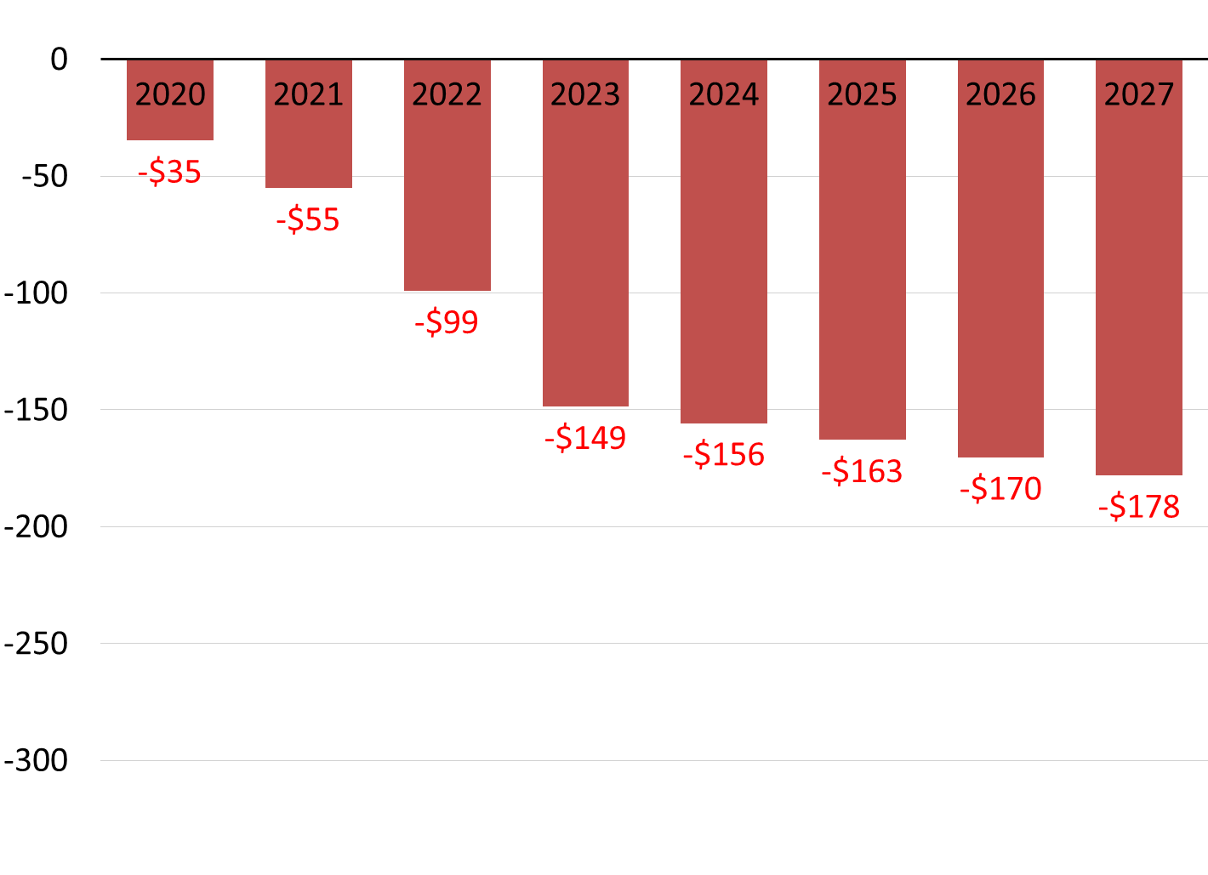
Capital Needs vs. Actual Applications
Future Transit Capital Funding Gap in $millions
  2017 Revenue Advisory Board Final Report
  Average of $130 million needed annually over next 10 years
  $110 million from revenues to replace existing CPR Bonds
  $20 million in new revenue sources
  Based upon forecast from 10 largest Virginia agencies
  2018 General Assembly authorized $50 million for 1 time CPR bond allocation to WMATA to complete PRIIA obligations by FY2021
  FY 2019 capital applications significantly below projected needs

Slide 11
Potential
Causes of
FY 2019
Needs
Gap
  Availability of alternative funding sources
  Ridership decline
  Inability to meet 4% minimum local match requirement
  Backlog of open grants from prior years
  Good maintenance of existing fleets allowing extended useful life of assets
  Cost advantages of rehabilitation versus replacement
  Applications focused on unrealistic requests instead of actual capital needs reporting
  Increase in requests for 30’ buses that last 7 years versus 20’ buses that last 4 years
  Unpredictability of federal funding for large capital expansion projects
    Future Capital Investment Grants (CIG) frozen for projects without a Full Funding Grant Agreement

Slide 12
Traditional
Public
Transportation
Ridership
Trends
From 2007 to 2015
Bus use nearly doubled from 1.8% to 3.0%
Total transit use rose from 5.1% to 6.8% — a 33% increase
Teleworking increased 4.5% to 8.3% — an 84% increase
Intermittent teleworking increased from 12% to 19% — 1 in 5 Virginia workers now telecommute occasionally
Virginia employers offering formal teleworking programs rose from 12% to 20%
From 2015 to present
National bus ridership decreased 6.7%
Total transit ridership in Virginia declined 13%
  9% from 2016-17 alone
7 systems showed increases in ridership, most notable of which were GLTC, Blacksburg, VRE

Slide 13
Alternative
Funding
Sources
  SMART SCALE
    Funds 100% of expansion costs with no local match requirement
    $178 million to transit in SMART SCALE I and II
  Toll Revenues to Transit
State Passenger and Freight Rail Funds to Commuter Rail
Northern Virginia Dedicated Funds
  NVTA: $311 million in transit expansion
  NVTC: $29 million in regional gas taxes to WMATA
Federal BUILD (formerly TIGER) Grants
  $25 million to GRTC for Richmond BRT
Dedicated state funding for Vanpools
  $1.2 million annually

Slide 14
FY17
Smart Scale
Transit
Projects
$31M
Hampton Roads
HRT Regional Commuter Express Bus
HRT Peninsula Regional Park and Ride Enhancement
Lynchburg
Lynchburg Central Business District Circulator (COMPLETED)
Danville Transit System Bus Shelter & Transit Buses Purchase (COMPLETED)
Northern Virginia
Ballston Metrorail Station West Entrance
ART Service Restructuring and Expansion
I-66 TDM Strategies (COMPLETED)
Richmond
Petersburg Station Park and Ride Structured Lot

Slide 15
FY18
Smart Scale Transit
Projects –
$168 M
Richmond
Broad Street Pedestrian and Transit Stop Improvements
Salem
Greater Roanoke Transit Company (GRTC) Smart Way Vehicle Expansion Project – 4th highest Benefit/Cost Score in Virginia
Parham Road Pedestrian and Transit Stop Improvements
City of Richmond E Smart Cities
Cogbill/Hopkins/Chippenham - Park and Ride Lot
GRTC Automatic Vehicle Locator/Real-Time Project
Valley Metro Vehicle Expansion Project
Blacksburg Expansion Bus Purchase
Staunton
Waynesboro Towne Center Park and Ride

Slide 16
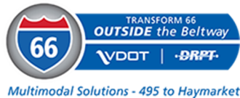
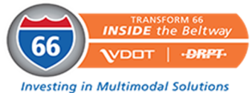


Toll Revenues to Transit
I-66 Outside the Beltway
$800M over the next 50 years to support enhanced transit service
I-66 Inside the Beltway
New and improved travel choices that include transit, TDM, bicycle, pedestrian, and roadway options
I-395
$15M annual transit investment to fund new and improved travel choices in corridor
I-64 (Hampton Roads)
Support enhanced express bus and vanpooling in the I-64 Express Lanes corridor

Slide 17
2018
General Assembly Reforms
Restructured Mass Transit Trust Fund
$154 million additional annually for WMATA with Reforms
No CPR Bond Reauthorization for Transit Capital
Capital Project Prioritization
  Implementation with FY20-25 Six-Year Improvement Program
  Separate Processes for state of good repair/minor enhancement and major expansion
Performance Based Operating Assistance
  Implementation with FY20 for entire program
  Based on TSDAC service delivery factors
Strategic Plans
  Larger agencies in urban areas (50,000+ population and 20+ buses)
  Guidelines by December 1, 2018

Slide 18
Restructured Mass Transit Trust Fund

Slide 19
Statewide Transit
Capital Prioritization
Effective July 1, 2019
State of Good Repair
  Based on transit asset management principles, including federal requirements for Transit Asset Management
Major Expansion
  Based on SMART SCALE factors:
    Congestion mitigation
    Economic development
    Accessibility
    Safety
    Environmental quality
    Land use

Slide 20
Project Types
State-of-Good Repair (SGR): Projects/programs to replace or rehabilitate an existing asset
  Includes acquiring assets/technology to serve current functions
Minor Enhancement: Projects/programs to add capacity, new technology, or a customer enhancement meeting the following:
  Project costs less than $2 million, OR
  Expansion vehicles: less than 5 vehicles or less than 5% of fleet
Major Expansion: New projects/programs that add, expand, or improve service (greater than $2M)
Notes:
Some exceptions - HRT's request for Paratransit vans (19 of them) is an example. At least 5 such applications under minor expansion as of now, which are over one of these thresholds. May need to be moved to Major expansion projects after further consideration.

Slide 21
Transit Capital Program Structure
Notes:
A minimum of 80% of the transit capital program should be dedicated to State of Good Repair
A single, consistent match rate should be applied to provide greater predictability in funding.
A higher match rate should be provided for state of good repair projects.
The Commonwealth Transportation Board should have the discretion to move funding from Major Expansion to State of Good Repair to meet program priorities

Slide 22
Structure for
Capital Program
Prioritization
Project Submittal
Project Type
SGR
Minor Enhanc.
Major Expansion
6 Criteria
Weighting
Technical Score
Technical Score:
Asset Condition + Service Impact
Technical Score:
Service Impact
Cost Effectiveness Score
Transit Capital Share of Cost
SGR Ranking
Minor Enhanc. Ranking
Expansion Ranking
Funding Allocation
Notes:
SGR/ME projects will be scored and ranked separately from Major Expansion projects
All eligible projects will receive a score and be ranked.
Structure for Capital Program Allocation

Slide 23
Capital Prioritization – Status
Continuing coordination with TSDAC
Extensive outreach to MPOs, transit agencies, and local governments
Working off the framework from the Revenue Advisory Board report (principles approved by CTB in July 2017)
  State of Good Repair/Minor Enhancement – 80% of program funding
  Board can use discretion to shift funds from Major expansion to State of Good Repair
  Establishment of a single matching rate across asset types, with State of Good Repair/Minor Enhancement matched at a higher rate than Major Expansion
  Maintain minimum local matching of 4%

Slide 24
Next Steps – Operating Allocation
December 4th – Workshop briefing on operating allocation
December 20th – Release draft operating allocation policy for public comment
December/January – Legislator outreach on draft CTB policy for operating allocation
January 15th – Workshop briefing on draft CTB policy for operating allocation
February 20th – Action on CTB policy for operating allocation

Slide 25
Urban
Transit
Agency Strategic
Plans
Required every five years from transit agencies with 20+ bus fleet serving urbanized areas of 50,000+ population
Impacted Agencies:
Alexandria (DASH) | Arlington Transit
Fairfax Connector | Loudoun Transit
PRTC | Blacksburg Transit
Charlottesville Area Transit | Fredericksburg Transit
GLTC- Lynchburg | GRTC- Richmond
GRTC- Roanoke | Harrisonburg Transit
Hampton Roads Transit | Petersburg Area Transit
Radford Transit | Williamsburg Area Transit

Slide 26
Strategic
Plans –
Major Components
    Assessment of state of good repair needs
    Review of the performance of fixed-route bus service
    Evaluation of opportunities to improve operating efficiency of the transit network
    Examination and identification of opportunities to share services where multiple transit providers' services overlap
    Examination of opportunities to improve service in underserved areas
Notes:
Hampton Roads Transit
Williamsburg Area Transit Authority

Slide 27
Strategic Plans - Status
Draft Guidelines are being developed and must be approved by CTB prior to December 1, 2018
Actively working with pilot agencies – Hampton Roads Transit and Greater Lynchburg Transit
Developed matrix for phased implementation
  Pilot phase – 2 agencies
  Transition (retrofit of existing planning efforts) – 8 agencies
  Next Plan (start from beginning) – 6 agencies

Slide 28
Next Steps – Capital and Strategic Plans
September 7th – TSDAC meeting to review CTB policy guidance and operating formula
September 10th – Release draft prioritization and strategic planning policy for public comment
September/October – Outreach to legislators on proposed CTB policy for transit capital prioritization and strategic planning
September 17th-Workshop briefing on draft CTB policy for prioritization and strategic planning
October 30th – Action on CTB policy for transit capital prioritization and strategic planning

Slide 29
State
Safety Oversight
FTA certified DRPT State Safety Oversight Program for The Tide in April 2018 – 1 Year ahead of deadline
Metro Safety Commission
  VA appointed its two primary members and one alternate
  MSC hired executive director
  April 2019 certification deadline to avoid 100% statewide withholding penalty

Slide 30
Future of
Transit in
Virginia
Making the Case for Funding
  Increased Accountability
  Long-Term Strategic Planning
  High Quality Data
  Impact of Emerging Technology

